Slide 1
Semantics/pragmatics
Language LING UA 1, NYU, Summer 2018
Masha Esipova & Yining Nie
partially based on the teaching materials by Masha Esipova and Lucas Champollion
for Introduction to Semantics LING-UA 4 at NYU in Fall 2017

Slide 2
What is pragmatics?
Presuppositions
Gricean maxims
Scalar implicatures
Summary of inference types
In-class practice
What you need to know

Slide 3
What is pragmatics?
Pragmatics is:
not a wastebasket for lazy semanticists and syntacticians!
‘Hm… My theory can’t handle X… X must be due to pragmatics!’ isn’t a good approach.
the part of grammar that represents a speaker’s knowledge of how to interpret utterances beyond their literal, compositional meaning
the subfield of linguistics that studies this knowledge

Slide 4
What is pragmatics?
Meaning of an utterance:
literal, or semantic: obtained from meanings of individual expressions and rules of semantic composition
strengthened, or pragmatic: the conjunction of the literal meaning with the inferences obtained via post-compositional reasoning on the speaker’s beliefs and motives
Formal pragmatics is in the business of making precise predictions about what the strengthened meaning of a given utterance in a given context is.

Slide 5
What is pragmatics?
Main question of the semantics/pragmatics interface: which phenomena belong in semantics and which in pragmatics?
In this module we’ll look at two phenomena that were originally analyzed as pragmatic: presuppositions and implicatures.

Slide 6
What is pragmatics?
Presuppositions
Gricean maxims
Scalar implicatures
Summary of inference types
In-class practice
What you need to know

Slide 7
Presuppositions
Presuppositions are a special type of inferences, triggered by presupposition triggers:
(1) The queen of Hungary is a witch.
→ Hungary has a unique queen.
(2) McGonagall has stopped drinking firewhisky in the morning.
→ McGonagall used to drink firewhisky in the morning.
(3) Lockhart knows that he is incompetent.
→ Lockhart is incompetent.
(4) Draco regrets becoming a Death Eater.
→ Draco has become a Death Eater.

Slide 8
Presuppositions
But what exactly are presuppositions?
First approximation: a sentence S has a presupposition P if S cannot be uttered felicitously unless the conversation participants take P for granted.
But this is too vague. Sentences can be infelicitous for many reasons, and speakers can take lots of things for granted.

Slide 9
Presuppositions
As a type of inferences, presuppositions are better characterized by their projection behavior. They survive in—or project from—various embedding contexts in which ordinary entailments don’t:
Ordinary entailments
(5) Viktor is Bulgarian. → Viktor is European. (6) Viktor is not Bulgarian. (7) Is Viktor Bulgarian? (8) If Viktor is Bulgarian, he speaks a Slavic language. (6)–(8): ↛ Viktor is European.
Presuppositions
(9) Draco regrets becoming a Death Eater. (10) Draco doesn’t regret becoming a Death Eater. (11) Does Draco regret becoming a Death Eater? (12) If Draco regrets becoming a Death Eater, he should talk to Snape. (9)–(12) → Draco has become a Death Eater.

Slide 10
Presuppositions
We said that all conversation participants take presuppositions for granted, but even if the addressee of (13) didn’t previously believe the speaker has a dog, they can tacitly adjust their beliefs to incorporate this inference. We call such adjustment global accommodation.
(13) Sorry, I’m late. I had to take my dog to the vet.
Global accommodation isn’t always easy. E.g., one might resist global accommodation in (14):
(14) Sorry, I’m late. I had to take my wombat to the vet.

Slide 11
Presuppositions
We also said that presuppositions project from questions, but, when appearing on a medical questionnaire, (15) doesn’t seem to presuppose that the patient used to smoke:
(15) Did you recently stop smoking?
≈ Did you use to smoke and recently stop?
In (15) the presupposition triggered by stop does not project and is treated as part of the at-issue content (as opposed to not-at-issue content, of which presuppositions are typically a subtype). We call this phenomenon local accommodation.

Slide 12
Presuppositions
Presuppositions of weak/soft triggers, like stop or start, are relatively easy to locally accommodate. Presuppositions of strong/hard triggers, like regret, are much harder, if not impossible, to locally accommodate.
(16) I don’t know if McGonagall drinks firewhisky in the morning, but if she starts doing so now, it’ll be hard for her to quit.
(17) ??I don’t know if Draco has become a Death Eater, but if he regrets doing so, he should talk to Snape.

Slide 13
Presuppositions
Presuppositions pose two major problems for theories of meaning:
The triggering problem: how do presuppositions arise in the first place?
The projection problem: how do complex sentences inherit presuppositions of their parts?
We will set the triggering problem aside and focus on the projection problem.

Slide 14
Presuppositions
The gist of the projection problem is that sometimes presuppositions do not get inherited by complex sentences:
(18) Lockhart knows that he is incompetent.
→ Lockhart is incompetent.
(19) Lockhart is incompetent and he knows that he is.
(20) Either Lockhart is not incompetent, or he knows that he is.
(21) If Lockhart is incompetent, he knows that he is.
(19)–(21): ↛ Lockhart is incompetent.
We want to account both for projection of presuppositions in sentences like (18) and for lack thereof in sentences like (19)–(21).

Slide 15
Presuppositions
Main insight: presuppositions are conditions on admitting a sentence into a context (originally: Stalnaker, later: Heim, van der Sandt, Schlenker, etc.).
Two relevant notions introduced by Stalnaker:
Common ground: the set of propositions that the participants in a given conversation agree to be true for the purposes of this conversation.
Context set: the set of worlds obtained by intersecting all the propositions in the common ground.

Slide 16
Presuppositions
Imagine (22) is our common ground CG. Then (23) is our context set C:
(22) CG = {{w | Hogwarts is in Scotland in w}, {w | Voldemort is back in w}, {w | Draco has become a Death Eater in w}}
(23) C = {w | Hogwarts is in Scotland in w and Voldemort is back in w and Draco has become a Death Eater in w}
When the speaker utters a declarative sentence S, the proposition denoted by S gets added to the common ground and shrinks the context set C.
A sentence S that has a presupposition P can only be felicitously uttered in C, if C entails P (modulo global accommodation).
E.g., one can felicitously utter Draco regrets becoming a Death Eater (or any of (10)–(12)) given the context set in (23), since (23) entails that Draco has become a Death Eater.

Slide 17
Presuppositions
C₁ = {w | Hogwarts is in Scotland in w and Voldemort is back in w and Draco has become a Death Eater in w}
We can now explain why Lockhart is incompetent and he knows that he is doesn’t as a whole presuppose that Lockhart is incompetent:
We start with a context set C₁.
We first add the left conjunct Lockhart is incompetent (L) to the common ground and update C accordingly, obtaining C₂.
By the time we utter the second conjunct he knows that he is our updated context set C₂ already entails that Lockhart is incompetent, so no requirements are imposed on C₁.
C₂ = {w | Hogwarts is in Scotland in w and Voldemort is back in w and Draco has become a Death Eater in w and Lockhart is incompetent in w}
C₁
L
C₂

Slide 18
Presuppositions
The same simple reasoning doesn’t apply to Either Lockhart is not incompetent, or he knows that he is and If Lockhart is incompetent, he knows that he is. Why?
We don’t permanently add disjuncts or antecedents of conditionals to our common ground.
This issue has led to further refinements of the basic Stalnakerian approach, but the main insights have been preserved in many subsequent theories.
One big question is whether patterns of presupposition projection in complex sentences are due to semantics (i.e., they are hardcoded into lexical entries of connectives) or to pragmatics (i.e., they are due to pragmatic reasoning).

Slide 19
What is pragmatics?
Presuppositions
Gricean maxims
Scalar implicatures
Summary of inference types
In-class practice
What you need to know

Slide 20
Gricean maxims
We have seen a basic pragmatic approach to presuppositions. We’ll now take a look at a pragmatic approach to implicatures.
The notion of implicature was introduced by Paul Grice.
Below is a version of his example. What would you think about the applicant if you were to get a letter like this?
(24) McGonagall is writing a recommendation letter for Hermione, who is applying for a Transfiguration Professor position:
Dear Sir/Madam,
Ms. Granger is very polite and her attendance in classes has been regular.
Yours,
Professor Minerva McGonagall

Slide 21
Gricean maxims
From the letter in (24) we infer that Hermione isn’t a very good student. This inference is cancellable, though; McGonagall could’ve continued her letter:
(25)
Dear Sir/Madam,
Ms. Granger is very polite and her attendance in classes has been regular. I mention these secondary facts at the outset because Mr. Malfoy, another talented transfigurationist, with whom Ms. Granger is often compared, lacks either of these qualities. In my view, Ms. Granger’s talent in Transfiguration surpasses that of Mr. Malfoy; but she will also prove to be a considerably more reliable colleague, and a far better teacher.
Yours,
Professor Minerva McGonagall

Slide 22
Gricean maxims
Grice put forward a general cooperative principle: pragmatic inferences are computed based on the assumption that speakers behave rationally and cooperatively.
He further seeked to identify general conversational maxims:
Quantity:
“Make your contribution as informative as is required (for the current purposes of the exchange).”
“Do not make your contribution more informative than is required.”

Slide 23
Gricean maxims
Grice put forward a general cooperative principle: pragmatic inferences are computed based on the assumption that speakers behave rationally and cooperatively.
He further seeked to identify general conversational maxims:
Quantity
Quality (“Try to make your contribution one that is true.”):
“Do not say what you believe to be false.”
“Do not say that for which you lack adequate evidence.”

Slide 24
Gricean maxims
Grice put forward a general cooperative principle: pragmatic inferences are computed based on the assumption that speakers behave rationally and cooperatively.
He further seeked to identify general conversational maxims:
Quantity
Quality
Relation: “Be relevant.”

Slide 25
Gricean maxims
Grice put forward a general cooperative principle: pragmatic inferences are computed based on the assumption that speakers behave rationally and cooperatively.
He further seeked to identify general conversational maxims:
Quantity
Quality
Relation
Manner (“Be perspicuous.”):
“Avoid obscurity of expression.”
“Avoid ambiguity.”
“Be brief (avoid unnecessary prolixity).”
“Be orderly.”

Slide 26
Gricean maxims
The Quantity maxim explains why the implicature that Hermione is not a good student arises in (24):
To be optimally informative in a recommendation letter, one is supposed to describe the applicant’s best academic qualities.
McGonagall only mentions Hermione’s politeness and good attendance.
Thus, we conclude that Hermione lacks better academic qualities.

Slide 27
What is pragmatics?
Presuppositions
Gricean maxims
Scalar implicatures
Summary of inference types
In-class practice
What you need to know

Slide 28
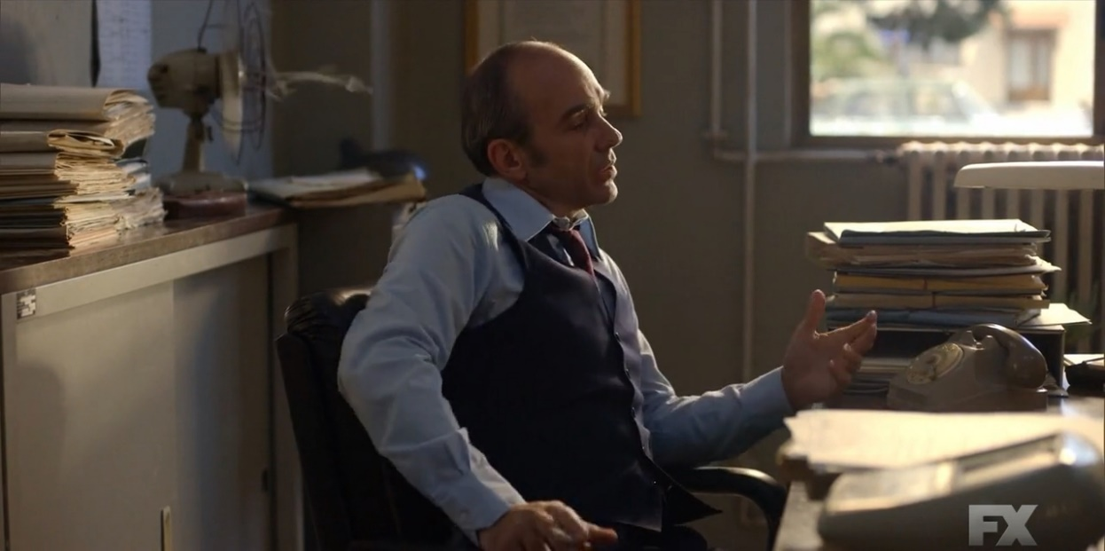
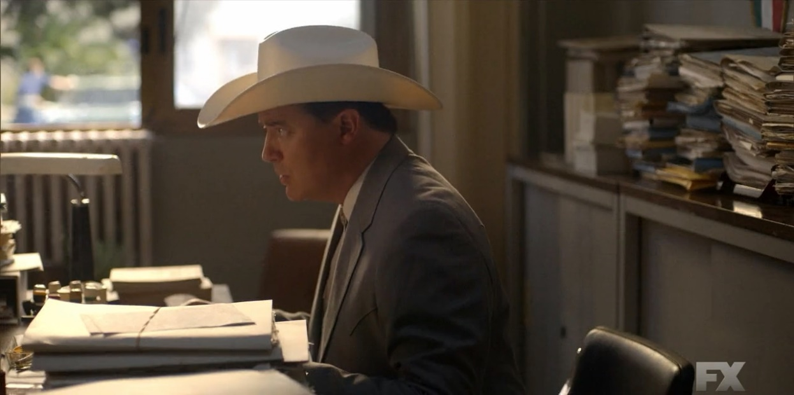
Scalar implicatures
Consider the following dialogue from ‘Trust’ (S01E02):
I’m happy to tell you that most kidnappings get resolved without violence.
Most?! ‘All’ would make me happy.
What in Inspector Giordano’s utterance stopped Fletcher Chace from being happy?

Slide 29
Scalar implicatures
Scalar implicatures are a type of quantity implicatures in which we consider alternatives to an utterance obtained by replacing certain words with members of their scales (sets of lexical alternatives).
(26) Most kidnappings get resolved without violence.
→ Not all kidnappings get resolved without violence.
(27) Hermione read some of the books.
→ Hermione didn’t read all of the books.
(28) Hermione will invite Luna or Ginny.
→ Hermione won’t invite both Luna and Ginny.

Slide 30
Scalar implicatures
How do we account for the inferences in (26)–(28)?
Option 1: Encode those inferences into the literal meaning of or and some. E.g., x or y literally means ‘(x or y) and not (x and y)’; thus, Hermione will invite Luna or Ginny literally means ‘Hermione will invite Luna or Ginny but not both’.
What is the literal meaning of Hermione read some of the books under this view?

Slide 31
Scalar implicatures
Option 2: Let or mean just ‘or’ and some just ‘some’. Derive the inferences in (26)–(28) as scalar implicatures via (neo-)Gricean reasoning. E.g., for Hermione will invite Luna or Ginny:
Sentence uttered: φ = Hermione will invite Luna or Ginny.
Alternative: By replacing or with its lexical alternative and we obtain an alternative to φ: φ' = Hermione will invite Luna and Ginny.
Informativity: φ' asymmetrically entails φ and thus would have been a more informative sentence to utter.
Primary implicature: The speaker didn’t utter φ', presumably because they were not in a position to do so, thus, it’s not the case that the speaker believes φ'.
Secondary implicature: Assuming the speaker is opinionated (i.e., either they believe φ' or they believe not φ'), the speaker believes not φ'.
How does this reasoning apply to Hermione read some of the books?

Slide 32
Scalar implicatures
Which option do you prefer? How do we tease them apart?
Once we start embedding sentences with scalar items, the literal meaning-based analysis (Option 1) starts predicting unattested readings. E.g., it predicts (29) to be equivalent to (29)' and (30) to (30)':
(29) Ron doubts that Hermione will invite Luna or Ginny.
(29)' Ron doubts that Hermione will invite Luna or Ginny and not both.
(≈ Ron thinks that either Hermione will invite neither or she’ll invite both.)
(30) If Hermione invites Luna or Ginny, I’ll give you a galleon.
(30)' If Hermione invites Luna or Ginny and not both, I’ll give you a galleon.
(If she invites both, I don’t owe you a galleon.)

Slide 33
Scalar implicatures
Note that for (29) and (30) we don’t get the inferences obtained by negating the alternatives with and either:
(29) Ron doubts that Hermione will invite Luna or Ginny.
↛ It’s not the case that Ron doubts that Hermione will invite Luna and Ginny.
(30) If Hermione invites Luna or Ginny, her party will be a success.
↛ It’s not the case that if Hermione invites Luna and Ginny, her party will be a success.
So we want to make sure the (neo-)Gricean analysis (Option 2) doesn’t predict those inferences.

Slide 34
Scalar implicatures
And it doesn’t. Here’s how it goes for Ron doubts that Hermione will invite Luna or Ginny:
Sentence uttered: φ = Ron doubts that Hermione will invite Luna or Ginny.
Alternative: By replacing or with its lexical alternative and we obtain an alternative to φ: φ' = Ron doubts that Hermione will invite Luna and Ginny.
Informativity: φ' does not asymmetrically entail φ (in fact, the opposite holds), so it wouldn’t have been a more informative sentence to utter. No implicature is computed.
So, the (neo-)Gricean, scalar implicature-based analysis of or makes better predictions than the literal meaning-based analysis.

Slide 35
Scalar implicatures
Note that scalar implicatures aren’t computed in the same environments in which ordinary entailments don’t survive, but presuppositions do:
(31) Ron doubts that Hermione has a ginger cat.
(32) If Hermione has a ginger cat, we can use its fur in the potion.
(31), (32): ↛ Hermione has a cat. (entailment)
(33) Ron doubts that Hermione fed her cat.
(34) If Hermione fed her cat, it’s happy.
(33), (34) → Hermione has a cat. (presupposition)

Slide 36
Scalar implicatures
Unlike ordinary entailments and presuppositions, implicatures are cancellable without sounding contradictory:
(35) Hermione read some books. In fact, she read all of them. (implicature)
(36) Hermione has a ginger cat. #In fact, she doesn’t have a cat. (entailment)
(37) Hermione fed her cat. #In fact, she doesn’t have a cat. (presupposition)

Slide 37
Scalar implicatures
Unlike ordinary entailments and presuppositions, implicatures can be reinforced without sounding trivial:
(38) Hermione read some books, but she didn’t read all of them. (implicature)
(39) Hermione has a ginger cat#, and she has a cat. (entailment)
(40) Hermione fed her cat#, and she has a cat. (presupposition)

Slide 38
What is pragmatics?
Presuppositions
Gricean maxims
Scalar implicatures
Summary of inference types
In-class practice
What you need to know

Slide 39
Summary of inference types
 | Preserved when embedded (under negation, in questions, in antecedents of conditionals, etc.)? | Cancellable w/o sounding contradictory? | Reinforceable w/o sounding trivial?
ordinary entailments | no | no | no
presuppositions | yes | no | no
implicatures | no | yes | yes

Slide 40
Summary of inference types
Important caveat 1
Be very careful when checking whether implicatures are preserved in embedded environments. (38) does give rise to the inference that resembles the corresponding scalar implicature of Hermione read most of the books. It’s not because the implicature survives embedding, however, but because negating a weaker alternative naturally renders all the stronger alternatives false.
(38) It’s not the case that Hermione read most of the books.
→ Hermione didn’t read all of the books.
Suggestion: use non-negative environments for the embedding test.

Slide 41
Summary of inference types
Important caveat 2
Be careful when drawing conclusions from the reinforceability test. It relies on redundancy rather than contradiction, and redundancy isn’t always infelicitous.

Slide 42
What is pragmatics?
Presuppositions
Gricean maxims
Scalar implicatures
Summary of inference types
In-class practice
What you need to know

Slide 43
In-class practice
For each of the examples below, determine whether the inference is an ordinary entailment, a presupposition, or an implicature, based on its (i) behavior in embedded environments (check at least one environment), (ii) cancellability, (iii) reinforceability.
Only use Harry doubts that… or an antecedent of a conditional (if…, then blah) when embedding the sentences (keep in mind that Harry might be wrong in his doubts).
If a given inference is a presupposition, say what triggers it.
(39) McGonagall is in Edinburgh.
→ McGonagall is in Scotland.
(40) It was Snape who told Voldemort about the prophecy.
→ Someone told Voldemort about the prophecy.
(41) Molly has children.
→ Molly has at least one child.
(42) Molly has children.
→ Molly has at least two children.

Slide 44
What is pragmatics?
Presuppositions
Gricean maxims
Scalar implicatures
Summary of inference types
In-class practice
What you need to know

Slide 45
What you need to know
Key notions: literal (semantic) meaning, strengthened (pragmatic) meaning, presuppositions, presupposition triggers, projection, global accommodation, at-issue vs. not-at-issue content, local accommodation, weak/soft vs. strong/hard triggers, the triggering problem, the projection problem, common ground, context set, implicatures, cooperative principle, conversational maxims, scalar implicatures, scales
Answers to the following questions:
What two main problems do presuppositions pose for theories of meaning?
How does the basic Stalnakerian approach handle the projection problem? What issues remain?
How is the (neo-)Gricean analysis of scalar implicatures more empirically adequate than the literal-meaning-based analysis?
Skills:
Derive scalar implicatures step by step via the (neo-)Gricean mechanism.
Distinguish among ordinary entailments, presuppositions, and implicatures based on their (i) behavior in certain embedded environments (under negation, in questions, in antecedents of conditionals), (ii) cancellability, (iii) reinforceability.

