Slide 1
Annoyance and architecture: lessons from Russian OY DA sentences
Maria Esipova (University of Oslo)
FASL 31
June 24, 2022

Slide 2
Intro
OY DA meaning and form
Analysis of OY DA
Outro
References

Slide 3
Intro
OY DA meaning and form
Analysis of OY DA
Outro
References

Slide 4
Intro
A common reasoning loop in linguistics:
Prosodic expression of affect-related meaning is “paralinguistic”, because it is done via “gradient” aspects of prosody, such as pitch height beyond a binary H vs. L distinction or voice quality, and truly linguistic representations rely on categorical distinctions
Also, such aspects of prosody as pitch height and voice quality are “gradient”, because they are typically used to express affect-related meaning, and any affect-related meaning expressed through prosody is “paralinguistic” and, thus, can’t possibly rely on categorical distinctions
This warps our ideas about what linguistic representations can look like, how meaning, prosody, and syntax interact, and which phenomena receive (formal) linguists’ attention in the first place!

Slide 5
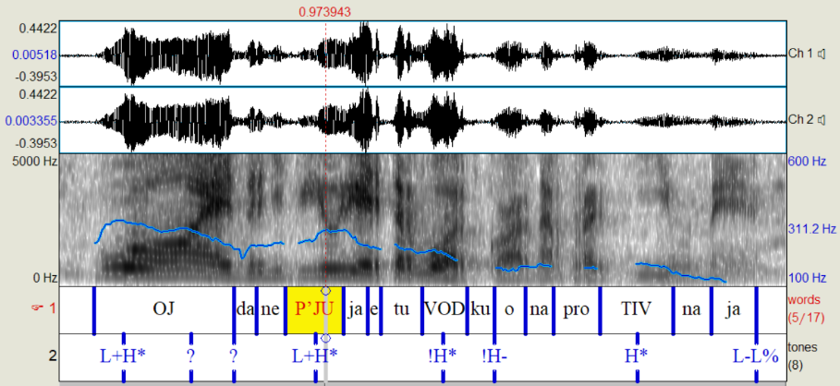
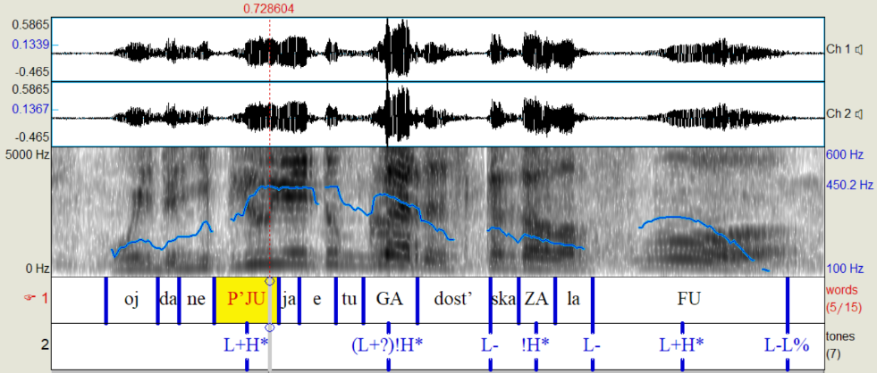
OY DA sentences
This is a case study of a type of sentences in Russian (labeled OY DA) that express a annoyed/dismissive attitude and sometimes involve a drastic pitch height increase:
(1) X: [asks M to drink vodka with him]
M: Oj da ne p’ju ja etu vodku, ona protivnaja!
OY DA not drink I this vodka it disgusting
≈‘I don’t drink vodka, it’s disgusting.’
X: [keeps insisting]
M: Oj da ne p’ju ja etu gadost’, skazala, fu!
OY DA not drink I this crap said ew
≈‘I said I don’t drink this crap, ew!’ (MURCO: Multimodal Russian Corpus)

Slide 6
This talk
Meaning and form of OY DA sentences:
Consistent and specific core meaning across different speech act types
Structural constraints on the OY DA prosody, including the pitch height increase
Analysis of OY DA sentences, aiming to properly fit their prosody into the architecture of grammar

Slide 7
Intro
OY DA meaning and form
Analysis of OY DA
Outro
References

Slide 8
OY DA meaning and form
OY DA is compatible with (almost?) any speech act type, with:
a common core meaning effect: annoyance at having to address the QUD associated w/the host utterance (often because it’s obvious or unimportant)
a common cluster of form effects:
segmental: interjections (often, but not necessarily oj da); (pretty much) obligatory
prosody:
L+H* on the first stressed syllable; obligatory
sharp increase of the height of the H of that initial L+H*, which I will indicate with a ↑; structurally optional, but seems to consistently signal stronger affect
non-modal voice quality (falsetto, breathiness); optional, but again, adds to the affective meaning
gesture (optional, but can add/reinforce meaning):
facial expressions signalling annoyance, disdain, etc. (e.g., eyerolling, frowning, squinting, etc.)
hand gestures (e.g., the THROW-AWAY gesture—see Francis et al. 2022 on the latter)

Slide 9
OY DA wh-questions
(2) Komu _{L+H*} ona budet zvonit’?
who.DAT she will call
‘Who will she call?’
(3) Oj da komu _{L+(↑)H*} ona budet zvonit’?
OY DA who.DAT she will call
≈‘Oh please, who will she even call?’
(She won’t call anyone of significance &
I’m annoyed this QUD is being raised.)
(4) Oj da otkuda_{L+↑H*} u nego deduška amerikanskij?
OY DA from-where at him grandfather American
≈‘Oh please, how would he even have an American grandfather?’ (MURCO)
(He doesn’t have an American grandfather &
I’m annoyed this QUD is being raised.)

Slide 10
OY DA declaratives
(5) A: Dima is trying to find out who Anya called.
B: Oj da Nine_{L+(↑)H*} ona zvonila!
OY DA Nina.DAT she called
≈‘Oh for god’s sake, she called Nina!’
(The QUD of who Anya called is not that puzzling or interesting &
I’m annoyed it’s being raised.)
(6) Oj da ne perčatki_{L+H*}, a ja poljubila
OY DA not gloves but I fell-in-love-with
drugogo!
another
≈‘Oh for god’s sake, it’s not about the gloves, it’s
that I fell in love with someone else!’ (MURCO)
(The glove QUD is not important &
I’m annoyed it’s being raised.)

Slide 11
OY DA imperatives
(7) Oj da zvoni_{L+(↑)H*} komu ugodno!
OY DA call.IMP.SG who.DAT want.ADV
≈‘Oh please, call whoever the hell you want!’
(The QUD of who you will call is not important & I’m annoyed it’s being raised.)
(8) Da poexali _{L+↑H*} kuda xočeš’, tol’ko ne v striptiz!
DA go.PAST.PL where want.2SG only not to strip-bar
≈‘Oh please, let’s go wherever you want, just not to a strip bar.’ (MURCO)
(The QUD of where we will go is not important & I’m annoyed it’s being raised.)

Slide 12
OY DA polar questions
The default in-situ strategy is incompatible with OY DA (for both structural and meaning-related reasons: usually no L+H* at the front + no rhetorical uses)
Li polar questions often clash with OY DA stylistically
(9) Oj da malo_{L+(↑)H*} li komu ona zvonila?!
OY DA few LI who.DAT she called
Lit.: ‘Did she call few [people]?’
(The QUD of who she called is not important & I’m annoyed it’s being raised.)
(10) Oj da ujdёš’_{L+↑H*} ty ili net?!
OY DA leave.2SG.FUT you or not
≈‘Oh ffs, will you leave or not?!’ (MURCO)
(I’m not asking if you’ll leave, I’m asking you to leave & I’m annoyed I have to ask.)

Slide 13
Constraints on OY DA prosody
There must be an L+H* on the first stressed syllable
OY DA itself cannot create a L+H* (with a caveat, which I’ll come back to), it has to parasitize on an already existing L+H*
(11) A: Dima is trying to find out who Anya called.
B: (i) Oj da Nine_{L+(↑)H*} ona zvonila!
OY DA Nina.DAT she called
≈‘Oh for god’s sake, she called Nina!’
(ii) * Oj da ona zvonila Nine_{L+(↑)H*}!
OY DA she called Nina.DAT
(iii) Ona zvonila Nine_{L+H*}.
she called Nina.DAT
(iv) # Oj da ona_{L+(↑)H*} zvonila Nine!
OY DA she called Nina.DAT

Slide 14
Constraints on OY DA prosody
Note that this is not a syntactic constraint requiring fronting of any item, as you can in principle have the OY DA L+H* on an in-situ item if the preceding material is prosodically light and can be fully deaccented
(12) a. Oj da ne znaju_{L+(↑)H*} ja ničego!
OY DA not know I nothing
b. Oj da ja ne znaju_{L+(↑)H*} ničego!
OY DA I not know nothing
‘Oh ffs, I don’t know anything!’
(13) Oj da mne nekogda_{L+↑H*}! (cf. Oj da nekogda mne!)
OY DA me.DAT no-time
‘Oh ffs, I don’t have time for this!’ (MURCO)

Slide 15
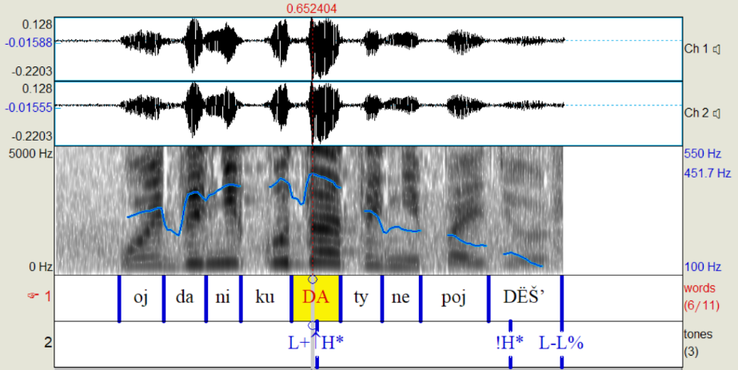
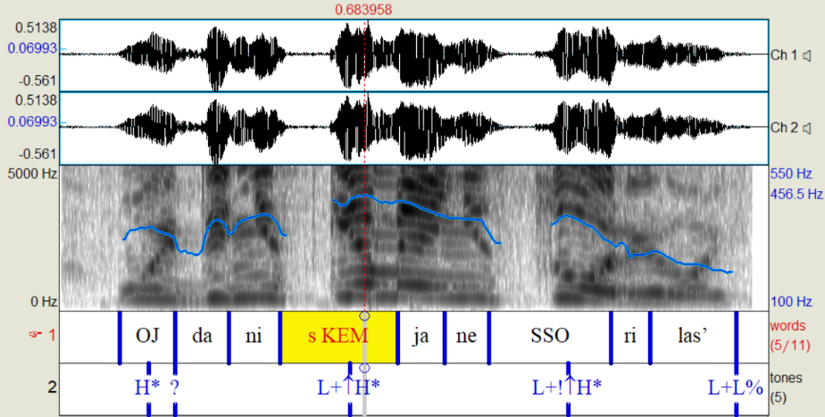
Constraints on OY DA prosody
The ↑ modification has to appear on the first L+H*
Subsequent occurrences are optional (but can signal higher affect strength)
(14) Oj da nikuda_{L+↑H*} ty ne pojdёš’_{!H*}!
OY DA nowhere you not go.FUT.2SG
‘Oh please, you aren’t gonna go anywhere!’ (MURCO)
(15) Oj da ni s kem_{L+↑H*} ja ne ssorilas’_{L+↑H*}!
OY DA not with who.DAT I not quarreled
‘Oh ffs, I didn’t quarrel with anyone!’ (MURCO)
(16) * Oj da ni s kem_{L+H*} ja ne ssorilas’_{L+↑H*}!
OY DA not with who.DAT I not quarreled

Slide 16
OY DA summary
The prosody of OY DA sentences, including its “gradient” aspects, i.e., the optional (but meaningful!) pitch height modulation, is subject to structural constraints
The affect-related meaning of OY DA sentences is also constrained, i.e., the affect has to be about the QUD associated with the host utterance being discussed
In other words, this is not an instance of “paralinguistic” changes in prosody affecting stretches of speech and signaling something about the speaker’s emotional state caused by utterance-external factors
We, thus, need a properly linguistic analysis of OY DA

Slide 17
Intro
OY DA meaning and form
Analysis of OY DA
Outro
References

Slide 18
Analysis of OY DA
Architectural assumptions:
Standard inverted Y model, w/syntax operating on abstract objects and specific exponents inserted at various stages during syntax→form mapping
Prosodic tunes are created in (at least) two passes:
First, the basic sequence of L and H tones is created, in a way that is sensitive to, a.o., information structure (which is itself operationalized via abstract syntactic features)
In the second pass, this sequence can be modified by operations such as ↑ (a drastic increase in F0 on the target tone)
Within this system:
We can have a syntactic object being exponed by a string of segments, a binary tune, a further operation on the binary tune, etc.
We can have multiple surface elements exponing the same syntactic object
We can have multiple syntactic objects being exponed by the same surface element (e.g., L+H* exponing both a focus feature and something affect-related)

Slide 19
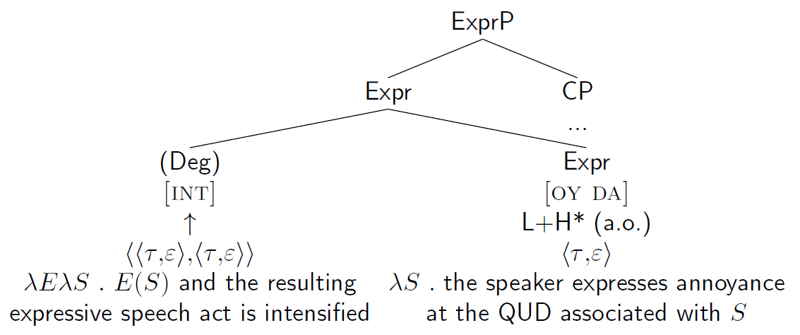
Analysis of OY DA
Structure of OY DA (the details are negotiable):
(17)

Slide 20
Analysis of OY DA
The L+H* pitch accent on the first stressed syllable is an obligatory exponent of [OY DA], but [OY DA] cannot create pitch accents that would cause a mismatch with the information structure
However, [OY DA] can impose a tune on frozen interjections with no propositional content and, thus, no internal information structure
(18) a. Oj da ja_{L+(↑)H*} tebja umoljaju _{(L+)(↑)(!)H*}!
OY DA I you.ACC beg
b. Oj da bože_{L+(↑)H*} ž ty moj_{(L+)(↑)(!)H*}!
OY DA god.VOC ZHE you my
Komu _{L+(↑)H*} on nužen_{(L+)(↑)(!)H*}?!
who.DAT he needed
≈‘Oh please! / Or for God’s sake! Who even needs him?!’

Slide 21
Intro
OY DA meaning and form
Analysis of OY DA
Outro
References

Slide 22
Outro
Some outstanding issues:
Operationalizing subsequent optional ↑
The exact nature of Expr and whether it’s the same projection that hosts the expressive component of exclamatives; the challenge is that exclamatives have a degree constraint (see, e.g., Rett 2011, Esipova 2021), but OY DA sentences don’t
Main take-home point:
Expression of affect-related meaning via prosody, including such “gradient” prosodic effects as pitch height increase, can, in fact, be regularized and should be given a proper linguistic analysis

Slide 23
Intro
OY DA meaning and form
Analysis of OY DA
Outro
References

Slide 24
References
Esipova, Maria. 2021. What I will tell you about “matrix” wh-“exclamatives”! To appear in Proceedings of West Coast Conference on Formal Linguistics (WCCFL) 39. https://ling.auf.net/lingbuzz/006029
Francis, Naomi, Patrick Georg Grosz & Pritty Patel-Grosz. 2022. The throwing away gesture: discourse management in the visual-gestural modality. Poster presented at SALT 32. https://osf.io/4usj7/
Rett, Jessica. 2011. Exclamatives, degrees and speech acts. Linguistics and philosophy 34(5). 411–442. https://doi.org/10.1007/s10988-011-9103-8

