Slide 1
Prejacent truth in rhetorical questions: lessons from Russian
Maria Esipova & Maribel Romero (University of Konstanz)
FASL 32
May 20, 2023

Slide 2
Intro
Root vs. explanation-seeking questions
Explanation-seeking vs. re-asking rhetorical strategies
Outro

Slide 3
Intro
Root vs. explanation-seeking questions
Explanation-seeking vs. re-asking rhetorical strategies
Outro

Slide 4
Intro: starting observation
Rhetorical questions (RheQs) are questions answers to which are assumed to be obvious by the speaker (Caponigro & Sprouse 2007, a.o.)
But! Yes/no questions (YNQs)—polar (PolQs) and ‘or not’ alternative questions (AltQs)—vary in whether their prejacent is assumed to be true or false when used rhetorically:
(1) Context: The addressee is known to be a(n) adult/human/Democrat, but their behavior at the moment is inconsistent with this characterization (e.g., they make a childish request/exhibit extreme cruelty/refuse to support a progressive initiative). The speaker asks them:
a. Are you a(n) child/animal/Republican? (prejacent assumed false)
b. ? /% Are you a(n) adult/human/Democrat? (prejacent assumed true)
c. Are you a(n) adult/human/Democrat or not? (prejacent assumed true)
d. # Are you a(n) child/animal/Republican or not? (prejacent assumed false)

Slide 5
Intro: prior literature
Mostly focuses on wh RheQs
Standard assumptions relevant for the issue at hand:
Prejacents of rhetorical YNQs are presumed to be false
AltQs across the board cannot be used as RheQs
E.g.:
Caponigro & Sprouse 2007: “yes/no [RheQ]s require an answer of the opposite polarity”
Van Rooy & Šafářová 2003:
“It is commonly assumed in the literature that for a rhetorical question the negative answer is presupposed to be true”
Note that Are you crazy or not? is weird as a RheQ; suggest that ‘or not’ AltQs can’t be used rhetorically (?)
Do not offer a satisfactory explanation for that, however (“The reason is that the agent wants to highlight/suggest that she recently got some indication that the positive proposition might be true after all”)
Do not discuss RheQs with prejacents assumed to be true, or the fact that ‘or not’ AltQs can be (and preferably are) used as such RheQs

Slide 6
Intro: this talk
Two rhetorical strategies at play in (1):
Re-asking: reminding the addressee that the prejacent is true in order to discourage/encourage a certain action; prejacent is true
Explanation-seeking: a preposterous explanation for a preposterous situation; prejacent is false
Two (relevant) types of YNQs meaning-wise (wrt alternatives and discourse structure):
Root: re-asking strategy when used rhetorically
Explanation-seeking: explanation-seeking strategy when used rhetorically
Forms of root vs. explanation-seeking YNQs in English and Russian:
English: regular PolQs can be either root or explanation-seeking and can thus in principle use either rhetorical strategy—hence the overall felicity of both (1a) and (1b)
Russian: “declarative string” PolQs distinguish between the two prosodically
Both: special ‘what’-marked forms of explanation-seeking YNQs
Both: ‘or not’ AltQs cannot be explanation-seeking—hence # in (1d)
Both: root PolQs (w/o ‘or not’) can be used as re-asking RheQs, but ‘or not’ AltQs are often better as such—hence ?/% in (1b)

Slide 7
Intro
Root vs. explanation-seeking questions
Explanation-seeking vs. re-asking rhetorical strategies
Outro

Slide 8
Root vs. explanation-seeking questions: basics
Root YNQs only introduce {p, ¬p} alternatives and don’t signal any larger question under discussion (QUD; Roberts 2012 et seq.)
Explanation-seeking YNQs are sub-QUDs of a larger QUD seeking an explanation for some contextual evidence (while still introducing {p, ¬p})
(2) a. Root YNQ (PolQ)
Context: Nina was supposed to take an exam. I am interested in the outcome.
Did Nina pass the exam?
p: ‘Nina passed the exam’; alternatives: {p, ¬p}; no larger QUD signalled
b. Explanation-seeking YNQ (PolQ)
Context: Nina was supposed to take an exam. I just saw her cheering in the hallway. I am wondering if she passed the exam and that’s why she’s cheering.
Did Nina pass the exam?
p: ‘Nina passed the exam’; situation s: Nina is cheering in the hallway; larger QUD Q: ‘What is the explanation for s?’
(b) is both a {p, ¬p} question and a sub-QUD of Q: {p is the answer to Q, ¬(p is the answer to Q)}

Slide 9
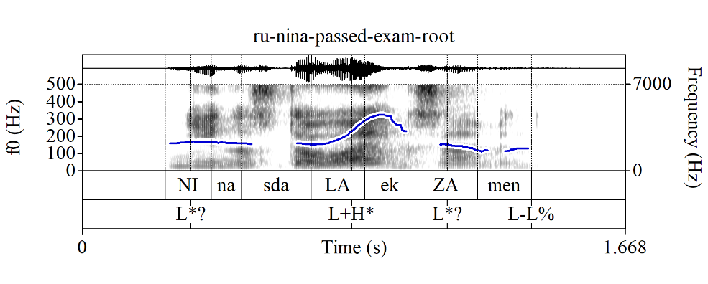
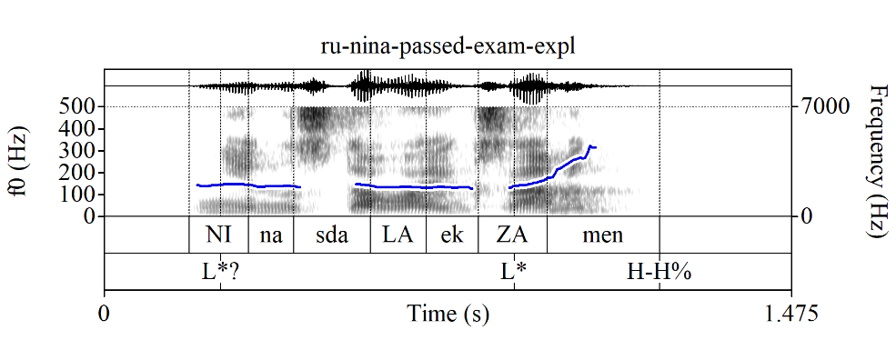
Root vs. explanation-seeking questions: Russian prosody
In English, the PolQs in (2a) and (2b) can in principle be asked with the same intonational contour (e.g., L* H-H%)
Russian “declarative string” (i.e., default) PolQs distinguish between root vs. explanation-seeking readings prosodically:
a. Root YNQ (PolQ w/“root contour”)
Context: Nina was supposed to take an exam.
I am interested in the outcome.
Nina sdala_{L+H*} ekzamen_{L-L%}
Nina passed exam
b. Explanation-seeking YNQ (PolQ w/“explanation-seeking contour”)
Context: Nina was supposed to take an exam.
I just saw her cheering in the hallway.
I am wondering if she passed the exam and
that’s why she’s cheering.
Nina sdala ekza_{L*}men_{H-H%}
Nina passed exam

Slide 10
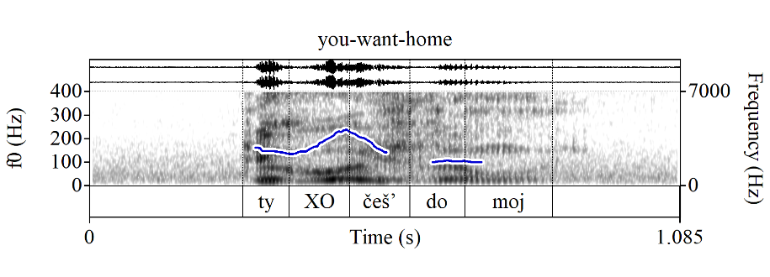
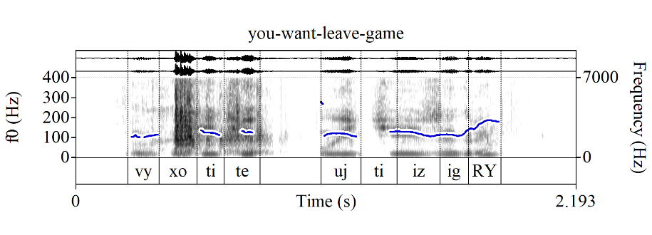
Root vs. explanation-seeking questions: Russian prosody
Naturalistic examples from MURCO:
(4) Ty XOčeš’ domoj? (root contour)
you want home
‘Do you want to go home?’
(5) Vy xotite ujTI? (explanation-seeking contour)
you want leave
‘Do you want to leave?’
(6) Vy xotite ujti iz igRY? (explanation-seeking contour)
you want leave from game
≈‘Do you want out?’

Slide 11
Question forms with only explanation-seeking uses
Both English and Russian have ‘what’-marked YNQs (w/syntactic and attitudinal differences b/n the two), which only have explanation-seeking uses
(7) ‘I just saw Nina cheering in the hallway.’
a. What_{H*} did she_{L-L%}, pass the exam_{L*H-H%}? (see Tortora & Bishop 2021)
b. Ona čto, sdala ekZAmen?
she WHAT pass exam

Slide 12
Question forms with only explanation-seeking uses
(8) Context A (root): I open the fridge to get wine for myself and ask Anna the following question to see if she wants a glass as well.
Context B (explanation-seeking): We’re in a restaurant, looking at the drinks menus; Anna goes straight for the wine list. Observing this, I ask the following question.
a. Are you interested in a glass of wine?
Context A: OK; Context B: OK (according to Tortora & Bishop 2021)
b. What are you, interested in a glass of wine?
Context A: #; Context B: OK (according to Tortora & Bishop 2021)
c. Ty XOčeš’ bokal vina? (root contour)
you want glass of-wine
Context A: OK; Context B: OK, but as “out of the blue”, ignoring the evidence
d. Ty xočeš’ bokal viNA? (explanation-seeking contour)
Context A: #; Context B: OK
e. Ty čto, xočeš’ bokal viNA?
you WHAT want glass of-wine
Context A: #; Context B: OK

Slide 13
Question forms with only explanation-seeking uses
Side note: there are at least two other YNQ forms in Russian that involve čto and/or a “meet”-type particle (in the sense of Szabolcsi 2015) and only have explanation-seeking uses (+ further differences in attitudinal and/or sociolinguistic component)
(9) a. Ty xočeš’ bokal viNA, čto li?
you want glass of-wine WHAT LI
b. Ty libo xočeš’ bokal viNA? (regional)
you LIBO want glass of-wine

Slide 14
‘Or not’ AltQs cannot be explanation-seeking
‘Or not’ AltQ counterparts are only available for root PolQs, but not for explanation-seeking PolQs (see also Bolinger 1978)
We can see this for YNQ forms that only have explanation-seeking uses:
(10) a. Nina sdaLA ekzamen ili net? (root contour)
Nina passed exam or not
b. Nina sdala ekZAmen {*ili net / ili čto}? (explanation-seeking contour)
Nina passed exam {*or not / or WHAT}
c. What did she, pass the exam {*or not / or something}?
d. Nina čto, sdala ekZAmen {* ili net / ili čto}?
Nina WHAT passed exam {* or not / or WHAT}

Slide 15
A note on constituent sub-QUD yes/no questions
PolQs can also signal larger QUDs of a constituent (i.e., sub-clausal) type; those are marked with narrow prosodic focus on the relevant constituent in both English and Russian, and can in principle have ‘or not’ AltQ counterparts, although other types of disjunct continuations are often preferable:
(11) a. Who called you? Did NIna call you (or someone else / ?or not)?
b. Kto tebe zvonil? Tebe NIna zvonila (ili kto / ? ili net)?
who you .DAT called you.DAT Nina called (or who / ? or not)
p: ‘Nina called you’; larger QUD Q: ‘Who called you?’; (a/b) is both a {p, ¬p} question and a sub-QUD of Q
We’ll set aside constituent sub-QUD YNQs beyond noting that they add further potential for ambiguity

Slide 16
Intro
Root vs. explanation-seeking questions
Explanation-seeking vs. re-asking rhetorical strategies
Outro

Slide 17
Prejacent truth in unambiguous yes/no RheQs
Explanation-seeking RheQs must have false prejacents, root RheQs must have true prejacents:
Russian “declarative string” rhetorical PolQs with obviously false prejacents can only have the explanation-seeking, but not the root contour, and conversely, those with true prejacents can only have the root contour:
(12) Context: The addressee is assumed to be sane, but is behaving weirdly.
a. Ty sošla s uMA? (explanation-seeking contour)
you stepped-down from mind
‘Have you lost your mind?’
b. # Ty sošLA s uma? (root contour)
you stepped-down from mind
c. Ty vmeNJAemyj čelovek? (root contour)
you sane person
‘Are you a sane person?’
d. # Ty vmenjaemyj čeloVEK? (explanation-seeking contour)
you sane person

Slide 18
Prejacent truth in unambiguous yes/no RheQs
Both English and Russian ‘what’-marked YNQs necessarily have obviously false prejacents when used rhetorically:
(13) Context: The addressee is assumed to be sane, but is behaving weirdly.
a. What are you, {insane / #sane}?
b. Ty čto, {nevmenjaemaja / # vmenjaemaja}?
you WHAT {insane / # sane}

Slide 19
Explanation-seeking vs. re-asking rhetorical strategies
We maintain that speakers do not simply ask a question with an obvious answer for no reason—they do so to make an additional point in a given context
However, yes/no RheQs whose prejacent is assumed to be false, like (1a) (Are you a child?), and those whose prejacent is assumed to be true, like (1c) (Are you an adult or not?), differ in how they make said additional point

Slide 20
Explanation-seeking rhetorical strategy
RheQs like (1a), where the prejacent is assumed to be false, are explanation-seeking questions using the explanation-seeking rhetorical strategy, i.e., “a preposterous explanation for a preposterous situation”:
A situation s that the speaker finds weird, preposterous, outrageous, etc. and wants to call it out as such
Prejacent p in any explanation-seeking YNQ, rhetorical or not, is a potential explanation for s
In RheQs like (1a) (e.g., Are you a child?), the speaker makes their rhetorical point by offering a “preposterous”, i.e., obviously false, potential explanation for s to alert the addressee to the preposterous nature of s itself
Thus, p must be false because:
If p was assumed to be true, but could not serve as an explanation for s, one would not be able to felicitously ask an explanation-seeking question with p as the prejacent (e.g., What are you, an adult? when the addressee is behaving childishly)
If p was assumed to be true and could also serve as an explanation for s, there would be no additional point to be made by offering an obviously true explanation for s (e.g., What are you, a republican? when the addressee is a Republican and is behaving accordingly)

Slide 21
Re-asking rhetorical strategy
RheQs like (1c) (e.g., Are you an adult or not?), where the prejacent is assumed to be true, employ the re-asking rhetorical strategy, i.e., “p is still true, so act accordingly”:
Their prototypical form is ‘p or not?’, hence the re-asking intuition, as ‘p or not?’ questions are typically used to re-ask an original p? (Biezma 2009)
When asking ‘p or not?’ rhetorically, the speaker pretends to re-ask an original PolQ ‘p?’ in order to discourage/encourage a certain behavior given situation s
‘p?’ is thus assumed to have been resolved, in principle to: (i) p or (ii) ¬p
However, only (i) gets to make a sensible rhetorical point:
Following Van Rooy & Šafářová 2003, the prejacent p of the original PolQ ‘p?’ was chosen so that it aligns with the speaker’s goals (e.g., ‘You are an adult/Democrat’ if you want to encourage adult/Democrat-like behavior)
In (i), a re-asking RheQ thus signals that, in view of situation s, the issue ‘p?’, which was “happily” settled to p, needs to be raised again to remind the addressee that the answer is still p in order to discourage/encourage an action wrt s
In case of resolution (ii), a re-asking RheQ would signal that, given situation s, the issue ‘p?’, which was “unhappily” settled to ¬p, needs to be raised again; but reminding the addressee that p is still “unhappily” false would serve no purpose: either s is “bad”, but consistent with ¬p; or it’s “good” and no action is needed

Slide 22
Re-asking rhetorical strategy
The re-asking rhetorical strategy, thus, has a more loaded pragmatics than the explanation-seeking one: the latter simply calls out the “weirdness” of the situation at hand; the former signals the speaker’s goals and sometimes even values, and is used as a call for action
This call for action via reminding the addressee about the truth of the prejacent doesn’t have to be to discourage some existing behavior, as in (1c), but could be to encourage some behavior (that would be in line with natural consequences of p)
(14) Context: The captain of the team currently holding the world champion title is addressing their teammates with a motivational speech before a decisive game in the ongoing world cup.
Are we the standing world champions or not?!

Slide 23
Going back to (1)
Re infelicity of (1d) (Are you a child or not? when the addressee is an adult):
‘Or not’ AltQs cannot have explanation-seeking uses, so only the re-asking strategy is available to them, thus, their prejacents must be true when they are used rhetorically
Re variably felicitous status of (1b) (Are you an adult? when the addressee is an adult):
PolQs without ‘or not’ can in principle be used to re-ask a question
But ‘or not’ AltQs are often a more optimal way to do so unambiguously and emphatically
However some re-asking PolQs without ‘or not’ are perfectly fine (e.g., Russian (12c))

Slide 24
Intro
Root vs. explanation-seeking questions
Explanation-seeking vs. re-asking rhetorical strategies
Outro

Slide 25
Outro: main take-home points
We have examined why in some yes/no RheQs the prejacent is assumed to be false, while in others it is assumed to be true
We have argued that there are (at least) two different rhetorical strategies:
Re-asking strategy, with the prejacent assumed to be true:
Only compatible with question forms that allow for “root” interpretations
Thus, forms that only allow for root interpretations (root contour PolQs in Russian and ‘or not’ AltQs in both English and Russian), can only be used as RheQs with obviously true prejacents
Explanation-seeking strategy, with the prejacent assumed to be false:
Only compatible with question forms that allow for “explanation-seeking” interpretations
Thus, forms that can only have explanation-seeking interpretations (explanation-seeking contour PolQs in Russian and ‘what’-marked YNQs in both English and Russian), can only be used as RheQs with obviously false prejacents

Slide 26
Outro: outlook
The two strategies we discussed are not the only rhetorical strategies out there; e.g., we did not talk about what Farkas (2022) calls “self-addressed”, in which “the speaker is assumed to be the responder”:
(15) Context: At a conference, where the organizer is introducing the keynote speaker.
Does our speaker still need an introduction? Of course not.
(English translation of Farkas 2022, (49))
Similarly, there are plenty of YNQ forms we didn’t discuss; e.g., Russian li questions (i) cannot be explanation-seeking; (ii) can be used rhetorically(-ish?), including in self-addressed questions like (15), and/or in a distinct “soapbox” manner (term jointly coined by Masha Esipova and Natasha Korotkova—stay tuned…)
(16) Nuždaetsja li naš dokladčik v predstavlenii? Konečno že net!
needs LI our speaker in introduction certainly že no
Most importantly: our work demonstrates the need for a more fine-grained taxonomy of RheQs and highlights the importance of cross-linguistic research and careful exploration of prosodic properties of RheQs for developing such a taxonomy

Slide 27
Thanks!
(Non-rhetorical) question time

Slide 28
References
Biezma, María. 2009. Alternative vs polar questions: the cornering effect. In Ed Cormany, Satoshi Ito & David Lutz (eds.), Proceedings of Semantics and Linguistic Theory 19, 37–54. doi: 10.3765/salt.v19i0.2519
Bolinger, Dwight. 1978. Yes-no questions are not alternative questions. In Henry Hiż (ed.), Questions, 87–105. Dodrecht, Holland: D. Reidel.
Caponigro, Ivano & Jon Sprouse. 2007. Rhetorical questions as questions. In Louise McNally & Estela Puig-Waldmüller (eds.), Proceedings of Sinn und Bedeutung 11, 121–133. doi:10.18148/sub/2007.v11i0.635.
Farkas, Donka F. 2022. Non-intrusive questions as a special type of non-canonical questions. Journal of Semantics 39(2). 295–337. doi: 10.1093/jos/ffac001.
Jeong, Sunwoo. 2018. Intonation and sentence type conventions: Two types of rising declaratives. Journal of Semantics 35(2). 305–356. doi: 10.1093/semant/ffy001.
Roberts, Craige. 2012. Information structure: Towards an integrated formal theory of pragmatics. Semantics and Pragmatics 5(6). 1–69. doi: 10.3765/sp.5.6.
Szabolcsi, Anna. 2015. What do quantifier particles do? Linguistics and Philosophy 38. 159–204. doi: 10.1007/s10988-015-9166-z.
Tortora, Christina & Jason Bishop. 2021. What-marked yes-no questions in New York City English. Talk given at Virtual NYI (The NY-St. Petersburg Institute of Linguistics, Cognition, and Culture) 3.
Van Rooy, Robert & Marie Šafářová. 2003. On polar questions. In Robert B Young & Yuping Zhou (eds.), Proceedings of Semantics and Linguistic Theory 13, 292–309. doi:10.3765/salt.v13i0.2887.

Slide 29
Root vs. explanation-seeking questions: basics
More naturalistic examples from MURCO:
(1) Even though I am a woman, I would never run away…
A vy umejete streljat’?
and you can shoot
‘And can you shoot?’
(2) Myshkin: And then I was feeling very good almost all of the time. I was… I was very happy.
Aglaya: Happy?
Myshkin: Uh-huh.
Aglaya: Vy umejete byt’ sčastlivym?
you can be happy
‘You know how to be happy?’

Slide 30
Misc notes
Russian explanation-seeking PolQs like (3b) are somewhat reminiscent of English rising declaratives (Jeong 2018, a.o.), which cannot be used as root questions, but can have explanation-seeking uses

