Slide 1
P3: Alternative Questions and Beyond
Maria Esipova and Maribel Romero
(previous members: Kajsa Djärv, Erlinde Meertens, Nadine Theiler)
FOR 2111 Final Workshop
Konstanz, June 2023

Slide 2
Project overview
Two Strategies for Rhetorical Questions:
Intro
Root vs. explanation-seeking questions
Explanation-seeking vs. re-asking rhetorical strategies
Outro

Slide 3
Project overview
P3 investigates the mapping from the surface form of Alternative Questions (AltQs) to their final complex semantic/pragmatic meaning, combining formal, experimental and cross-linguistic research.
(1) a. Do you want coffee_{L*H-} or tea_{H*L-L%}? b. Is the light on or off? c. Did Jane come or not?
Three main objectives:
Form-to-meaning composition of AltQs crosslinguistically
Complex utterance meaning of root AltQs in comparison to their polar and wh-question counterparts
Complex semantic/pragmatic meaning of embedded AltQs in comparison to polar and wh-questions

Slide 4
Project overview
Objective I: Form-to-meaning composition of AltQs cross-linguistically.
Languages use different surface cues to build an AltQ:
Prosody (multiple accent and final boundary tone): English, German
Placement of Q-particles: Turkish, Sinhala, Macedonian
Word order: Korean, Japanese, Russian, Ossetic
Lexical choice of disjunction: Basque, Finnish, Egyptian Arabic
P3 identified recurrent surface patterns (e.g., multiple accents/Q-particles) and assigned to them a unified meaning contribution, resulting in a cross-linguistically informed compositional analysis of AltQs.
(Meertens 2019, 2021, Jordanoska & Meertens 2019, Meertens et al. 2019, Romero & Meertens 2022)

Slide 5
Project overview
Objective II: Complex utterance meaning of root AltQs in comparison to their polar and wh-question counterparts (in terms of repeat contexts, rhetorical uses, presupposition projection, response particles, a.o.)
E.g., rhetorical uses:
Context: We are at a soccer summer camp (for adults) and one of the participants keeps whining about how hard the training is. The coach ask: a. ✓ Are you a baby? b. ?/% Are you an adult? c. # Are you a baby or not? d. ✓ Are you an adult or not?
Overall, P3 investigates how the semantic/pragmatic characteristics of the question form and discourse pressures interact to derive the observed empirical patterns.
Today’s talk
(Beltrama et al. 2020, Theiler subm., Esipova & Romero 2023, Mohammadi & Romero 2023)

Slide 6
Project overview
Objective III: Complex semantic/pragmatic meaning of embedded AltQs in comparison to wh- and polar questions.
Embedding puzzles:
(3) a. ✓It surprised Amy which of the two finalists won the game. WhQ
b. * It surprised Amy whether the older finalist or the younger finalist won the game. AltQ
c. * It surprised Amy whether the older finalist won the game. PolQ
P3 investigates how the semantic/pragmatic characteristics of the question form and the properties of the embedding verb conspire to derive embedding asymmetries.
(Djärv 2021, 2022a, 2022b, Djärv & Romero 2021)

Slide 7
Project overview
Two Strategies for Rhetorical Questions:
Intro
Root vs. explanation-seeking questions
Explanation-seeking vs. re-asking rhetorical strategies
Outro

Slide 8
Intro: starting observation
Rhetorical questions (RheQs) are questions answers to which are assumed to be obvious by the speaker (Caponigro & Sprouse 2007, a.o.)
But! Yes/no questions (YNQs)—polar (PolQs) and ‘or not’ alternative questions (AltQs)—vary in whether their prejacent is assumed to be true or false when used rhetorically:
(4) Context: The addressee is known to be a(n) adult/human/Democrat, but their behavior at the moment is inconsistent with this characterization (e.g., they make a childish request/exhibit extreme cruelty/refuse to support a progressive initiative). The speaker asks them:
a. Are you a(n) child/animal/Republican? (prejacent assumed false)
b. ? /% Are you a(n) adult/human/Democrat? (prejacent assumed true)
c. Are you a(n) adult/human/Democrat or not? (prejacent assumed true)
d. # Are you a(n) child/animal/Republican or not? (prejacent assumed false)

Slide 9
Intro: prior literature
Mostly focuses on wh RheQs
Earlier assumptions relevant for the issue at hand:
Prejacents of rhetorical YNQs are presumed to be false (but see, e.g., Rohde 2006)
AltQs typically cannot be used as RheQs (but see, e.g., Biezma & Rawlins 2017)
E.g.:
Caponigro & Sprouse 2007: “yes/no [RheQ]s require an answer of the opposite polarity”
Van Rooy & Šafářová 2003:
“It is commonly assumed in the literature that for a rhetorical question the negative answer is presupposed to be true”
Note that Are you crazy or not? is weird as a RheQ; suggest that ‘or not’ AltQs can’t be used rhetorically (?)
Do not offer a satisfactory explanation for that, however (“The reason is that the agent wants to highlight/suggest that she recently got some indication that the positive proposition might be true after all”)
Do not discuss RheQs with prejacents assumed to be true, or the fact that ‘or not’ AltQs can be (and preferably are) used as such RheQs

Slide 10
Intro: this talk
Two rhetorical strategies at play in (4):
Re-asking: reminding the addressee that the prejacent is true in order to discourage/encourage a certain action; prejacent is true
Explanation-seeking: a preposterous explanation for a preposterous situation; prejacent is false
Two (relevant) types of YNQs meaning-wise (wrt alternatives and discourse structure):
Root: re-asking strategy when used rhetorically
Explanation-seeking: explanation-seeking strategy when used rhetorically
Forms of root vs. explanation-seeking YNQs in English and Russian:
English: regular PolQs can be either root or explanation-seeking and can thus in principle use either rhetorical strategy—hence the overall felicity of both (4a) and (4b)
Russian: “declarative string” PolQs distinguish between the two prosodically
Both: special ‘what’-marked forms of explanation-seeking YNQs
Both: ‘or not’ AltQs cannot be explanation-seeking—hence # in (4d)
Both: root PolQs (w/o ‘or not’) can be used as re-asking RheQs, but ‘or not’ AltQs are often better as such—hence ?/% in (4b)

Slide 11
Project overview
Two Strategies for Rhetorical Questions:
Intro
Root vs. explanation-seeking questions
Explanation-seeking vs. re-asking rhetorical strategies
Outro

Slide 12
Root vs. explanation-seeking questions: basics
Root YNQs only introduce {p, ¬p} alternatives and don’t signal any larger question under discussion (QUD; Roberts 2009/2012 et seq.)
Explanation-seeking YNQs are sub-QUDs of a larger QUD seeking an explanation for some contextual evidence (while still introducing {p, ¬p})
(5) a. Root YNQ (PolQ)
Context: Nina was supposed to take an exam. I am interested in the outcome.
Did Nina pass the exam?
p: ‘Nina passed the exam’; alternatives: {p, ¬p}; no larger QUD signalled
b. Explanation-seeking YNQ (PolQ)
Context: Nina was supposed to take an exam. I just saw her cheering in the hallway. I am wondering if she passed the exam and that’s why she’s cheering.
Did Nina pass the exam?
p: ‘Nina passed the exam’; situation s: Nina is cheering in the hallway; larger QUD Q: ‘What is the explanation for s?’
(b) is both a {p, ¬p} question and a sub-QUD of Q: {p is the answer to Q, ¬(p is the answer to Q)}

Slide 13
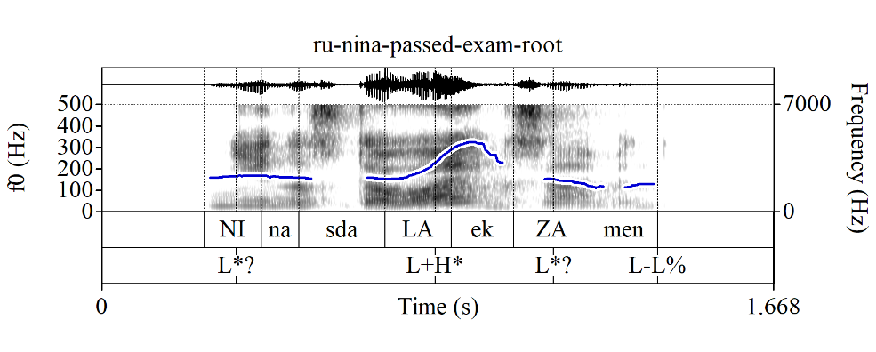
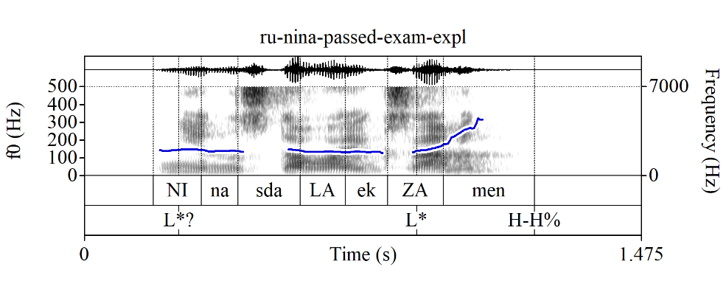
Root vs. explanation-seeking questions: Russian prosody
In English, the PolQs in (5a) and (5b) can in principle be asked with the same intonational contour (e.g., L* H-H%)
Russian “declarative string” (i.e., default) PolQs distinguish between root vs. explanation-seeking readings prosodically:
(6) a. Root YNQ (PolQ w/“root contour”)
Context: Nina was supposed to take an exam.
I am interested in the outcome.
Nina sdala_{L+H*} ekzamen_{L-L%}
Nina passed exam
b. Explanation-seeking YNQ (PolQ w/“explanation-seeking contour”)
Context: Nina was supposed to take an exam.
I just saw her cheering in the hallway.
I am wondering if she passed the exam and
that’s why she’s cheering.
Nina sdala ekza_{L*}men_{H-H%}
Nina passed exam

Slide 14
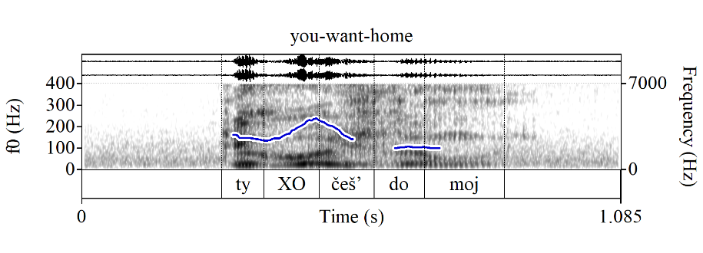
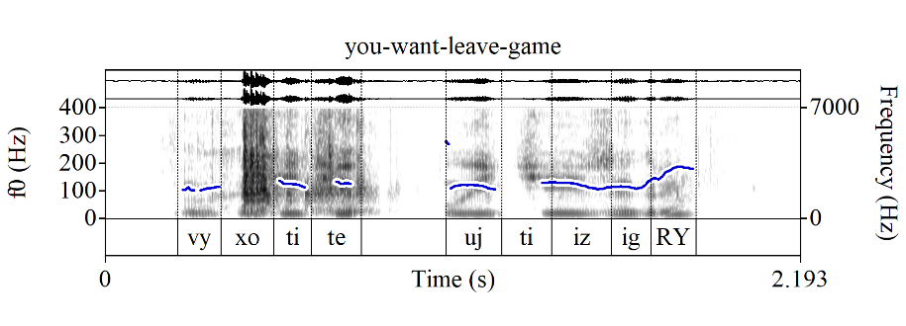
Root vs. explanation-seeking questions: Russian prosody
Naturalistic examples from MURCO:
(7) Ty XOčeš’ domoj? (root contour)
you want home
‘Do you want to go home?’
(8) Vy xotite ujTI? (explanation-seeking contour)
you want leave
‘Do you want to leave?’
(9) Vy xotite ujti iz igRY? (explanation-seeking contour)
you want leave from game
≈‘Do you want out?’

Slide 15
Question forms with only explanation-seeking uses
Both English and Russian have ‘what’-marked YNQs (w/syntactic and attitudinal differences b/n the two), which only have explanation-seeking uses
(10) ‘I just saw Nina cheering in the hallway.’
a. What_{H*} did she_{L-L%}, pass the exam_{L*H-H%}? (see Tortora & Bishop 2021)
b. Ona čto, sdala ekZAmen?
she WHAT pass exam

Slide 16
Question forms with only explanation-seeking uses
(11) Context A (root): I open the fridge to get wine for myself and ask Anna the following question to see if she wants a glass as well.
Context B (explanation-seeking): We’re in a restaurant, looking at the drinks menus; Anna goes straight for the wine list. Observing this, I ask the following question.
a. Are you interested in a glass of wine?
Context A: OK; Context B: OK (according to Tortora & Bishop 2021)
b. What are you, interested in a glass of wine?
Context A: #; Context B: OK (according to Tortora & Bishop 2021)
c. Ty XOčeš’ bokal vina? (root contour)
you want glass of-wine
Context A: OK; Context B: OK, but as “out of the blue”, ignoring the evidence
d. Ty xočeš’ bokal viNA? (explanation-seeking contour)
Context A: #; Context B: OK
e. Ty čto, xočeš’ bokal viNA?
you WHAT want glass of-wine
Context A: #; Context B: OK

Slide 17
Question forms with only explanation-seeking uses
Side note: there are at least two other YNQ forms in Russian that involve čto and/or a “meet”-type particle (in the sense of Szabolcsi 2015) and only have explanation-seeking uses (+ further differences in attitudinal and/or sociolinguistic component)
(12) a. Ty xočeš’ bokal viNA, čto li?
you want glass of-wine WHAT LI
b. Ty libo xočeš’ bokal viNA? (regional)
you LIBO want glass of-wine

Slide 18
‘Or not’ AltQs cannot be explanation-seeking
‘Or not’ AltQ counterparts are available for root PolQs, but not for explanation-seeking PolQs (Bolinger 1978 for English):
(13) What’s the matter? Are you tired (#or not)?
We can also see this for YNQ forms that only have explanation-seeking uses:
(14) a. Nina sdaLA ekzamen ili net? (root contour)
Nina passed exam or not
b. Nina sdala ekZAmen {*ili net / ili čto}? (explanation-seeking contour)
Nina passed exam {*or not / or WHAT}
c. What did she, pass the exam {*or not / or something}?
d. Nina čto, sdala ekZAmen {* ili net / ili čto}?
Nina WHAT passed exam {* or not / or WHAT}

Slide 19
A note on constituent sub-QUD yes/no questions
PolQs can also signal larger QUDs of a constituent (i.e., sub-clausal) type; those are marked with narrow prosodic focus on the relevant constituent in both English and Russian:
(15) a. Who called you? Did NIna call you?
b. Kto tebe zvonil? Tebe NIna zvonila?
who you .DAT called you.DAT Nina called
p: ‘Nina called you’; larger QUD Q: ‘Who called you?’; (a/b) is both a {p, ¬p} question and a sub-QUD of Q
Explanation-seeking questions are, thus, a special sub-case of sub-QUD YNQs, but with sentence-level focus
We’ll set aside constituent sub-QUD YNQs beyond noting that they add further potential for ambiguity

Slide 20
Project overview
Two Strategies for Rhetorical Questions:
Intro
Root vs. explanation-seeking questions
Explanation-seeking vs. re-asking rhetorical strategies
Outro

Slide 21
Prejacent truth in unambiguous yes/no RheQs
Explanation-seeking RheQs must have false prejacents, root RheQs must have true prejacents:
Russian “declarative string” rhetorical PolQs with obviously false prejacents can only have the explanation-seeking, but not the root contour, and conversely, those with true prejacents can only have the root contour:
(16) Context: The addressee is assumed to be sane, but is behaving weirdly.
a. Ty sošla s uMA? (explanation-seeking contour)
you stepped-down from mind
‘Have you lost your mind?’
b. # Ty sošLA s uma? (root contour)
you stepped-down from mind
c. Ty vmeNJAemyj čelovek? (root contour)
you sane person
‘Are you a sane person?’
d. # Ty vmenjaemyj čeloVEK? (explanation-seeking contour)
you sane person

Slide 22
Prejacent truth in unambiguous yes/no RheQs
Both English and Russian ‘what’-marked YNQs, which we have shown to always be explanation-seeking, necessarily have obviously false prejacents when used rhetorically:
(17) Context: The addressee is assumed to be sane, but is behaving weirdly.
a. What are you, {insane / #sane}?
b. Ty čto, {nevmenjaemaja / # vmenjaemaja}?
you WHAT {insane / # sane}

Slide 23
Explanation-seeking vs. re-asking rhetorical strategies
We maintain that speakers do not simply ask a question with an obvious answer for no reason—they do so to make an additional point in a given context (see also, e.g., Biezma & Rawlins 2017)
However, yes/no RheQs whose prejacent is assumed to be false, like (4a) (Are you a child?), and those whose prejacent is assumed to be true, like (4c) (Are you an adult or not?), differ in how they make said additional point

Slide 24
Explanation-seeking rhetorical strategy
RheQs like (4a), where the prejacent is assumed to be false, are explanation-seeking questions using the explanation-seeking rhetorical strategy, i.e., “a preposterous explanation for a preposterous situation”:
A situation s that the speaker finds weird, preposterous, outrageous, etc. and wants to call it out as such
Prejacent p in any explanation-seeking YNQ, rhetorical or not, is a potential explanation for s
In RheQs like (4a) (e.g., Are you a child?), the speaker makes their rhetorical point by offering a “preposterous”, i.e., obviously false, potential explanation for s to alert the addressee to the preposterous nature of s itself
Thus, p must be false because:
If p was assumed to be true, but could not serve as an explanation for s, one would not be able to felicitously ask an explanation-seeking question with p as the prejacent (e.g., What are you, an adult? when the addressee is behaving childishly)
If p was assumed to be true and could also serve as an explanation for s, there would be no additional point to be made by offering an obviously true explanation for s (e.g., What are you, a republican? when the addressee is a Republican and is behaving accordingly)

Slide 25
Re-asking rhetorical strategy
RheQs like (4c) (e.g., Are you an adult or not?), where the prejacent is assumed to be true, employ the re-asking rhetorical strategy, i.e., “p is still true, so act accordingly”:
Their prototypical form is ‘p or not?’, hence the re-asking intuition, as ‘p or not?’ questions are typically used to re-ask an original p? (Biezma 2009)
When asking ‘p or not?’ rhetorically, the speaker pretends to re-ask an original PolQ ‘p?’ in order to discourage/encourage a certain behavior given situation s
‘p?’ is thus assumed to have been resolved, in principle to: (i) p or (ii) ¬p
However, only (i) gets to make a sensible rhetorical point:
Following Van Rooy & Šafářová 2003, the prejacent p of the original PolQ ‘p?’ was chosen so that it aligns with the speaker’s goals (e.g., ‘You are an adult/Democrat’ if you want to encourage adult/Democrat-like behavior)
In (i), a re-asking RheQ thus signals that, in view of situation s, the issue ‘p?’, which was “happily” settled to p, needs to be raised again to remind the addressee that the answer is still p in order to discourage/encourage an action wrt s
In case of resolution (ii), a re-asking RheQ would signal that, given situation s, the issue ‘p?’, which was “unhappily” settled to ¬p, needs to be raised again; but reminding the addressee that p is still “unhappily” false would serve no purpose: either s is “bad”, but consistent with ¬p; or it’s “good” and no action is needed

Slide 26
Re-asking rhetorical strategy
The re-asking rhetorical strategy, thus, has a more loaded pragmatics than the explanation-seeking one: the latter simply calls out the “weirdness” of the situation at hand; the former signals the speaker’s goals and sometimes even values, and is used as a call for action
This call for action via reminding the addressee about the truth of the prejacent doesn’t have to be to discourage some existing behavior, as in (4c), but could be to encourage some behavior (that would be in line with natural consequences of p)
(18) Context: The captain of the team currently holding the world champion title is addressing their teammates with a motivational speech before a decisive game in the ongoing world cup.
Are we the standing world champions or not?!

Slide 27
Going back to (4)
(4) Context: The addressee is known to be a(n) adult/human/Democrat, but their behavior at the moment is inconsistent with this characterization (e.g., they make a childish request/exhibit extreme cruelty/refuse to support a progressive initiative). The speaker asks them:
a. Are you a(n) child/animal/Republican? (prejacent assumed false)
b. ?/% Are you a(n) adult/human/Democrat? (prejacent assumed true)
c. Are you a(n) adult/human/Democrat or not? (prejacent assumed true)
d. # Are you a(n) child/animal/Republican or not? (prejacent assumed false)
(4a) is a standard explanation-seeking RheQ
(4c) is a standard re-asking RheQ
(4d) is infelicitous because:
‘Or not’ AltQs cannot have explanation-seeking uses, so only the re-asking strategy is available to them, thus, their prejacents must be true when they are used rhetorically
(4b) is variably felicitous because:
PolQs without ‘or not’ can in principle be used to re-ask a question
But ‘or not’ AltQs are often a more optimal way to do so unambiguously and emphatically
However, some re-asking PolQs without ‘or not’ are perfectly fine (e.g., Russian (16c))

Slide 28
Project overview
Two Strategies for Rhetorical Questions:
Intro
Root vs. explanation-seeking questions
Explanation-seeking vs. re-asking rhetorical strategies
Outro

Slide 29
Outro: main take-home points
We have examined why in some yes/no RheQs the prejacent is assumed to be false, while in others it is assumed to be true
We have argued that there are (at least) two different rhetorical strategies:
Explanation-seeking strategy, with the prejacent assumed to be false:
Only compatible with question forms that allow for “explanation-seeking” interpretations
Thus, forms that can only have explanation-seeking interpretations (explanation-seeking contour PolQs in Russian and ‘what’-marked YNQs in both English and Russian), can only be used as RheQs with obviously false prejacents
Re-asking strategy, with the prejacent assumed to be true:
Only compatible with question forms that allow for “root” interpretations
Thus, forms that only allow for root interpretations (root contour PolQs in Russian and ‘or not’ AltQs in both English and Russian), can only be used as RheQs with obviously true prejacents

Slide 30
Outro: outlook
The two strategies we discussed are not the only rhetorical(-ish) strategies out there; e.g., we did not talk about what Farkas (2022) calls “self-addressed” questions (not classified as rhetorical proper), in which “the speaker is assumed to be the responder”:
(19) Context: At a conference, where the organizer is introducing the keynote speaker.
Does our speaker still need an introduction? Of course not.
(English translation of Farkas 2022, (49))
Similarly, there are plenty of YNQ forms we didn’t discuss; e.g., Russian li questions (i) cannot be explanation-seeking; (ii) can be used rhetorically(-ish?), including in self-addressed questions like (20), and/or in a distinct “soapbox” manner (term jointly coined by Masha Esipova and Natasha Korotkova—stay tuned…)
(20) Nuždaetsja li naš dokladčik v predstavlenii? Konečno že net!
needs LI our speaker in introduction certainly že no
Most importantly: our work demonstrates the need for a more fine-grained taxonomy of RheQs and highlights the importance of cross-linguistic research and careful exploration of prosodic properties of RheQs for developing such a taxonomy

Slide 31
Thanks!
(Non-rhetorical) question time

Slide 32
References
Beltrama, Andrea, Erlinde Meertens, and Maribel Romero. 2020. Alternative questions: Distinguishing between negated and complementary disjuncts. Semantics and Pragmatics 13(5). doi:10.3765/sp.13.5
Biezma, María. 2009. Alternative vs polar questions: the cornering effect. In Ed Cormany, Satoshi Ito & David Lutz (eds.), Proceedings of Semantics and Linguistic Theory 19, 37–54. doi: 10.3765/salt.v19i0.2519
Biezma, María & Kyle Rawlins. 2017. Rhetorical questions: Severing questioning from asking. In Proceedings of SALT 27. pp. 302-322. doi:10.3765/salt.v27i0.4155
Bolinger, Dwight. 1978. Yes-no questions are not alternative questions. In Henry Hiż (ed.), Questions, 87–105. Dodrecht, Holland: D. Reidel.
Caponigro, Ivano & Jon Sprouse. 2007. Rhetorical questions as questions. In Louise McNally & Estela Puig-Waldmüller (eds.), Proceedings of Sinn und Bedeutung 11, 121–133. doi:10.18148/sub/2007.v11i0.635
Djärv, Kajsa. 2023. Source and Content DPs: belief-verbs as optionally ditransitive Hintikkan attitudes. In Ryan Walter Smith (ed.) Proceedings of the 39th West Coast Conference on Formal Linguistics (WCCFL 39).
Djärv, Kajsa. 2022a. On the interpretation and distribution of embedded main clause syntax: new perspectives on complex discourse moves. Glossa: a journal of general linguistics, 7(1).
Djärv, Kajsa. 2022b. Knowing and believing things: what DP-complements can tell us about the argument structure and composition of (factive) attitudes. To appear in Journal of Semantics.
Kajsa Djärv and Maribel Romero. 2021. Emotive factives and strong exhausitvity: an experimental investigation. Invited talk at the MECORE kickoff workshop Approaches to the semantics of clause-embedding predicates: theories, cross-linguistic data, and experimentation. University of Edinburgh, Oct 21, 2021.
Esipova, Maria & Maribel Romero. 2023. Prejacent truth in rhetorical questions: lessons from Russian. Talk at Formal Approaches to Slavic Linguistics (FASL) 32, Indiana University.
Farkas, Donka F. 2022. Non-intrusive questions as a special type of non-canonical questions. Journal of Semantics 39(2). 295–337. doi: 10.1093/jos/ffac001
Jeong, Sunwoo. 2018. Intonation and sentence type conventions: Two types of rising declaratives. Journal of Semantics 35(2). 305–356. doi: 10.1093/semant/ffy001

Slide 33
References
Jordanoska, Izabela, and Erlinde Meertens. 2019. The pragmatic effects of Macedonian li: an experimental study. In Proceedings of Formal Description of Slavic Linguistics 13 (FDSL13). To appear.
Meertens, Erlinde. 2019. How prosody disambiguates between Alternative and Polar Questions. In Schlöder, J.J., D. McHugh and F. Roelofsen (eds.), Proceedings of the 22nd Amsterdam Colloquium, pp. 299–308.
Meertens, Erlinde. 2021. Alternative Questions: From surface to meaning. Ph.D. dissertation, University of Konstanz.
Meertens, Erlinde, Sophie Egger, and Maribel Romero. 2019. Multiple accent in alternative questions. In Espinal, M.T., E. Castroviejo, M. Leonetti, L. McNally and C. Real-Puigdollers (eds.), Proceedings of Sinn und Bedeutung 23, vol. 2, pp. 179-195.
Mohammadi, Maryam and Maribel Romero. 2023. Polar particles in Farsi: Sensitivity to the Scoreboard Model of Discourse. Upcoming talk at Sinn und Bedeutung 28.
Penka, Doris and Maribel Romero. In progress. Adding emphasis with ex situ discourse particles.
Roberts, Craige. 2012. Information structure: Towards an integrated formal theory of pragmatics. Semantics and Pragmatics 5(6). 1–69. doi: 10.3765/sp.5.6
Romero, Maribel and Meertens, Erlinde. 2022. Q-particles and islands in Sinhala wh- and polar questions, Acta Linguistica Academica 69(1), 104–127.
Rohde, Hannah. 2006. Rhetorical questions as redundant interrogatives. San Diego Linguistics Papers 2. 134–168.
Szabolcsi, Anna. 2015. What do quantifier particles do? Linguistics and Philosophy 38. 159–204. doi: 10.1007/s10988-015-9166-z
Nadine Theiler. Subm. A pragmatic account of presupposition projection in questions. Under review at Semantics & Pragmatics.
Tortora, Christina & Jason Bishop. 2021. What-marked yes-no questions in New York City English. Talk given at Virtual NYI (The NY-St. Petersburg Institute of Linguistics, Cognition, and Culture) 3.
Van Rooy, Robert & Marie Šafářová. 2003. On polar questions. In Robert B Young & Yuping Zhou (eds.), Proceedings of Semantics and Linguistic Theory 13, 292–309. doi:10.3765/salt.v13i0.2887

Slide 34
Root vs. explanation-seeking questions: basics
More naturalistic examples from MURCO:
(1) Even though I am a woman, I would never run away…
A vy umejete streljat’?
and you can shoot
‘And can you shoot?’
(2) Myshkin: And then I was feeling very good almost all of the time. I was… I was very happy.
Aglaya: Happy?
Myshkin: Uh-huh.
Aglaya: Vy umejete byt’ sčastlivym?
you can be happy
‘You know how to be happy?’

Slide 35
Misc notes
Russian explanation-seeking PolQs like (6b) are somewhat reminiscent of English rising declaratives (Jeong 2018, a.o.), which cannot be used as root questions, but can have explanation-seeking uses

