Slide 1
To Q or not to Q?
Masha Esipova (Bar-Ilan University)
TCD Linguistics Research Seminar
October 10, 2023

Slide 2
Intro
Q-Peak in questions
Q-Peak in requests
No Q-Peak in suggestions
What does the Q-Peak do?
Outro

Slide 3
Intro
Q-Peak in questions
Q-Peak in requests
No Q-Peak in suggestions
What does the Q-Peak do?
Outro

Slide 4
Intro: background
Typological generalization in Rudin 2018, further explored in Rudin & Rudin 2022 (R&R):
Languages in which rising declaratives (L* H-H%, but see Jeong 2018) comprise non-canonical yes/no questions (YNQs)—like English in (1) and Bulgarian in (2)—also allow for rising imperatives, used as friendly/polite/tentative requests or non-committal suggestions:
(1) English
a. Did you pour me wine_{L* H-H%}? (“syntactically” marked canonical YNQ)
b. You poured me wine_{L* H-H%}? (rising declarative as a non-canonical YNQ) c. Pour me wine_{L* H-H%}? (rising imperative as a request) d. A: What should I do relax?
B: I don’t know... Pour yourself wine_{L* H-H%}? Make yourself a bath_{L* H-H%}?
(rising imperatives as suggestions)

Slide 5
Intro: background
(2) Bulgarian (from R&R)
a. Šte xodiš li na kino?
FUT go.2SG Q-prt to cinema
‘Are you going to the movies?’ (“lexically” marked canonical YNQ)
b. Šte xodiš na kino_{L* H-H%}?
FUT go.2SG to cinema
‘You’re going to the movies?’ (rising declarative as a non-canonical YNQ)
c. Daj mi edna sigara_{L* H-H%}?
give.IMP me.DAT a cigarette?
‘Give me a cigarette?’ (rising imperative as a request)
d. A: ‘What should I do today?’
B: Napiši si doklada_{L* H-H%}? Ela s mene na plaža_{L* H-H%}?
write.IMP REFL paper.DEF come.IMP with me to beach.DEF
‘Write your paper? Come to the beach with me?’ (rising imperatives as suggestions)
NB: There are some differences for some speakers for requests vs. suggestions, though

Slide 6
Intro: background
Languages in which rising declaratives comprise canonical YNQs, like Macedonian, don’t allow for such rising imperatives:
(3) Macedonian (from R&R)
a. Ke odiš na kino_{L* H-H%}?
FUT go.2SG to cinema
‘Are you going to the movies?’ (rising declarative as a canonical YNQ)
b. # Daj mi edna sigara_{L* H-H%}?
give.IMP me.DAT a cigarette?
Intended: ‘Give me a cigarette?’ (no rising imperatives as requests)
d. A: ‘What should I do today?’
B: # Piši go referatot_{L* H-H%}? Odi na plaža_{L* H-H%}?
write.IMP it paper.DEF go.IMP to beach.DEF
Intended: ‘Write your paper? Go to the beach?’ (no rising imperatives as suggestions)
NB from R&R: “Li questions do also exist in Macedonian (…) but their semantics necessarily involves focus; they “emphasize a particular sentence element” (Kramer 2003:17), namely the constituent preceding li”

Slide 7
Intro: this talk
This talk looks at another Slavic language Russian, further expanding and fine-tuning the typology of how languages realize various discourse-oriented meanings across sentence types:
While, like in Macedonian, Russian canonical YNQs are formed via an “intonation-only” strategy, said intonation doesn’t involve a rising tune, but what I call here the Q-Peak
Despite marking canonical YNQs, the Q-Peak can also be used in friendly/polite requests like (1/2c), but…
…not in non-committal suggestions like (1/2d)
I propose that:
The Q-Peak realizes an operator that asks the addressee to respond to an issue—appropriate in (some) questions and requests, but not in non-committal suggestions
Thus, the Q-Peak is different from the rising tune in English and Bulgarian (and, to some extent, Russian), which, in R&R’s words, simply “calls off the speaker’s commitment” and can, thus, turn declaratives into non-canonical YNQs and imperatives into unimposing requests or non-committal suggestions

Slide 8
Intro
Q-Peak in questions
Q-Peak in requests
No Q-Peak in suggestions
What does the Q-Peak do?
Outro

Slide 9
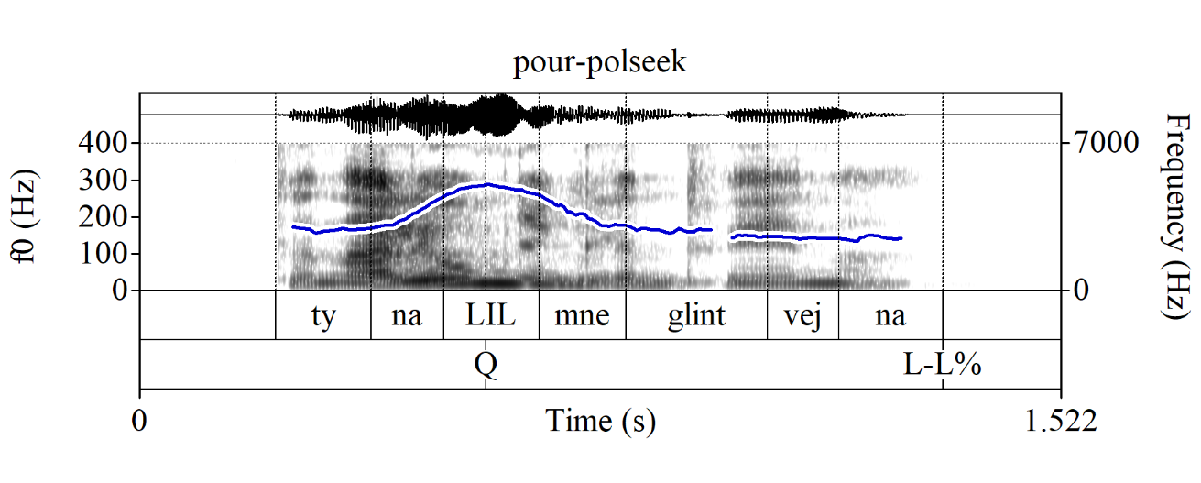
YNQs in Russian: basics
Default strategy of forming canonical YNQs in Russian:
Same string as in a declarative sentence
A special prosodic peak, the Q-Peak, on the locus of prosodic focus marking within the semantically focused constituent; labelled here as Q
E.g., for what Esipova & Romero (2023) call polarity-seeking YNQs, where the locus of prosodic focus marking is usually the lexically stressed syllable of the inflected verb (unlike English):
(4) Context: You were supposed to pour me mulled wine. I am asking you if you have done so (no bias either way).
Ty nalil_{Q} mne glintvejna_{L-L%}?
you.SG/T.NOM pour.PAST.SG.M me.DAT mulled-wine.PART
‘Did you pour me mulled wine?’

Slide 10
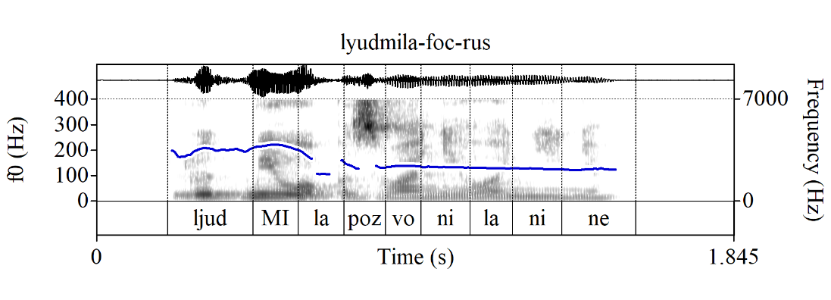
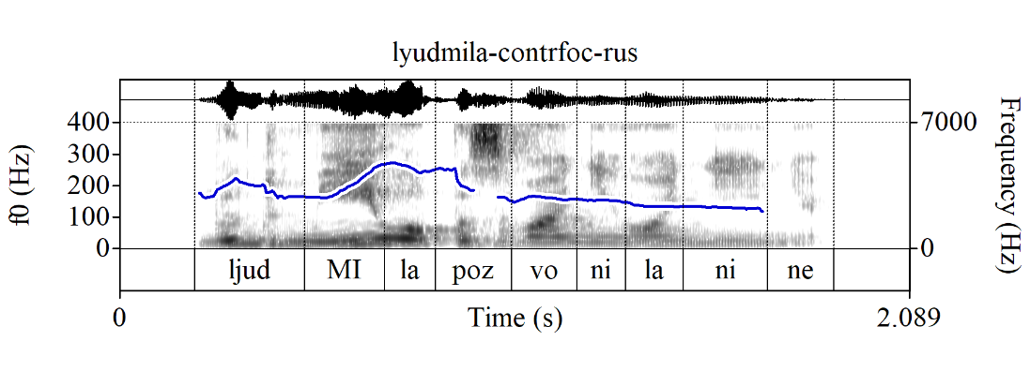
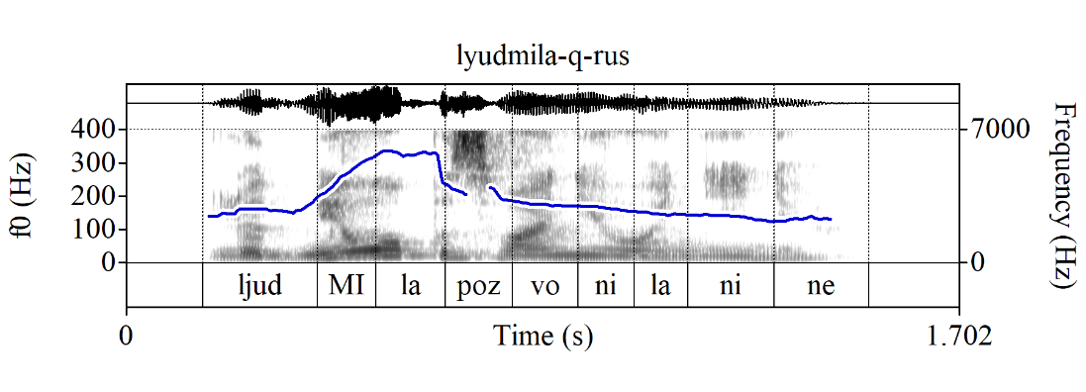
Q-Peak vs. focus marking
The Q-Peak is reliably different in production and perception from both “regular” (new information) and contrastive (e.g., corrective) focus marking (see also Meyer & Mleinek 2006):
(5) Regular focus on the subject
A: ‘Who called Nina?’
B: [Ljudmila]_{FOC} pozvonila Nine.
Lyudmila.NOM call.PAST.SG.F Nina.ACC
‘Lyudmila called Nina.’
(6) Contrastive focus on the subject
A: ‘Marina called Nina.’
B: [Ljudmila]_{CONTRFOC} pozvonila Nine!
Lyudmila.NOM call.PAST.SG.F Nina.ACC
‘Lyudmila called Nina!’
(7) YNQ w/focus on the subject
‘Who called Nina?’ [Ljudmila]_{Q-FOC} pozvonila Nine?
Lyudmila.NOM call.PAST.SG.F Nina.ACC
‘Who called Nina? Did Lyudmila call Nina?’

Slide 11
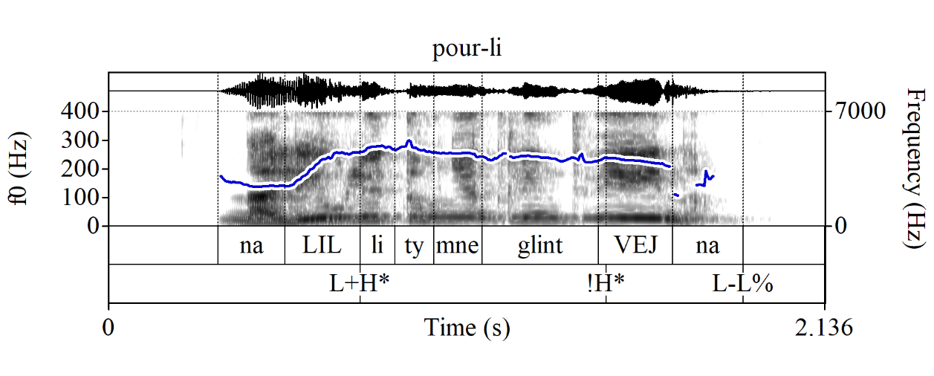
Li YNQs
Matrix li YNQs also exist in Russian, but they are marked (although not like what R&R claim is the case for Macedonian; we’ll come back to this): the focused constituent is fronted and carries regular-ish prosodic focus marking (the Q-Peak is not possible)
(8) Nalil_{L+H*} li ty mne glintvej_{!H*}na_{L-L%}?
pour.PAST.SG.M Q-prt you.SG/T.NOM me.DAT mulled-wine.PART?
‘Did you pour me mulled wine?’

Slide 12
Intro
Q-Peak in questions
Q-Peak in requests
No Q-Peak in suggestions
What does the Q-Peak do?
Outro

Slide 13
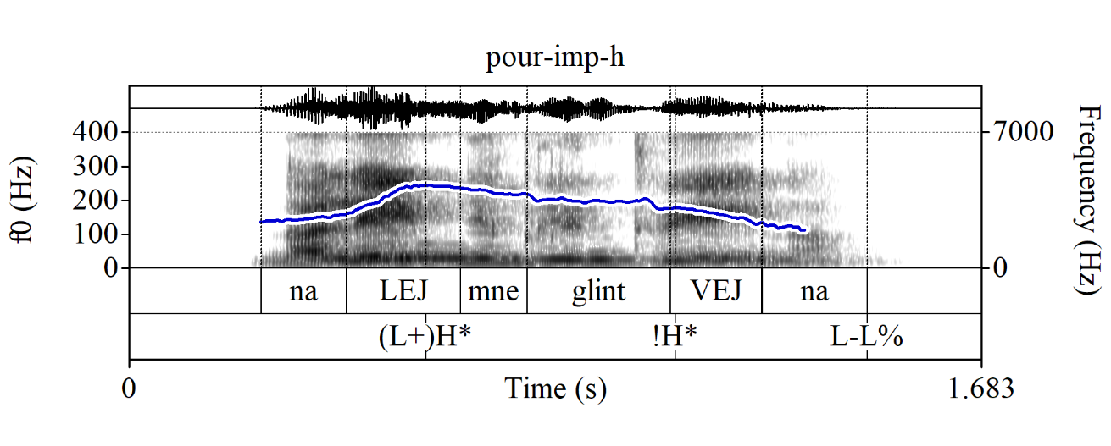
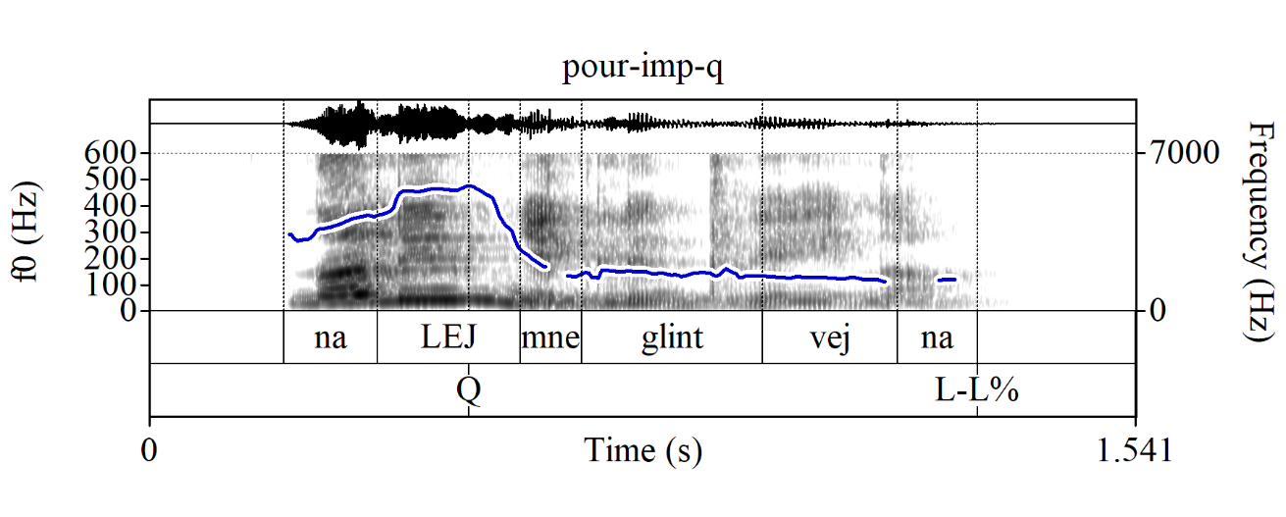
Q-Peak in requests: imperatives
I observe that the Q-Peak can be used in different sentence types to mark polite/friendly requests. Let’s look at a few cases:
Imperatives
(9) Nalej mne glintvejna
pour.IMP.SG/T me.DAT mulled-wine.PART
a. Command (‘Pour me mulled wine!’) b. Request (≈‘Pour me mulled wine[, will you]?’)

Slide 14
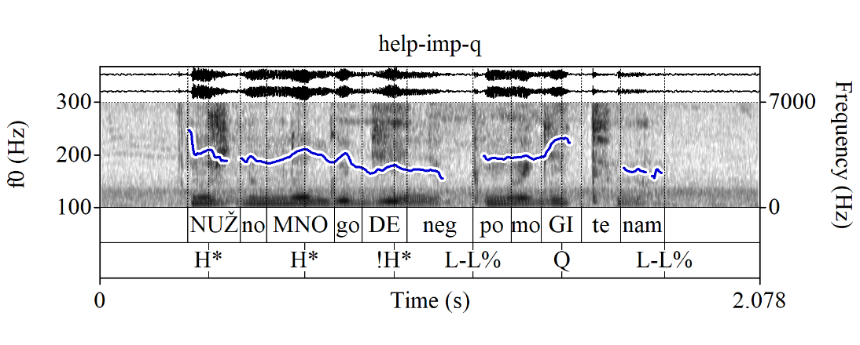
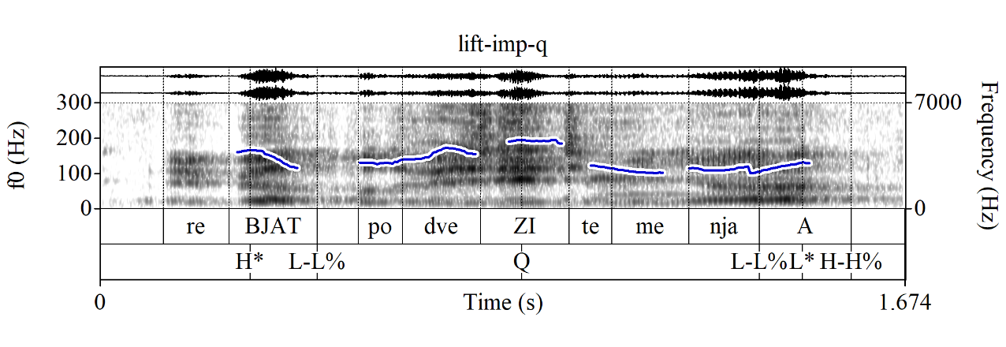
Q-Peak in requests: imperatives
Some naturalistic examples (MURCO, https://ruscorpora.ru/new/search-murco.html) of Q-Peak-marked imperative requests:
(10) Nužno mnogo deneg. Pomogi_{Q}te nam_{L-L%}?
need.ADJ much money.PART help.IMP.PL/V us.DAT
‘A lot of money is needed. Help us?’ (MURCO)
(11) Rebjat_{H* L-L%}, podvezi_{Q}te menja_{L-L%}, a_{L* H-H%}?
guys.VOC give-a-lift.IMP.PL/V me.ACC PRT
≈‘Guys, give me a lift, will you?’ (MURCO)

Slide 15
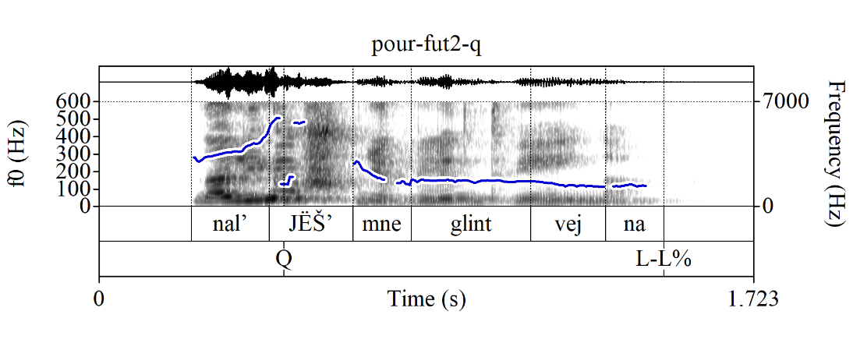
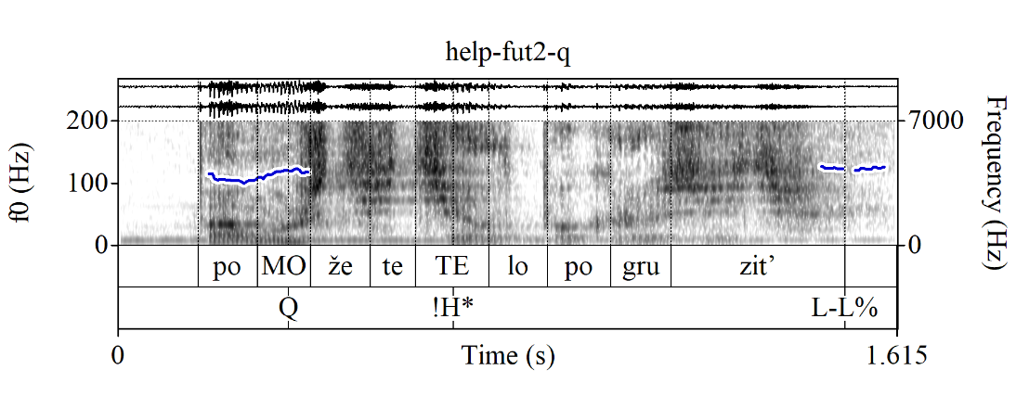
Q-Peak in requests: FUT.2
FUT.2 Q-Peak-marked declarative string “questions” (?) used as requests (preferably, but not obligatorily w/o an overt subject):
(12) Naljёš’_{Q} mne glintvejna_{L-L%}?
pour.FUT.2SG/T me.DAT mulled-wine.PART
Lit.: ‘Will you pour me mulled wine?’
Cf. the imperative request in (9b):
(13) Pomo_{Q}žete te_{!H*}lo pogruzit’_{L-L%}?
help.FUT.2PL/V body.ACC load.INF
Lit.: ‘Will you help us load the body?’ (MURCO)

Slide 16
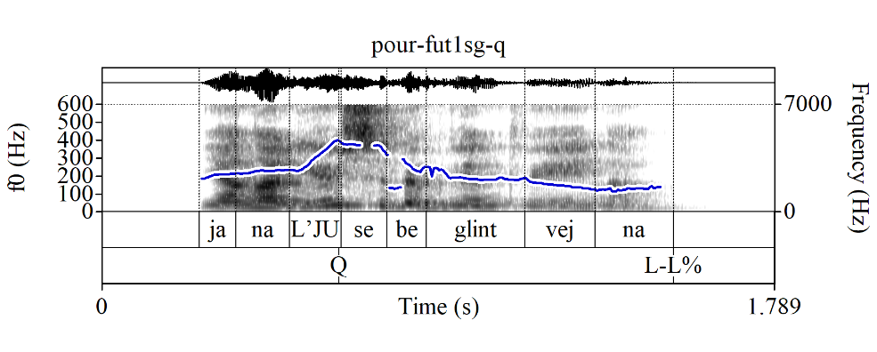
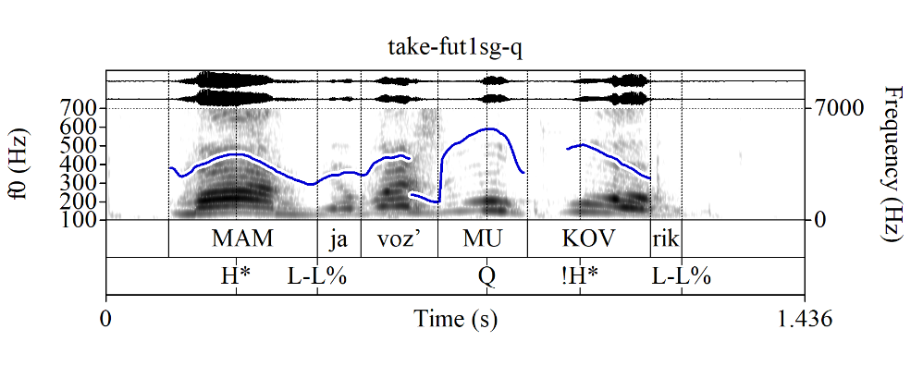
Q-Peak in requests: FUT.1SG
FUT.1SG (also, sometimes PAST, but let’s not go there) Q-Peak-marked declarative string “questions” (?) used as permission requests (here the subject seems obligatory), in which the speaker assumes the permission will likely be granted:
(14) Ja nalju_{Q} sebe glintvejna_{L-L%}?
I.NOM pour.FUT.1SG self.DAT mulled-wine.PART
Lit.: ‘Will I pour myself mulled wine?’
≈‘I’ll pour myself mulled wine, OK?’
(15) Mam_{H* L-L%}, ja voz’mu_{Q} kovrik_{L-L%}?
Mom.VOC I.NOM take.FUT.1SG rug.ACC
Lit.: ‘Mom, will I take the rug?’
≈‘Mom, I’ll take the rug, OK?’ (MURCO)
NB: Here it’s easy to tell that these are not info-seeking questions, because you wouldn’t respond to them w/smth like ‘Yes, pour/take.FUT.2SG’, but rather permission-granting/denying utterances, e.g., ‘Yes, pour/take.IMP’

Slide 17
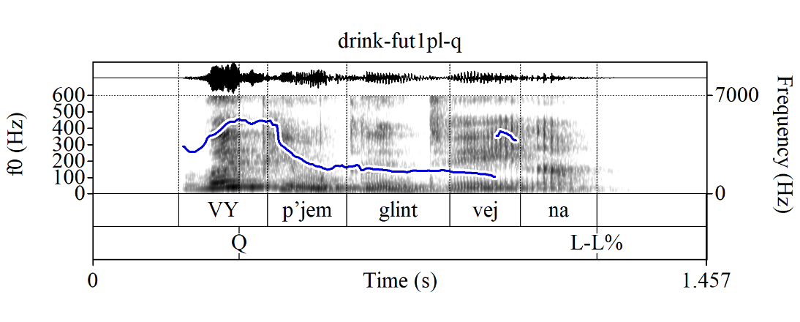
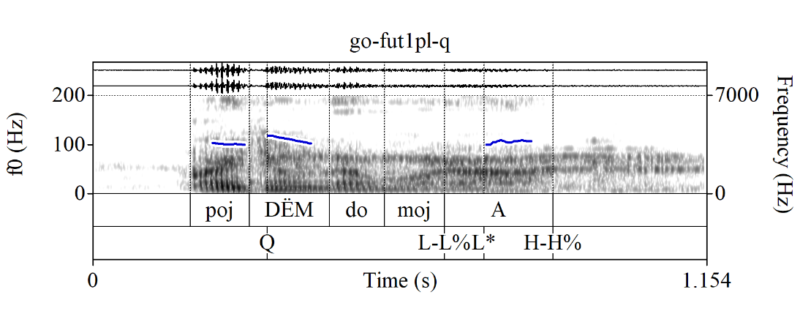
Q-Peak in requests: FUT.1PL
FUT.1PL (also, sometimes PAST, but let’s not go there) Q-Peak-marked declarative string “questions” (?) used as joint action requests (one could also say “suggestions”, but these “suggestions” are not non-committal!):
(16) Vy_{Q}pjem glintvejna_{L-L%}?
drink.FUT.1PL mulled-wine.PART
‘Let’s drink mulled wine[, shall we]?’
(17) Pojdёm_{Q} domoj_{L-L%}, a_{L* H-H%}?
go.FUT.1PL home PRT
‘Let’s go home, shall we?’ (MURCO)

Slide 18
Intro
Q-Peak in questions
Q-Peak in requests
No Q-Peak in suggestions
What does the Q-Peak do?
Outro

Slide 19
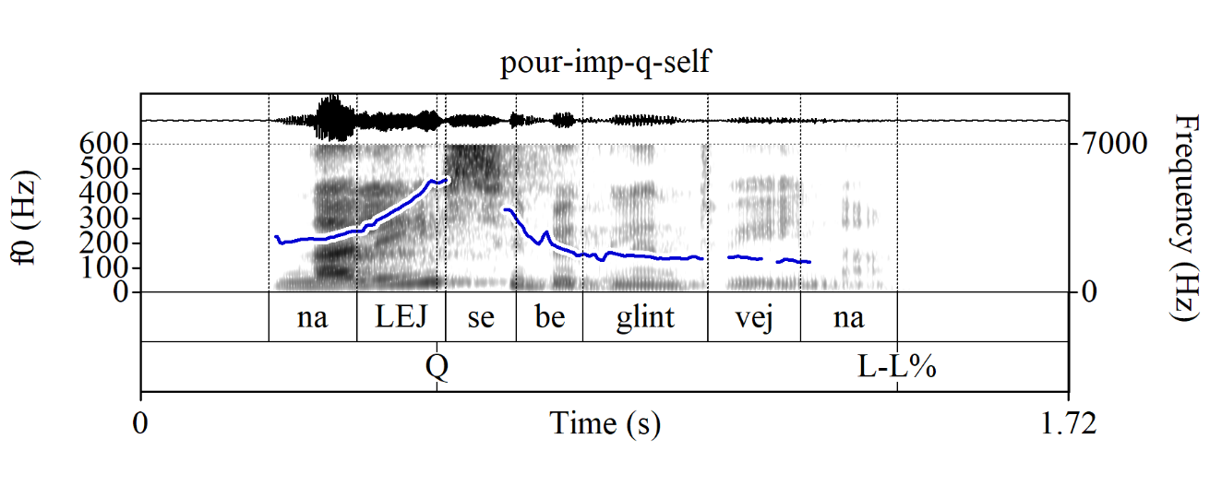
No Q-Peak in suggestions
The Q-Peak cannot be used in non-committal suggestions in Russian:
(18) A: ‘What should I do to relax?’
B: # Nalej_{Q} sebe glintvejna_{L-L%}?
pour.IMP.2SG/T self.DAT mulled-wine.PART
Intended: ‘Pour yourself mulled wine? [But I don’t really care.]’

Slide 20
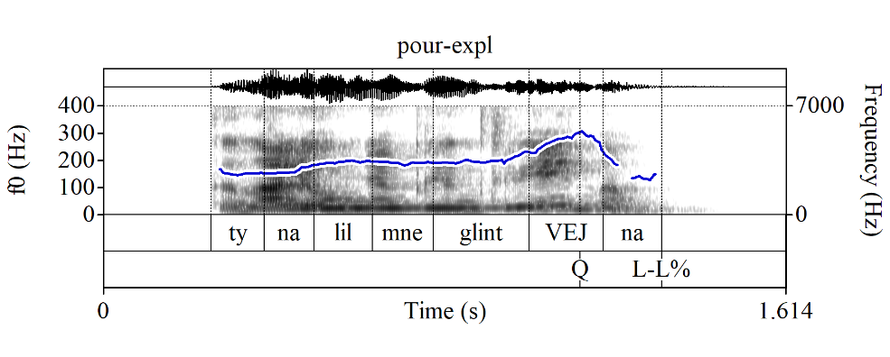
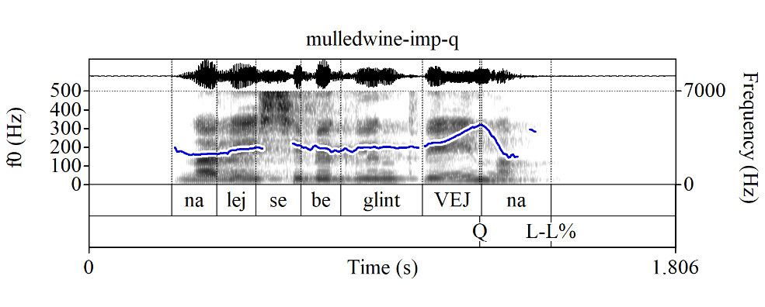
No Q-Peak in suggestions
Note that this is not an issue of where the Q-Peak goes, i.e., where the focus is
Russian declarative string YNQs can also be produced with a sentence-level Q-Peak when they are what Esipova & Romero (2023) call explanation-seeking questions (biased, but still info-seeking):
(19) Context: We’re having dinner. I stepped away to go to the bathroom and come back to a glass of mulled wine next to my plate. I am asking what the explanation for this is:
Ty nalil mne glintvej_{Q}na_{L-L%}?
you.SG/T.NOM pour.PAST.SG.M me.DAT mulled-wine.PART
‘[What is the explanation for this?]
Did you pour me mulled wine?’
Yet, a sentence-level Q-Peak still can't be used in non-committal suggestions. In fact, imperatives with a sentence-level Q-Peak sound straight-up odd:
(20) # Nalej sebe glintvej_{Q}na_{L-L%}?
pour.IMP.2SG/T self.DAT mulled-wine.PART
Intended: ‘Pour me mulled wine?’

Slide 21
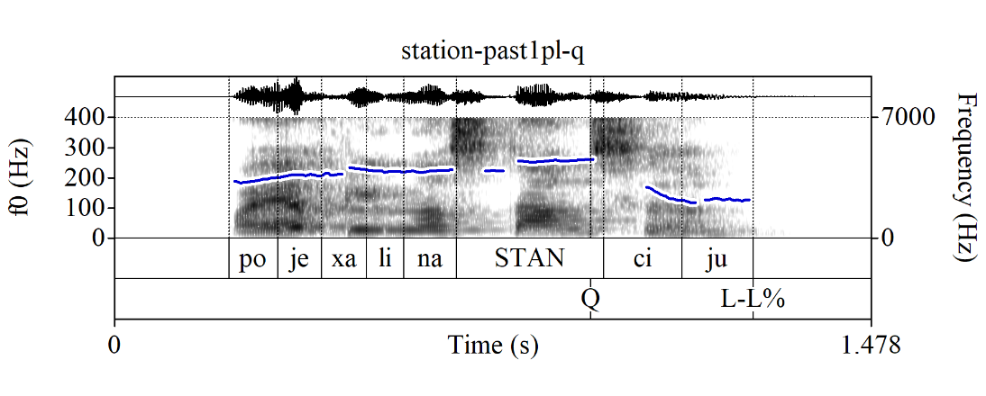
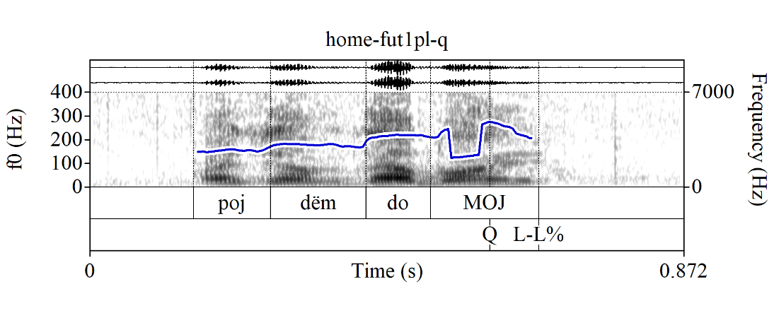
1PL joint action requests with sentence-final focus
Unlike imperative requests, (some) 1PL joint action requests can be used with a sentence-level Q-Peak (indicating a sentence-level focus, which, I imagine, signals an implicit ‘What should we do next?’ parent QUD), but they still don’t have the non-committal suggestion interpretation, i.e., they are still friendly, but invested joint action requests:
(21) Poexali na stan_{Q}ciju_{L-L%}?
go.PAST.PL on station.ACC
‘Let’s go to the station[, shall we?]’
(22) Pojdёm domoj_{Q L-L%}?
go.FUT.1PL home
‘Let’s go home[, shall we?]’ (MURCO)

Slide 22
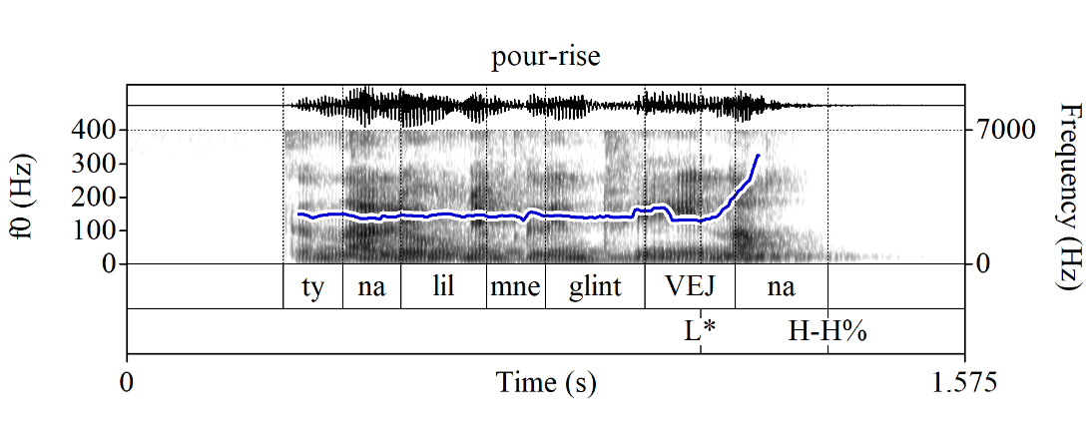
Rising contour in suggestions
OK then, but how do we make non-committal suggestions in Russian?
Russian does have English-style rising declaratives, albeit w/a more limited range of uses:
(23) Ty nalil mne glintvej_{L*}na_{H-H%}?
you.SG/T.NOM pour.PAST.SG.M me.DAT mulled-wine.PART
‘You poured me mulled wine?’
There is some overlap in uses between Q-Peak-marked explanation-seeking YNQs like (21) and rising declaratives like (23), but there are also some differences—e.g., only the latter can be used as an echo question in response to ‘I poured you mulled wine’ (same for the English translations)

Slide 23
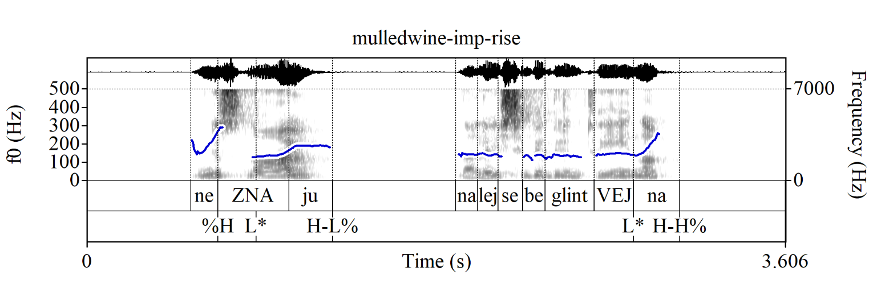
Rising contour in suggestions
Can we use this rising contour in non-committal suggestions, e.g., with imperatives?
🤷‍♀️
I can somewhat accept them, but it might be an influence from English; I haven’t found any exx like this in the MURCO corpus yet (but such suggestions seem in general uncommon, unlike requests)
(24) A: ‘What should I do to relax?’
B: Ne znaju… ? Nalej sebe glintvej_{L*}na_{H-H%}?
NEG know.PRS.1SG pour.IMP.2SG/T self.DAT mulled-wine.PART
‘I don’t know… Pour yourself mulled wine?’

Slide 24
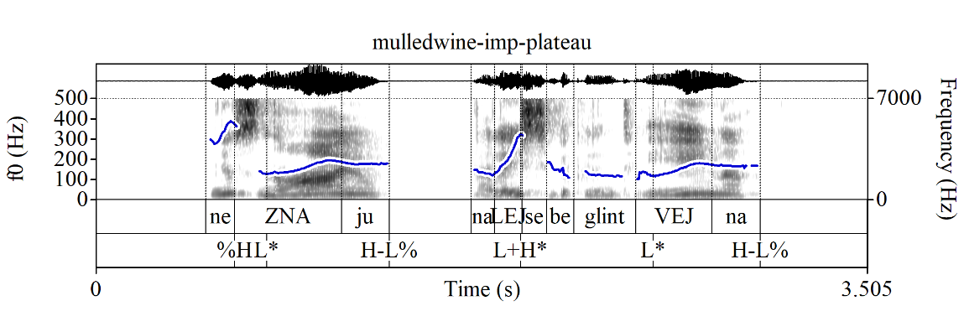
Plateau contour in suggestions
A more natural way to produce such non-committal suggestions is with a mid-plateau contour:
(25) A: ‘What should I do to relax?’
B: Ne zna_{L*}ju_{H-L%}…
NEG know.PRS.1SG
Nalej sebe glintvej_{L*}na_{H-L%}...
pour.IMP.2SG/T self.DAT mulled-wine.PART
‘I don’t know… Pour yourself mulled wine...’
(26) Nu ty tam svari_{L+H*}
well you.SG/T.NOM there boil.IMP.2SG/T
kakuju-nit’ ka_{L*}šu, čto li, sebe_{H-L%}...
some.ACC porridge.ACC WHAT PRT self.DAT
‘Well, make yourself some porridge or something...’ (MURCO)
NB: These are even more “disinterested” than rising suggestions—cf. plateaus in “disinterested lists” (Beckman & Ayers 1997), “calling contour” imperatives in English (Jeong & Condoravdi 2017)

Slide 25
Intro
Q-Peak in questions
Q-Peak in requests
No Q-Peak in suggestions
What does the Q-Peak do?
Outro

Slide 26
A few more relevant facts
Li YNQs—which, remember, do not have a Q-Peak—don’t seem to (explicitly) require a move from the addressee, but declarative string, Q-Peak-marked YNQs do (Esipova & Korotkova 2023):
Li YNQs often sound more polite and/or formal:
(27) Context: On a formal medical questionnaire.
a. Ku_{L+H*}rite li vy_{L-L%}? b. ? Vy ku_{Q}rite_{L-L%}?
smoke.PRS.2PL/V Q-PRT you.NOM.PL/V you.NOM.PL/V smoke.PRS.2PL/V
‘Do you smoke?’
Li YNQs, but not declarative string YNQs are good as conjectural questions (cf. Eckardt 2020):
(28) a. Xm, jest’_{L+H*} li žizn’ na drugix planetax_{L-L%}?
hm be.PRS.3SG Q-PRT life.NOM on other.PREP planets.PREP
b. # Xm, na drugix planetax jest’_{Q} žizn’_{L-L%}?
hm on other.PREP planets.PREP be.PRS.3SG life.NOM
Bylo b neploxo uznat’…
be.PAST.SG.N SUBJ not-bad.ADV learn.INF
‘Hm… Is there life on other planets[, I wonder]? Would be nice to know…’

Slide 27
Meaning components of questions
Some of the meaning components that a question can have (and mark on the surface):
Creating a partition; in YNQs: {p, ¬p} (e.g., {‘You poured me mulled wine’, ¬‘You poured me mulled wine’})
Raising an issue wrt that partition (“putting it on the table”; indicating that this partition is relevant for the current discourse)
Focus, signaling how this issue fits into a larger discourse structure, specifically, its parent QUD (e.g., ‘What is the truth value of p?’; ‘What is the explanation for s?’; ‘Who called Nina?’)
Asking for a move from the addressee, namely, to respond to this issue
1–2 appear to be core components of what we routinely call “questions”; 3 is not intrinsic to questions, but still has to be expressed in questions; 4 seems optional (cf. Russian li YNQs, conjectural and self-addressed questions, etc.)
NB: There are also, e.g., different types of bias, but let’s set that aside

Slide 28
What does the Q-Peak do?
Combining the data about:
Q-Peak-marked requests (move required) vs. #non-committal suggestions (no move required), and
Q-Peak-marked declarative string YNQs (move required) vs. Q-Peak-less li YNQs (no move required)
I propose that the Russian Q-Peak realizes component 3, i.e., focus (by virtue of being the main prominence of the utterance) and component 4, i.e., asking for a move from the addressee (the shape of the Q-Peak itself)

Slide 29
What does the Q-Peak do?
For canonical declarative string Q-Peak-marked YNQs, two possibilities then:
Silent operator(s) contributing components 1 and 2 (creating a partition & raising an issue wrt it)
Coercion into an issue-raising interpretation that is not syntactically represented
For FUT.2/1SG/1PL Q-Peak-marked requests that have the same form as declarative string YNQs, same analysis (?) + further pragmatic reasoning (cf. Could you pass me the salt?)
For imperative Q-Peak-marked requests: a coercion-based analysis seems more reasonable (e.g., you coerce an issue wrt partition {‘You’ll pour me mulled wine’, ¬‘You’ll pour me mulled wine’}, and the Q-Peak asks the addressee to respond to this issue, which is less imposing than a regular imperative)
For li YNQs:
Component 4 (asking for a move) is not present
Component 3 (focus): marked via regular prosodic focus marking
Li realizes some combination of 1 and 2 (creating a partition and raising an issue wrt it); etymologically li is part of ili (‘or’) and libo (‘or’; free choice)—it’s ostensibly a “join quantifier particle” in the sense of Szabolcsi 2015
The role of fronting: ? (3? 1 and/or 2? All of the above?)

Slide 30
What about the other languages?
English:
Auxiliary inversion in regular YNQs likely realizes some combination of components 1 and/or 2
The rising tune? R(&R): “rising intonation is calling off the speaker’s commitment to their utterance, proffering a course of action for the addressee without throwing the speaker’s weight behind them pursuing it” (presumably has the same role in Russian)
Thus, different source of politeness/tentativeness in English-style rising imperatives (you “call off the commitment”) vs. Russian Q-Peak-marked imperatives (you turn your imperative into an issue that you ask the addressee to respond to)
Bulgarian: like English, except components 1 and/or 2 are realized by the li particle
Macedonian: IDK, but perhaps:
The rising tune has been conventionalized to realize operators contributing components 1 and/or 2 (creating a partition and raising an issue wrt it)
Partition-creating/issue-raising operators cannot combine with imperatives (which is why we might want the coercion-based analysis for Russian Q-Peak-marked imperatives)
Li does something additional, not just components 1 and/or 2 (R&R suggest focus in Macedonian li YNQs has an emphatic interpretation, not regular focus like in Russian)

Slide 31
Intro
Q-Peak in questions
Q-Peak in requests
No Q-Peak in suggestions
What does the Q-Peak do?
Outro

Slide 32
Outro
Take-home points:
In Russian, in neutral matrix YNQs, we systematically realize the ‘asking for a move’ component—unlike in English (and arguably Bulgarian and Macedonian?)—via the Q-Peak
The Q-Peak can also be used in requests, including imperative requests, making them more polite/friendly—by turning smth that would by default be a command into an issue and asking the addressee to respond to it
The Q-Peak cannot be used in non-committal suggestions, because in those, we don’t want to ask the addressee to make a move
The Q-Peak is different from the rising tune in English and Bulgarian (and to some extent, Russian), which “calls off the speaker’s commitment” and can, thus, be used to turn declaratives into “non-canonical” YNQs and imperatives into either unimposing requests or non-committal suggestions
It appears that the rising tune has a different use in Macedonian, possibly conventionalized to realize the ‘partition-creating’ and/or ‘issue-raising’ components
Future research:
Look at more languages
Do a more thorough empirical investigation of Bulgarian and Macedonian than in R&R

Slide 33
Thanks!
Questions? Requests? Suggestions?

Slide 34
References
Beckman, Mary E. & Gayle Ayers. 1997. Guidelines for ToBI labelling. Version 3.0. The Ohio State University Research Foundation.
Eckardt, Regine. 2020. Conjectural questions: The case of German verb-final wohl questions. Semantics and Pragmatics 13(9). 1–54. doi:10.3765/sp.13.9
Esipova, Maria & Natasha Korotkova. 2023. To li or not to li. Upcoming talk at Formal Description of Slavic Languages (FDSL) 16, University of Graz.
Esipova, Maria & Maribel Romero. 2023. Prejacent truth in rhetorical questions. Ms.
Jeong, Sunwoo. 2018. Intonation and sentence type conventions: Two types of rising declaratives. Journal of Semantics 35(2). 305–356. doi:10.1093/semant/ffy001
Jeong, Sunwoo & Cleo Condoravdi. 2017. Imperatives with the calling contour. In Proceedings of the 43rd Annual Meeting of the Berkeley Linguistics Society (BLS 43), 185–209.
Meyer, Roland & Ina Mleinek. 2006. How prosody signals force and focus—A study of pitch accents in Russian yes–no questions. Journal of Pragmatics 38(10). 1615–1635. doi:10.1016/j.pragma.2005.05.011
Rudin, Catherine & Deniz Rudin. 2022. On rising intonation in Balkan Slavic. Journal of Slavic Linguistics (FASL 29 extra issue) 30. 1–10. http://ojs.ung.si/index.php/JSL/article/view/88
Rudin, Deniz. 2018. Rising above commitment: University of California, Santa Cruz dissertation.
Szabolcsi, Anna. 2015. What do quantifier particles do? Linguistics and Philosophy 38. 159–204. doi:10.1007/s10988-015-9166-z

