Slide 1
Language acquisition
Language LING UA 1, NYU, Summer 2018
Masha Esipova & Yining Nie
based on the slides by Ailís Cournane for Language and Mind LING-UA 3 at NYU in Fall 2016
and the slides by Dunja Veselinović for Language LING-UA 1 at NYU in Summer 2016

Slide 2
What is language acquisition?
Learning theories
Stages of language acquisition
Child errors
Language emergence
What you need to know

Slide 3
What is language acquisition?
Language acquisition is:
broadly speaking, the process of humans learning a language:
L1 acquisition—We’ll only talk about this one, so for us language acquisition = L1 acquisition.
L2 acquisition
the subfield of linguistics that studies language acquisition

Slide 4
What is language acquisition?
Major questions that acquisitionists are trying to address:
How do we go from pre-linguistic infants to linguistically proficient adults?
What are the development pathways? Do they differ across languages, across children?
What learning mechanisms/abilities do children rely on? Imitation? Analogy? Statistical Learning? Innate knowledge?
What are the milestones of development in the different levels of language (phonetics, phonology, morphology, syntax, semantics, pragmatics)?
How can we explain infant and child development?

Slide 5
What is language acquisition?
Language acquisition is species specific:
Language cannot be taught to other species. Other apes can be taught individual words or signs, but they never attain the same level of productivity as humans.
Humans are biologically equipped to learn language:
Young infants process speech sounds differentially from other sounds.
Any typically developing human child can acquire any human language.
The developmental milestones (e.g., babbling, first words, etc.) are uniform in our species, unaffected by the culture or the language learned.
Language acquisition is automatic (unlike acquisition of other skills, such as spelling, math, or riding a bike).
But! Unlike walking or vision, social transmission is required for language. We cannot acquire a language without being exposed to one.

Slide 6
What is language acquisition?
Learning theories
Stages of language acquisition
Child errors
Language emergence
What you need to know

Slide 7
Learning theories
What learning mechanisms do children rely on to learn language?
The Imitation Hypothesis: learning via caregiver imitation
“If we will observe how children learn languages we shall find that (…) people ordinarily show them the thing (…) and then repeat to them the name.” (John Locke, 1690)
Language is seen as an entirely learned behavior, the child as a passive recipient, tabula rasa, an imitator.
This hypothesis is thus behaviorist in nature.
Does this sound right to you? Why or why not?

Slide 8
Learning theories
Some support for this hypothesis:
Children whose mothers are more responsive show more rapid language growth.
Reinforcement and incremental shaping can dramatically improve language skills in atypical language populations.
The input (the language data the child hears, primarily from caregivers) is critical in language acquisition. Why can we say this with certainty?
But!

Slide 9
Learning theories
The input children get is really bad:
noisy
incomplete:
finite set of output utterances
positive evidence only—no or very few ungrammatical utterances, so how do children come to know what’s ungrammatical?
Poverty of the stimulus: given the relatively limited data available to children learning a language, language should be unlearnable.

Slide 10
Learning theories
Children produce constructions that are not in the input; these are innovative as the child’s grammar creatively constructs them. This cannot be imitation. For example:
CHILD: Want other one spoon, Daddy.
ADULT: You mean, you want the other spoon.
CHILD: Yes, I want other one spoon, please Daddy.
ADULT: Can you say “the other spoon”?
CHILD: Other… one… spoon.
ADULT: Say “other”.
CHILD: Other.
ADULT: “Spoon”.
CHILD: Spoon.
ADULT: “Other… spoon”.
CHILD: Other… spoon. Now give me other one spoon.

Slide 11
Learning theories
Maybe when parents correct their children, children learn?
CHILD: He bringed doggy.
ADULT: You mean he brought the doggy.
This doesn’t happen very often at all.
CHILD: It doing dancing.
ADULT: Yes, it’s dancing.
This is recasting (repeating what the child said, and if the child’s utterance is ungrammatical, restating it correctly).
One study found that mothers recast only about 25% of ungrammatical utterances. Even better—grammatical ones are recast just as often.
Parents are more likely to correct the content than the form.
CHILD: Daddy come on Tuesday.
ADULT: No, he comes on Wednesday.

Slide 12
Learning theories
But even when adults do try to correct the form, it often fails.
CHILD: Nobody don’t like me.
ADULT: No, say “Nobody likes me”.
CHILD: Nobody don’t like me.
ADULT: No, say “Nobody likes me”.
CHILD: Nobody don’t like me.
ADULT: No, say “Nobody likes me”.
CHILD: Nobody don’t like me.
[dialogue repeated five more times]
ADULT: Now listen carefully, say “Nobody likes me”.
CHILD: Oh! Nobody don’t likes me.

Slide 13
Learning theories
The Innateness Hypothesis (a.k.a the Nativist Hypothesis): the human species is genetically equipped with a Universal Grammar, the basic blueprint all human languages follow.
The child interacts with the data, and actively builds their grammar. The child is not a tabula rasa.
This hypothesis, proposed by Noam Chomsky, thus rejects behaviorism.

Slide 14
Learning theories
It is common for the proponents of the Innateness Hypothesis to also posit the existence of a critical period in language acquisition, i.e., the window of opportunity during childhood for acquiring a native language.
There is no consensus on when the critical period ends; also, it’s more of a gradient notion (the more you go on without any linguistic input, the lower the level of linguistic competence you can attain).
Can you think of any evidence supporting the existence of a critical period in language acquisition?

Slide 15
What is language acquisition?
Learning theories
Stages of language acquisition
Child errors
Language emergence
What you need to know

Slide 16
Stages of language acquisition
Acquiring sounds
From birth: reflexive crying & vegetative sounds
6–12 weeks: cooing & laughter
16–30 weeks: vocal play (consonant-like sounds and vowels combined), onset of babbling
6–10 months: canonical babbling (true syllables)
10 months and older: variegated babbling, inventory expansion, emergence of protowords

Slide 17
Stages of language acquisition
The babbling stage (6–10 months)
https://youtu.be/_JmA2ClUvUY
Why do infants go [bɑbɑ], [wɑwɑ], [gugu], etc.? Why not [ʤɑɹʤɑɹ]? (No infant goes [ʤɑɹʤɑɹ].)
CV syllables are universally preferred.
Babies’ tongues are too big for their mouths, and they have no fine motor skills.
Stops form 85% of the language input.
The 12 most frequent consonants in the world’s languages ([p, t, k, s, b, d, g, h, m, n, w, j]) make up 95% of the consonants infants use at this stage.

Slide 18
Stages of language acquisition
The sounds produced at the earlier stages of sound acquisition:
are the same for all (hearing) babies in all languages
consist of phonemes and syllable patterns that are most common across languages, and
include sounds that do not occur in the language of the household (for example, Arabic doesn’t have [p], but babies born in an Arabic-speaking environment would produce [p])
Does this support or contradict the Innateness Hypothesis?
Hypothesis: children know what possible sounds of human language are before they figure out which of those their native language uses.

Slide 19
Stages of language acquisition
How do we test this hypothesis? We can’t just ask babies for judgements. Instead:
Naturalistic approach: observe and record children’s spontaneous utterances
Experimental approach: design tasks to elicit a particular kind of linguistic behavior or a behavioral response to linguistic stimuli

Slide 20
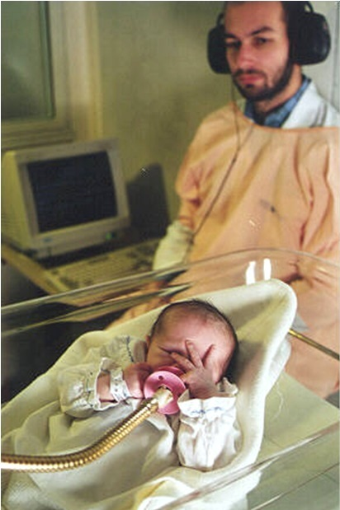
Stages of language acquisition
High Amplitude Sucking (HAS) method:
Used with infants up to 6 months old.
Each suck on the pacifier generates a sound.
Test:
The infant sucks to hear the input (e.g., [ba]) until it gets bored and stops sucking.
The experimenter plays new input (e.g., [ba] or [pa]) to see if the infant starts sucking again (no longer bored, recognizes it as new, wants to hear more) or not (still bored, doesn’t make the distinction).
HAS data: infants make the distinctions not used in their language until they are 6–10 months.

Slide 21
Stages of language acquisition
But why do babies babble?
By the time a baby turns 3 months old, its larynx has descended into the throat, opening up the cavity behind the tongue and allowing it to move.
By listening to themselves babble, babies learn how moving their muscles changes the sounds.
Knowing how to produce each sound is a prerequisite for duplicating the speech of their parents.

Slide 22
Stages of language acquisition
Acquiring words
Holophrastic stage (1–2 years): children start producing single word that appears to express thoughts usually expressed by a sentence (mama, cookie, juice, bye).
But they haven’t perfected their phonology yet! These are common processes:
Syllable deletion:
Helicopter [ɛlkat]
Kangaroo [wu]
Cluster reduction:
Stop [tɑp]
From [fʌm]
Substitution:
This [dɪt]
Spoon [bud]

Slide 23
Stages of language acquisition
Bonus cross-modal puzzle
Children acquiring a sign language go through the same stages as with spoken language (given an early input). However, on average, children start using their first signs (6–8 months) earlier than words (~11 months). Why would there be such a difference?

Slide 24
Stages of language acquisition
At the holophrastic stage, children realize that sounds are related to meanings.
And they have some biases in learning new meanings!
Type assumption: new words refer to a type of thing, not a particular thing.
Whole object assumption: new words refer to whole objects, not just their substance, color, or parts.

Slide 25
Stages of language acquisition
How do we know about these biases? From experiments! E.g.:
Layout: pewter tongs, plastic tongs, pewter cup, and plastic cup
Group 1:
The experimenter points at the pewter tongs and says, ‘See the biff. That’s a biff. Can you give me another biff?’
The child picks out the plastic tongs.
Group 2:
The experimenter points at the pewter cup and says, ‘See the biff. That’s a biff. Can you give me another biff?’
Child picks out the pewter tongs.
How would you interpret the results of this experiment?

Slide 26
Stages of language acquisition
Some common errors in vocabulary development:
Overextension: broadening a word’s meaning to a more general one
doggy for dogs, cats, rabbits, all medium-sized animals
quackquack for all birds
Bob for all men in helmets
daddy for all men
Underextension: using the word too restrictively
doggy for labradors and beagles, but not for chihuahuas
flower for roses only
After the child acquires their first 75–100 words, the overextended meanings start to narrow until they correspond to those of the other speakers of the language.

Slide 27
Stages of language acquisition
Acquiring syntax
2-word stage (2–2.5 years): first collocations
no mama, no milk, no pee, mommy sock, mommy juice
Telegraphic stage (2.5–3 years): sentences consisting almost entirely of content morphemes, as functional morphemes are still missing (e.g., in English: omitted subjects, determiners, subject-verb agreement, etc.)
Salt all shut. Milk all gone. Kitty down there.
Complex syntax (3 years +): utterances of increasing length and syntactic complexity (functional elements, coordination and subordination, etc.)
Where that ball that I got? I let it go 'cos it hurted me. Tell me what it's called.

Slide 28
Stages of language acquisition
Comprehension-production asymmetry
Children understand more than they produce, in all domains and at all developmental stages.
At 18 months, typically infants produce only about 50 words, but they understand over 250.
Toddlers who consistently produce [su] for ‘shoe’ know that the adult target is [ʃu].
Children who produce no or almost no instances of long distance questions (Where did Billy say that he fell?) nonetheless interpret them in an adult-like way.
Once again, the evidence comes from experiments: https://youtu.be/EFlxiflDk_o?t=5m27s

Slide 29
What is language acquisition?
Learning theories
Stages of language acquisition
Child errors
Language emergence
What you need to know

Slide 30
Child errors
There are two classes of errors made by children in production:
Errors of omission: omission of obligatory morphemes, particularly of function words; word order is preserved; very common early on with gradual resolution.
Daddy go [= Daddy goes]
Want play with teddy [= I want to play with the teddy]
Errors of commission: erroneous modification or addition; less common than one might expect.
Him eat [He eats]
brang [brought]
I’ll play behind dinner [= I’ll play after dinner]
Errors of overgeneralization (when a rule is applied to its exceptions) are a subtype of errors of commission.
goed [went]
singed [sang]

Slide 31
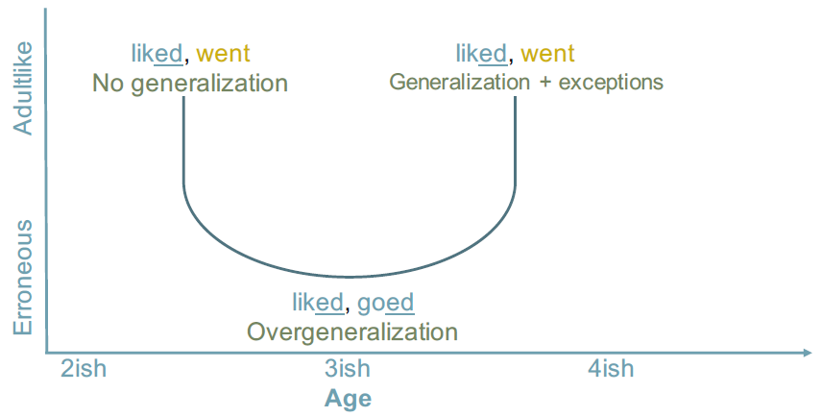
Child errors
The development of regular rules, like regular plurals or regular past tense marking, follows a pattern of U-shaped development:
Initially children learn by rote, both regular and exceptional forms. E.g., they don’t know that liked is bimorphemic.
Performance on exceptions drops when children have learned and generalized a past tense rule across verbs, applying it to exceptions.
Children learn exceptions to the rule.

Slide 32
What is language acquisition?
Learning theories
Stages of language acquisition
Child errors
Language emergence
What you need to know

Slide 33
Language emergence
So, the Innateness Hypothesis says that children aren’t born as tabula rasa but are biologically predisposed for language.
One of the strongest pieces of evidence supporting that claim is that children not only innovate within the language they are acquiring, they create new languages!

Slide 34
Language emergence
Nicaraguan Sign Language (Idioma de Señas de Nicaragua)
Before 1970s: No schools for Deaf, no sign language in Nicaragua. Deaf children and adults were isolated from one another, usually interacting almost exclusively with hearing people via home sign systems and gesture.
Late 1970s: The first school for Deaf children opens in Managua. The first generation of Deaf children (age 10 and higher) arrives and starts creating a pidgin-like system based on their home sign systems and gesture.
Younger children (age 4–5) continued to join the school. They regularized the pidgin of the first generation, made it more complex: Idioma de Señas de Nicaragua, a fully expressive language with its own grammar, was born.
1986: Judy Kegl and other linguists arrived in Nicaragua and documented the communication systems used by the first and the second generations.
A video, if we have time: https://youtu.be/GTb9uVVx20Y
Take away: children are predisposed to grammaticalize and impose systematic structure on linguistic elements.

Slide 35
What is language acquisition?
Learning theories
Stages of language acquisition
Child errors
Language emergence
What you need to know

Slide 36
What you need to know
Key notions: language acquisition, L1 vs. L2 acquisition, the Imitation Hypothesis, behaviorism, poverty of the stimulus, recasting, the Innateness/Nativist Hypothesis, Universal Grammar, critical period, stages of language acquisition (babbling, holophrastic, telegraphic, etc.), naturalistic vs. experimental approach, type assumption and whole object assumption, overextension and underextension, comprehension-production asymmetry, types of child errors (omission, commission, overgeneralization), U-shaped development, home sign, pidgin
Answers to the following questions:
What is the gist of the two main learning hypotheses we discussed? Which one seems more plausible? Why?
What are the major stages of language acquisition (their approximate onsets and characteristic features)?
What does the story of how Nicaraguan Sign Language emerged tell us about language?

