Slide 1
Sign language linguistics
Language LING UA 1, NYU, Summer 2018
Masha Esipova & Yining Nie
partially based on the slides by Jeremy Kuhn
for Language LING-UA 1 at NYU in Summer 2014

Slide 2
What is sign language?
Sign language phonetics
Sign language phonology
Non-segmental non-manual markers
Sign language morphology
Sign language syntax
Pronouns in sign language
Event visibility hypothesis
What you need to know

Slide 3
What is sign language?
Natural language exists in two modalities.
So far we’ve mostly focused on spoken language:
articulators: tongue, lips, teeth, etc.
signal: linear, acoustic waveform
perception: auditory system (ears)
Today we will talk about sign language:
articulators: two hands, face
signal: multidimensional, visual signal
perception: visual system (eyes)

Slide 4
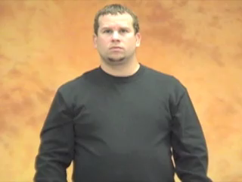
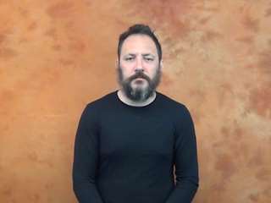
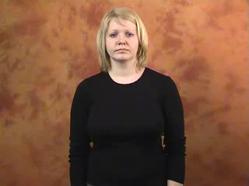
What is sign language?
Let’s burst some myths about sign language.
Myth 1: Sign language is mime.
Sign language does exhibit more iconicity than spoken language, but as in spoken language, words in sign language are often completely arbitrary.
E.g., can you tell what the following signs mean?
ASL: WHERE
LIS: NOT
RSL: WHAT

Slide 5
What is sign language?
Myth 2: There is only one sign language.
There are many Deaf communities around the world, so there are many sign languages (‘Ethnologue’ currently lists 142: https://www.ethnologue.com/subgroups/sign-language).

Slide 6
What is sign language?
Sign languages aren’t all mutually intelligible.
E.g., the pic below shows Dr. Peter Hauser (on the right) presenting in ASL at TISLR 11, simultaneously being translated into English, British Sign Language (on the left), and various other sign languages (across the bottom of the stage).

Slide 7
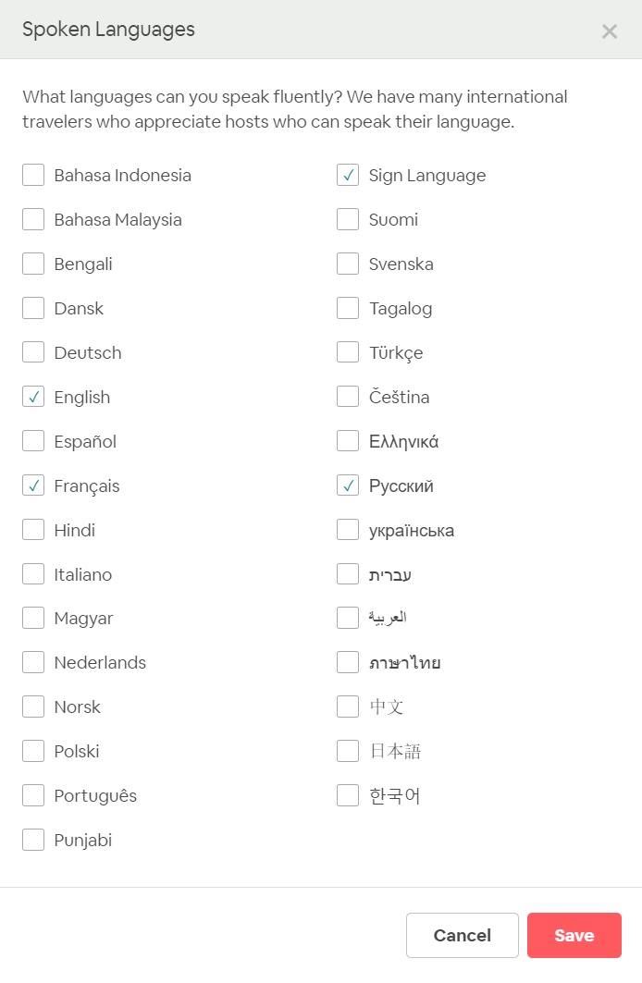
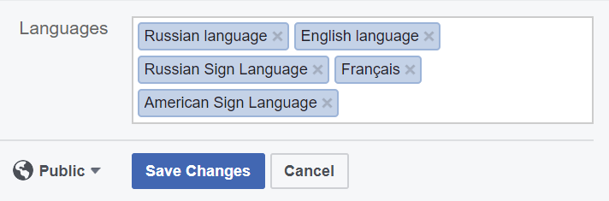
What is sign language?
This is a very persistent myth, though… Shame on you, Airbnb! (Btw, nothing has changed since Jeremy taught this course in 2014.) Good job, Facebook!

Slide 8
What is sign language?
Myth 3: Sign languages are signed versions of spoken languages.
Sign languages are influenced by spoken languages they come in contact with, but as we will see, sign languages have their own grammars.
There exist artificial signed systems that rely on the grammar of this or that spoken language to a varied extent (e.g., Signing Exact English, Signed Russian called калька ‘calque’ by RSL researchers), but those are not natural languages (remember, natural languages emerge spontaneously).
Moreover, sign and spoken languages don’t even have the same geographical distribution, because they have different histories.
E.g., ASL (American Sign Language) and BSL (British Sign Language) are different sign languages (they aren’t even in the same family). ASL is descended from LSF (French Sign Language), so an American signer will understand a French signer better than a British signer.

Slide 9
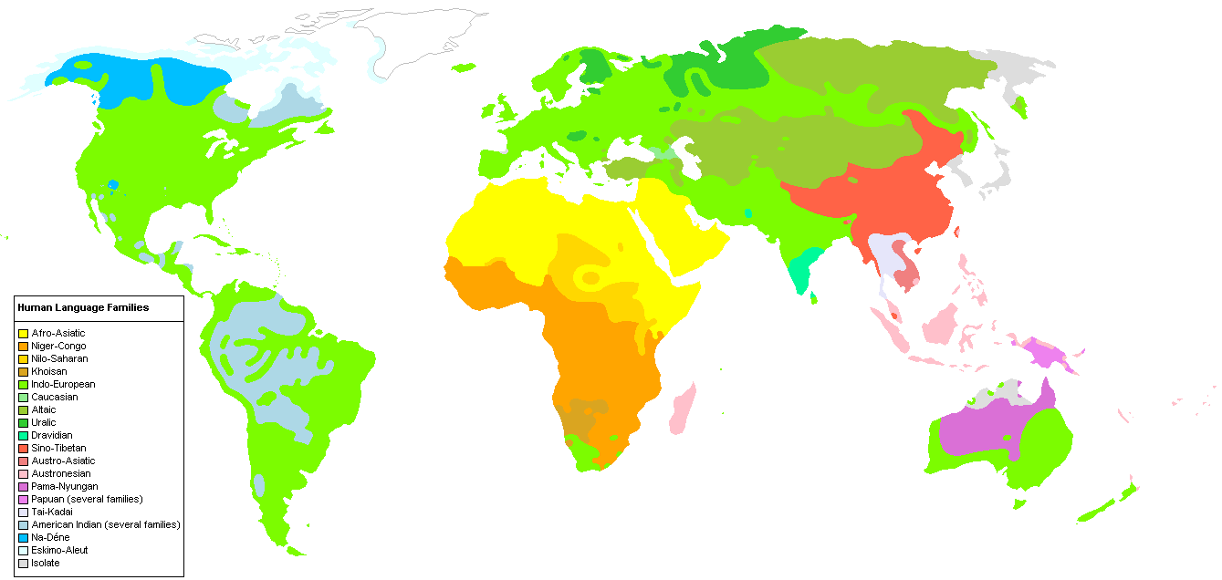
What is sign language?

Slide 10
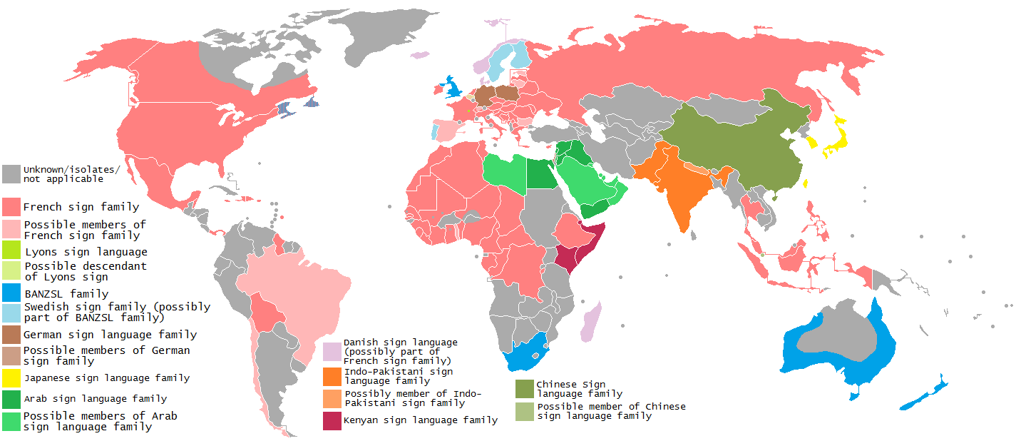
What is sign language?

Slide 11
What is sign language?
So, sign languages are:
natural human languages
that use the visual-kinetic modality
and are primary means of communication in Deaf communities
And sign language is the manifestation of the abstract, cognitive phenomenon that language is in the visual-kinetic modality.
We will now take a look at some grammatical patterns observed in sign language and we will see that:
There is a great deal of similarity between sign and spoken language. So, we can assume the same underlying cognitive system for the two.
But there are differences, too. So, modality matters! Some modality-specific properties of sign language we’ll talk about:
  synchronicity
  use of space
  iconicity

Slide 12
What is sign language?
Sign language phonetics
Sign language phonology
Non-segmental non-manual markers
Sign language morphology
Sign language syntax
Pronouns in sign language
Event visibility hypothesis
What you need to know

Slide 13
Sign language phonetics
Recall the articulatory parameters for spoken language consonants:
place of articulation
manner of articulation
voicing
Here are the articulatory parameters in sign language:
handshape
location
movement
orientation
(mouth gestures)

Slide 14
Sign language phonetics
In spoken language, we can find minimal pairs for each parameter. Here are some from English:
place of articulation: /pæp/, /tæp/, /kæp/
manner of articulation: /dɛd/, /nɛd/, /zɛd/
voicing: /bɪg/, /pɪg/
In sign language, we can also find minimal pairs.

Slide 15
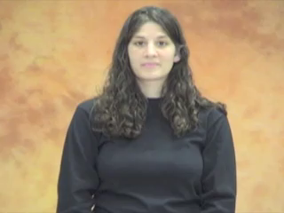
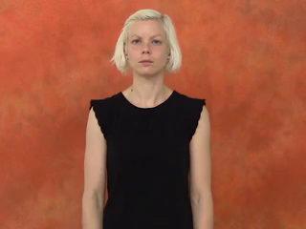
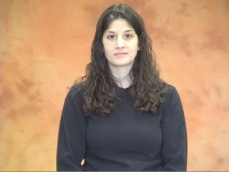
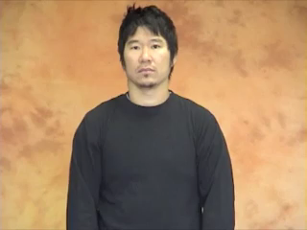
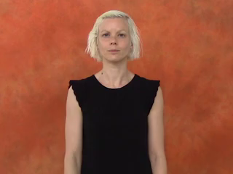
Sign language phonetics
Handshape minimal pairs in ASL:
CANDY
APPLE
TWIN
RESTAURANT
ISRAEL

Slide 16
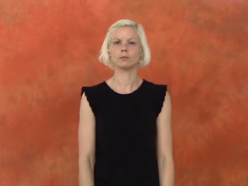
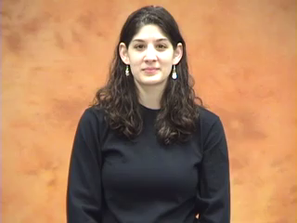
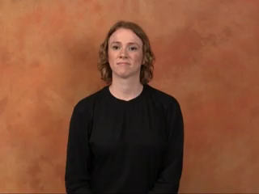
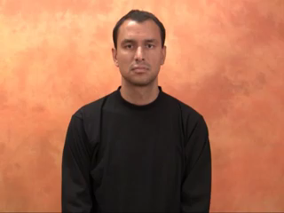
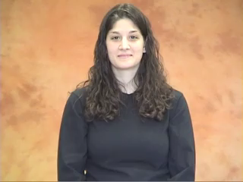
Sign language phonetics
Location minimal pairs in ASL:
FATHER
MOTHER
FINE
DRY
UGLY

Slide 17
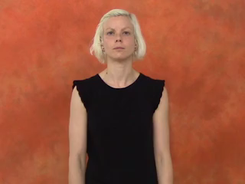
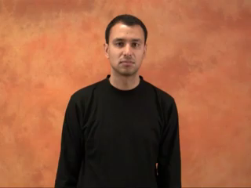
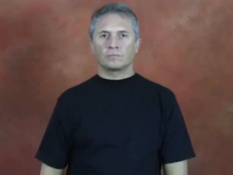
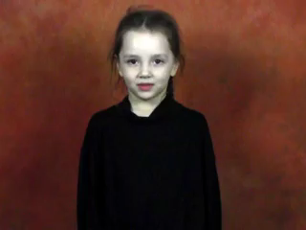
Sign language phonetics
Movement minimal pairs in ASL:
MAKE
COFFEE
And RSL:
MOSCOW
GRANDMA

Slide 18
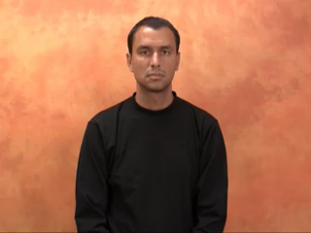
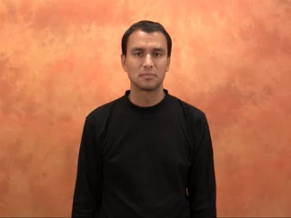
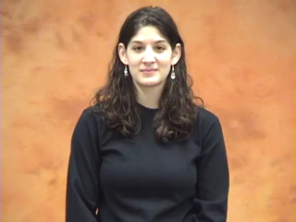
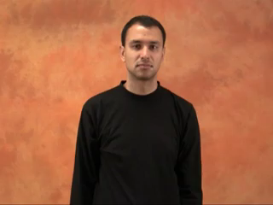
Sign language phonetics
Orientation minimal pairs in ASL:
STARS
SOCKS
NAME
CHAIR

Slide 19
Sign language phonetics
Mouth gestures
Sometimes signs are accompanied with mouthing, the production of visual syllables based on spoken language counterparts (typically reduced). The amount of mouthing differs across sign languages, individual signers, and linguistic contexts (e.g., mouthing accompanies nouns much more often than verbs). A signer can produce a lot of mouthing even without knowing the relevant spoken language.

Slide 20
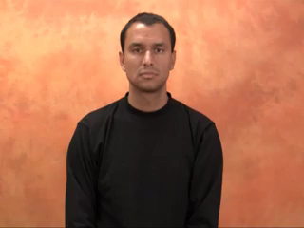
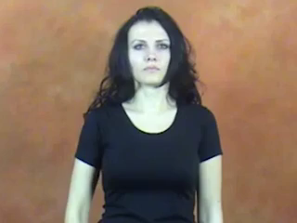
Sign language phonetics
Some mouth gestures do not correspond to anything in a spoken language. Such gestures tend to be obligatory components of signs.
NOT YET
(ASL)
VERY BIG
(RSL)

Slide 21
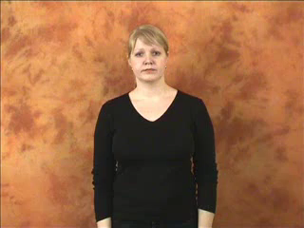
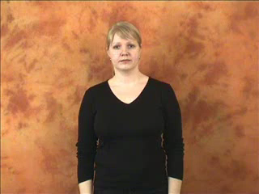
Sign language phonetics
An example of a minimal pair in RSL that is only distinguished by the mouth gesture parameter:
COFFEE
BROWN

Slide 22
Sign language phonetics
There also exist fully non-manual signs in some sign languages.
E.g., in Yoruba Sign Language:
  SURPRISE: a wide-open mouth
  MANY: closing and opening of lips for production of [p] and [o] (based on Yoruba word kpɔ̀ ‘many’)
  WHITE: production of [f] and [u] + show of upper teeth (based on the Yoruba word fũfũ ‘white’)

Slide 23
What is sign language?
Sign language phonetics
Sign language phonology
Non-segmental non-manual markers
Sign language morphology
Sign language syntax
Pronouns in sign language
Event visibility hypothesis
What you need to know

Slide 24
Sign language phonology
To analyze phonological regularities in spoken language, we broke down articulatory parameters into features.
E.g., place = [±coronal], [±velar], [±anterior], [±labial], …
We can do the same with sign language articulatory parameters:
E.g., handshape = [±thumb], [±bent], [±ulnar], [±one], …

Slide 25
Sign language phonology
We have seen an example of a regular phonological process that happens in natural language, assimilation, when a segment becomes similar to an adjacent segment.
E.g., nasal place assimilation in English:
intangible intolerant | /n/ → [n]
impossible implausible | /n/ → [m]
Rule: /n/ → [+labial] / __ [+labial]

Slide 26



Sign language phonology
Assimilation happens in sign language, too.
E.g., handshape assimilation in ASL:
RED + CHOP = TOMATO
THINK + SELF = THINK-FOR-ONESELF
Full assimilation (the whole handshape)
[+one] [−one] [+one] [−one]
[−thumb] [+thumb] [+thumb] [+thumb]
Partial assimilation (only one feature)

Slide 27
What is sign language?
Sign language phonetics
Sign language phonology
Non-segmental non-manual markers
Sign language morphology
Sign language syntax
Pronouns in sign language
Event visibility hypothesis
What you need to know

Slide 28
Non-segmental non-manual markers
We have already seen that non-manuals can be phonemic.
Non-segmental non-manuals have several functions in sign language, e.g.:
grammatical markers (marking negation, clause types, topics, focus, etc.); can be compared to intonation in spoken language:
_hn _________________br
(1 ) IX-a LIKE COFFEE IX-a (2) IX-a LIKE COFFEE IX-a
‘S/he likes coffee.’ ‘Does s/he like coffee?’
adverbial modifiers (slowly, sloppily, etc.); no counterpart in spoken language proper:
_______th
(3) XI-a WRITE (4) IX-a WRITE
‘S/he is writing.’ ‘S/he is writing sloppily.’

Slide 29
What is sign language?
Sign language phonetics
Sign language phonology
Non-segmental non-manual markers
Sign language morphology
Sign language syntax
Pronouns in sign language
Event visibility hypothesis
What you need to know

Slide 30
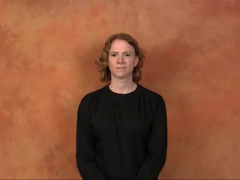
Sign language morphology
We have already seen that sign language can have compounds (e.g., THINK-FOR-ONESELF in ASL).
We have also seen that in sign language you can produce signals with two independent articulators simultaneously (as in non-manual adverbial modifiers).
But, although the two hands are independent articulators, we never see simultaneous, two-handed compounds in sign language.
E.g., in ASL, PARENTS = MOTHER + FATHER, produced in succession, not simultaneously with two hands.

Slide 31
Sign language morphology
However, compounds can consist of a fully non-manual sign and a manual sign produced simultaneously.
E.g., in Brazilian Sign Language:
  SEX: cheek puff
  HOTEL: a manual sign
  TRAVEL: a manual sign
  MOTEL = SEX + HOTEL
  HONEYMOON = SEX + TRAVEL
So, simultaneous morphology is possible in sign language, but it is phonologically constrained.

Slide 32
Sign language morphology
Incorporated numerals are another example of simultaneous morphology in sign language.
E.g., in ASL:
  1, 2, …, 9 + WEEK/MONTH/YEAR/etc. = 1, 2, …, 9 WEEKS/MONTHS/YEARS/etc.
Why can you only incorporate numerals up to 9?
In RSL you can only incorporate numerals up to 5. Why?

Slide 33
What is sign language?
Sign language phonetics
Sign language phonology
Non-segmental non-manual markers
Sign language morphology
Sign language syntax
Pronouns in sign language
Event visibility hypothesis
What you need to know

Slide 34
Sign language syntax
Like spoken languages, sign languages have their own syntactic rules.
E.g., let’s look at some aspects of the syntax of ASL where it’s different from that of English.
One such difference is that ASL allows much more scrambling, i.e., non-obligatory movement. E.g., it’s standardly assumed that the default word order in ASL is SVO, but OSV or SOV orders are also possible due to freer topicalization (in that respect ASL is more like, e.g., Russian):
a. I like coffee. b. %Coffee, I like. c. *I coffee like.
_____br ________br
(6) a. IX-1 LIKE COFFEE b. COFFEE IX-1 LIKE c. IX-1 COFFEE LIKE

Slide 35
Sign language syntax
We have already seen that yes/no questions in ASL don’t involve any movement (they are marked non-manually).
In wh-questions in ASL the wh-phrase is typically on the right (or is sometimes doubled on the left and on the right) and is marked by lowered eyebrows:
___bl
(7) (WHO) LIKE COFFEE WHO
‘Who likes coffee?’
What, do you think, is going on here?

Slide 36
Sign language syntax
We have seen instances of synchronicity in sign language phonetics and morphology.
We have also seen how the hands and the mouth can be used as simultaneous articulators in sign language syntax—remember non-manual adverbial modifiers?
The two hands can also be used as simultaneous articulators in sign language syntax, e.g.:
(8) CAT TABLE LH:CL-FLAT-HOLD
RH:CL-SMALL-ANIMAL-ON-LH
‘A cat is sitting on a table.’

Slide 37
What is sign language?
Sign language phonetics
Sign language phonology
Non-segmental non-manual markers
Sign language morphology
Sign language syntax
Pronouns in sign language
Event visibility hypothesis
What you need to know

Slide 38
Pronouns in sign language
(8) also shows how sign language uses space to iconically represent the spatial relationship between two individuals.
Space is used in a more abstract way in sign language, too.
All studied sign languages use space to establish anaphoric links between pronouns and their antecedents.
In spoken languages pronouns are sometimes ambiguous; he could refer to Harry or Ron (or even someone else we mentioned before):
(9) Harry_{i} told Ron_{j} that he_{i/j/k} is smart.
We use subscripts, or indices, to indicate an anaphoric relation.

Slide 39
Pronouns in sign language
Sign languages can famously disambiguate sentences like (9) by assigning referents to areas of space, called loci (plural of locus), and then pointing back to them.
An example from ASL:
(10) HARRY IX-a TELL-b RON_{b} (IX-b) IX-a SMART
‘Harry_{i} told Ron_{j} that he_{i/*j/*k} [= Harry] is smart.’
(11) HARRY IX-a TELL-b RON_{b} (IX-b) IX-b SMART
‘Harry_{i} told Ron_{j} that he_{*i/j/*k} [= Ron] is smart.’
(NB: I took the name signs for HP characters from here: http://bit.ly/1uZWBhT)

Slide 40
Pronouns in sign language
Pointing to loci in sign language can be used not only to express simple co-reference, but also binding.
In (12) they is bound by every student, because the referent of they co-varies with students:
(12) [Every student]_{i} thinks [he or she]_{i} is smart.
= Every x is such that if x is a student, x is smart.
(13) has the same interpretation as (12):
(13) EVERY STUDENT IX-a THINK IX-a SMART

Slide 41
Pronouns in sign language
Here we have only used indices as a notational convention. They have also been posited as a formal tool to analyze anaphora. But we don’t hear them in spoken language.
The way sign languages use space to encode anaphoric relationships has led some researchers to claim that loci are overt instantiations of indices (although there has been some pushback on/refinement of those claims recently).

Slide 42
What is sign language?
Sign language phonetics
Sign language phonology
Non-segmental non-manual markers
Sign language morphology
Sign language syntax
Pronouns in sign language
Event visibility hypothesis
What you need to know

Slide 43
Event visibility hypothesis
Apart from its synchronicity and use of space, sign language differs from spoken language in how much it relies on iconicity, i.e., similarity between the form of a linguistic expression and its meaning.
There is some iconicity in spoken language. Can you think of any examples?
onomatopoeia: meow, splash, etc.
iconic prosodic modulations (e.g., vowel lengthening, high/low pitch when talking about small/large objects):
(14) The lecture was loooooong.

Slide 44
Event visibility hypothesis
Sign language has plenty of lexical iconicity.
E.g., in ASL: TREE, BIRD, LOOK-AT, etc.
But iconicity also permeates the grammar of the language. For example, the use of space in sign language is often highly iconic.
We will now briefly look at another example of grammatical iconicity in sign language.

Slide 45
Event visibility hypothesis
Telicity is an important property of natural language predicates.
Telic predicates describe events that have a point of culmination:
  e.g., sneeze, swim a mile, fly to Hogsmeade
  are not divisible: if there is an event of Ginny swimming a mile whose runtime is from 10am to 10:10am, it’s not true that there is an event of Ginny swimming a mile whose runtime is from 10am to 10:05am
  (15) Ginny swam a mile in/*for ten minutes.
Atelic predicates describe events that happen over time with no culmination:
  e.g., sleep, swim laps, fly towards Hogsmeade
  are divisible: if Ginny swam laps from 10am to 10:10am, she also swam laps from 10am to 10:05am
  (16) Ginny swam laps for/*in ten minutes.

Slide 46
Event visibility hypothesis
Telicity is a property of predicates, not lexical items (although there can be lexical constraints on telicity).
The same verb can participate both in telic and atelic predicates:
(17) Luna sneezed once. (telic, one punctual event)
(18) Luna sneezed for ten minutes. (atelic, multiple punctual events)
(19) Hermione brew a potion in an hour. (telic, one durative event that reached completion)
(20) Hermione was brewing a potion. (atelic, one durative event that didn’t reach completion)

Slide 47
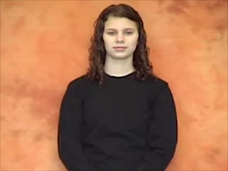
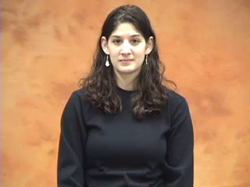
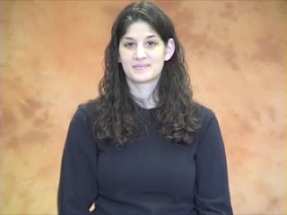
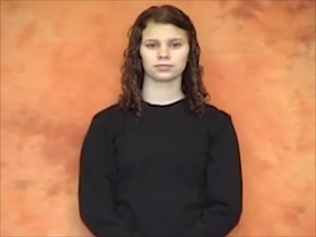
Event visibility hypothesis
Can you guess which of the following ASL predicates are telic and which are atelic? How would you change the telic predicates to coerce them into an atelic interpretation?
DIE
PLAY
WAIT
DECIDE

Slide 48
Event visibility hypothesis
Event visibility hypothesis: in the sign language predicate system, the semantics of the event structure is visible in the phonological form of the predicate sign.
Two components of this hypothesis (there are more):
A phonological path movement maps to the runtime of a durative event.
Each phonological end-point maps to the culmination of a telic event.
How does this hypothesis explain your intuitions about the ASL predicates in the previous slide?

Slide 49
What is sign language?
Sign language phonetics
Sign language phonology
Non-segmental non-manual markers
Sign language morphology
Sign language syntax
Pronouns in sign language
Event visibility hypothesis
What you need to know

Slide 50
What you need to know
Key notions:
languages in two modalities: spoken vs. sign language, modality
sign language-specific phenomena: synchronicity, use of space, iconicity
phonemic parameters of a sign: handshape, location, orientation, movement, mouth gestures, mouthing
linguistic phenomena: assimilation, incorporated numerals, scrambling, anaphora (pronouns and antecedents, indices, co-reference, binding), telicity (telic vs. atelic predicates)
other: non-segmental non-manuals, loci, event visibility hypothesis
Answers to the following questions:
What are some of the most pervasive myths about sign language? How are they false?
What are some examples of phonological constraints on morphological processes in sign language?
What are some examples of ASL syntax being different from English syntax?
Skills:
Given descriptions or pictures/videos of two or more signs, be able to say if they constitute a minimal tuple phonologically, and which parameters are the same/different across them.

