Slide 1
Syntax
Language LING UA 1, NYU, Summer 2018
Masha Esipova & Yining Nie
based on the slides by Dunja Veselinović
for Language LING-UA 1 at NYU in Summer 2016

Slide 2
What is syntax?
Syntactic categories
Syntactic constituency
In-class practice I
Building phrases
In-class practice II
Building sentences
In-class practice III
Embedding
Movement
What you need to know

Slide 3
What is syntax?
Syntax is:
the part of grammar that is responsible for building sentences from smaller units (words and phrases) and represents a speaker’s knowledge about possible sentence structure (which strings of words are well-formed sentences and which aren’t)
the subfield of linguistics that studies this knowledge

Slide 4
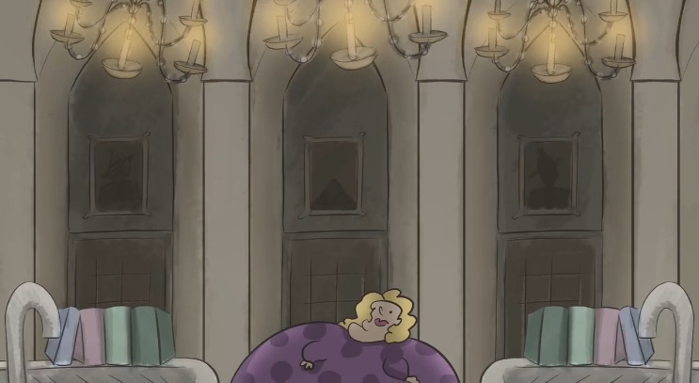
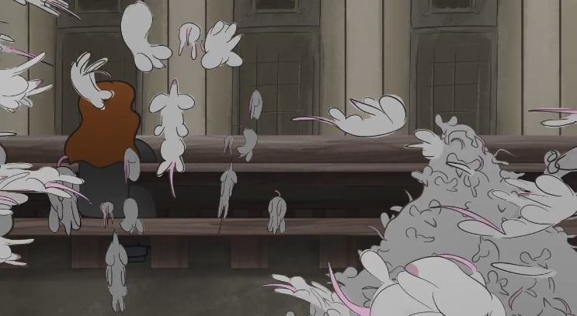
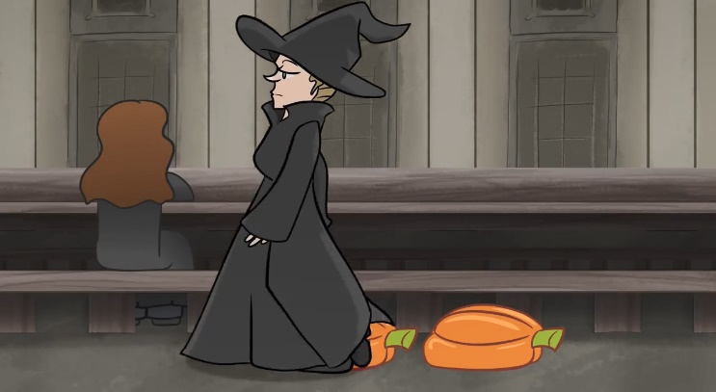
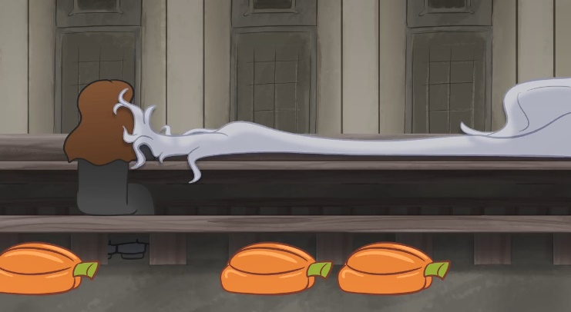
What is syntax?
When is a sentence grammatical?
When it is true?
(1) A triangle has seven sides.
When it makes sense?
(2) The Great Hall was filled with incredible moaning chandeliers and a large librarian who had decorated the sinks with books about masonry. Mountains of mice exploded. Several long pumpkins fell out of McGonagall. Dumbledore’s hair scooted next to Hermione as Dumbledore arrived at school. (‘Harry Potter and What Looked Like a Large Pile of Ash’, http://botnik.org/content/harry-potter.html)
(3) *Me go sleep now.
When it is prescriptively “correct”?
(4) *This is the kind of nonsense up with which we will not put.
(5) I can’t get no satisfaction.

Slide 5
What is syntax?
We build sentences using a mental lexicon and a set of syntactic rules. It is the syntactic rules of a language that determine whether a sentence is grammatical or not.
These rules specify:
how words can be combined into phrases, and phrases into sentences
(6) Nobody is despised who can manage a hippogriff.
(7) *A hippogriff can despised is who nobody manage.
how different combinations of the same words yield different meanings
(8) Ron sees what he eats.
(9) Ron eats what he sees.
If a sentence is grammatical according to this set of rules, we say that it is generated by the grammar.

Slide 6
What is syntax?
Syntactic categories
Syntactic constituency
In-class practice I
Building phrases
In-class practice II
Building sentences
In-class practice III
Embedding
Movement
What you need to know
7

Slide 7
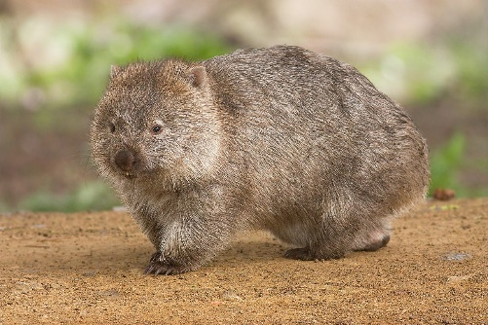
Syntactic categories
In our mental lexicon we store lexical items. Here’s a toy lexical entry for wombat:
The syntactic information that is part of our lexical entries specifies the syntactic category a lexical item belongs to.
wombat | phonology: | /'wɑmˌbæt/
 | syntax: | noun
 | semantics: | {x | x is a wombat}
 | concept:

Slide 8
Syntactic categories
How do we know wombat is a noun? What is a noun?
Noun, v.1: Something that denotes ‘a person, a place, or a thing’
Which of those is jealousy?
Noun, v.2: Something that denotes ‘a person, a place, a thing, a state, an activity, or a quality’
Is this approach to defining a noun a good one? Why?
This definition suggests that you can only determine the syntactic category of a word if you know its meaning.
Also, what category is shame? What about run?

Slide 9
Syntactic categories
For each of the underlined words in the passage below, identify its syntactic category (noun, verb, or adjective) and explain your decision:
‘Twas brillig, and the slithy toves
Did gyre and gimble in the wabe;
All mimsy were the borogoves,
And the mome raths outgrabe.

Slide 10
Syntactic categories
Now identify the syntactic categories of the underlined words in this passage:
Iff ozy Jabberwock sin-son!
Tup kix zi ap, tup kix zu schlatch!
Param li Jubjub klitchu klun
Frum iz la Bandersnatch!

Slide 11
Syntactic categories
We determine the category of a word based on its grammatical distribution:
Syntactic distribution: what kinds of words can precede and follow the word in question
Morphological distribution: what affixes we can add to the word in question and what affixes it already contains
In other words, we focus on structure rather than meaning.
This also captures the fact that, when you learn a new word, you immediately know how to form sentences with it (i.e., you know its grammatical distribution).

Slide 12
Syntactic categories
Nouns (N)
Syntactic distribution:
Can appear after determiners such as the, this, my, every
Can appear after adjectives
Can appear as the subject of the sentence
Can appear as the object of the sentence
Can be negated by no
Morphological distribution:
Inflectional suffixes: plural -s and its allomorphs
Derivational suffixes: -ment, -ness, -ity, -(a)tion, -ism, -ist, -er, -ee, -ship, -hood

Slide 13
Syntactic categories
Important caveat
Distributional tests are diagnostic tests. This means that they only work one way:
If we can add -s to make X plural, X is a noun.
If we can’t add -s to make X plural, X is not a noun.
By that standard, child is not a noun. Neither is linguistics.
We cannot draw conclusions from negative results.

Slide 14
Syntactic categories
Verbs (V)
Syntactic distribution:
Can follow auxiliaries and modals such as will, can, could, should, may, must, be, have
Can follow non-finite to
Can follow subjects
Can follow adverbs such as often and frequently
Can be negated by not
Morphological distribution:
Inflectional suffixes: past tense -ed and its allomorphs, third person singular -s, progressive -ing
Derivational suffixes: -ize, -ate, -ify

Slide 15
Syntactic categories
Adjectives (Adj)
Syntactic distribution:
Can appear between a determiner and a noun
Can follow the copula be
Can be modified by the adverb very
Can be negated by the prefix un-
Morphological distribution:
Inflectional suffixes: comparative -er (or more), superlative -est (or most)
Derivational suffixes: -ive, -able, -al, -ish, -some, -ful, -less

Slide 16
Syntactic categories
It’s not always easy to distinguish between adjectives and verbs:
(10) Ron’s wand was broken.
Some tests:
Seem/remain test
Verbs like seem and remain only go with adjectives, not verbs:
(11) Professor Binns seems boring.
(12) *Professor Binns seems boring the students.

Slide 17
Syntactic categories
It’s not always easy to distinguish between adjectives and verbs:
(10) Ron’s wand was broken.
Some tests:
Seem/remain test
Un- test
Un- + V means ‘reverse V’; un- + Adj means ‘not Adj’:
(13) George’s shoelaces were untied by Fred.
(14) George’s shoelaces remain untied.
By test

Slide 18
Syntactic categories
It’s not always easy to distinguish between adjectives and verbs:
(10) Ron’s wand was broken.
Some tests:
Seem/remain test
Un- test
By test
Adjectives cannot be modified by a by‐phrase, but passivized verbs can:
(15) The Room of Requirement was discovered by Umbridge.
(16) *The Room of Requirement was undiscovered by Umbridge.

Slide 19
Syntactic categories
It’s not always easy to distinguish between adjectives and verbs:
(10) Ron’s wand was broken.
Some tests:
Seem/remain test
Un- test
By test
Very test
Only adjectives can be modified by very:
(17) Professor Binns is very boring.
(18) *Professor Binns is very boring the students.

Slide 20
Syntactic categories
Adverbs (Adv)
Syntactic distribution:
Cannot appear between a determiner and a noun
Cannot follow the copula be
Can be modified by the adverb very
Morphological distribution:
Derivational suffixes: -ly

Slide 21
Syntactic categories
Lexical categories include nouns, verbs, adjectives, and adverbs and are an open class (we can invent new ones).
Functional categories are a closed class; here’s a non-exhaustive list of functional categories:
determiners (D): a(n), the, my, every, most
prepositions (P): on, under, about, through
auxiliaries: have, do, be
modals: might, can, must, may
complementizers: that, whether
connectives: and, or, but

Slide 22
What is syntax?
Syntactic categories
Syntactic constituency
In-class practice I
Building phrases
In-class practice II
Building sentences
In-class practice III
Embedding
Movement
What you need to know
19

Slide 23
Syntactic constituency
When talking about morphology we saw that words have internal hierarchical structure ([[un]do]able vs. un[[do]able]).
Is the same true of sentences, or are sentences just strings of words? What kind of evidence would help you answer this question?

Slide 24
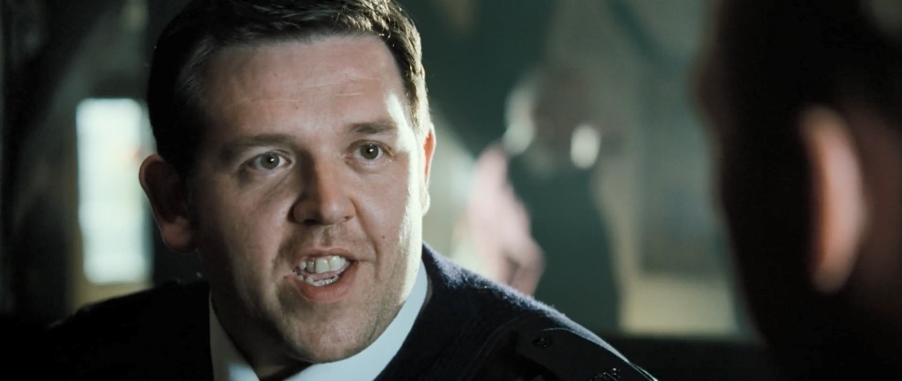
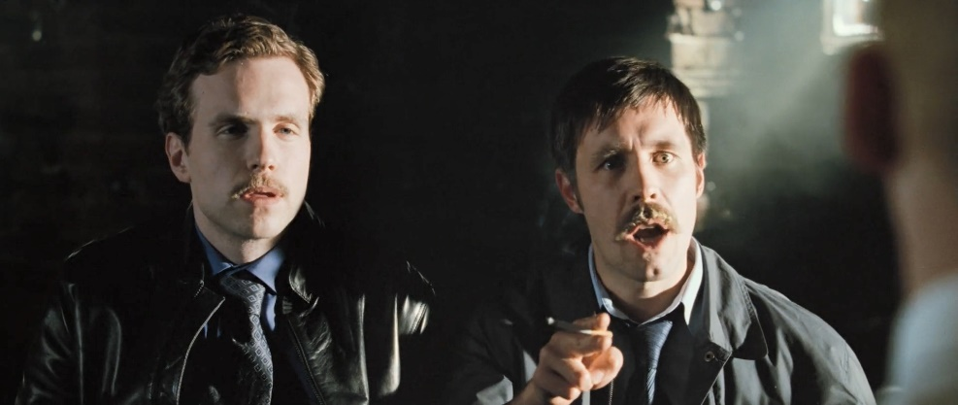
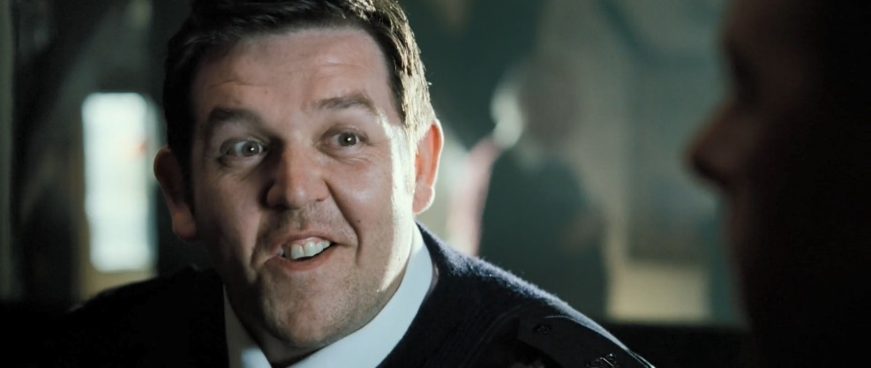
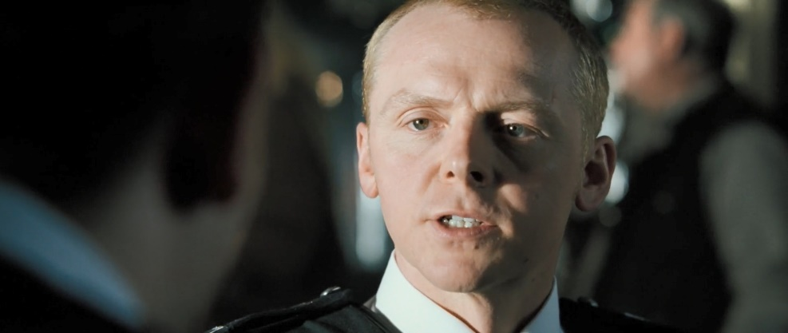
Syntactic constituency
Consider the following exchange from ‘Hot Fuzz’:
Did you shoot anybody?
He shot a crackhead with a Kalashnikov.
Cor! Where did you get that?
The offender had the Kalashnikov.
What makes it funny?

Slide 25
Syntactic constituency
Structural ambiguity:
he [shot [a crackhead with a Kalashnikov]] (Andy’s intended parse)
vs.
he [[shot a crackhead] with a Kalashnikov] (Danny’s parse)

Slide 26
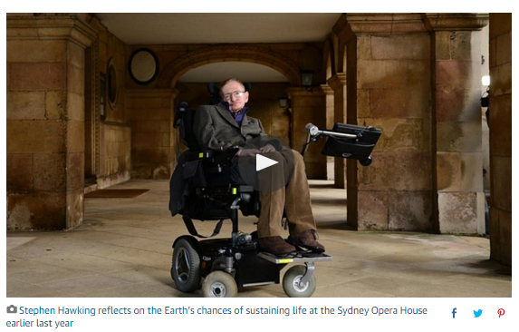
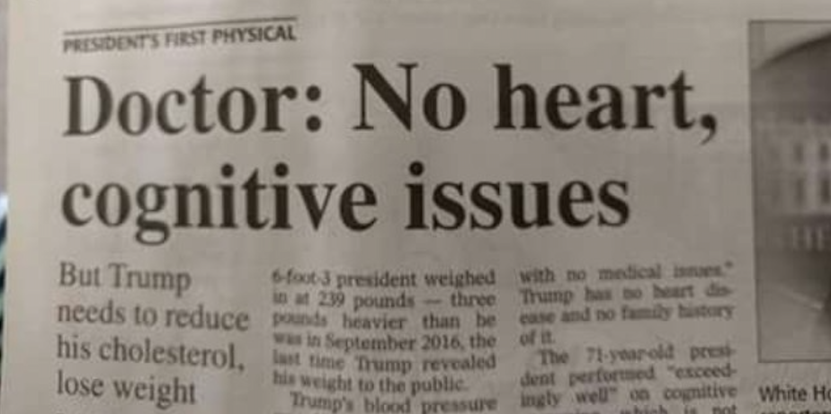
Syntactic constituency
More structural ambiguity in the wild

Slide 27
Syntactic constituency
Every parse of a phrase or sentence that is generated by the grammar groups words into units, which are called constituents.
Constituents are “natural groupings of words”.
Individual words are constituents, too! They are minimal units of sentences. We are more interested in multi-word constituents.
As we just saw, if a string has two (or more) possible constituent structures, two (or more) meanings often result.

Slide 28
Syntactic constituency
If we want to determine the syntactic rules of a language, we need to be able to identify what the constituents of sentences are. Why?
Rules of syntax don’t apply to individual words—otherwise we’d need an absurd number of rules. Instead, they apply to syntactic categories, i.e., types of constituents.
But how do we determine the constituent structure of a sentence?

Slide 29
Syntactic constituency
In many cases you intuitively know which words in a sentence “go together”.
(19) Hermione petted the cat.
Do all of the following strings feel equally like a unit?
the cat
petted the cat
petted the
Hermione petted the
Hermione petted
But intuitions can only take you that far…

Slide 30
Syntactic constituency
We know that the cat or petted the cat in Hermione petted the cat behave like constituents because syntax treats them as units.
Constituency tests
Stand-alone test
Can a string of words function as a stand-alone answer to a question?
(20) Q: Who did Hermione pet?
A: The cat.
(21) Q: What happened to the cat?
A: *Hermione petted. (NB: This would be grammatical in some languages, but for different reasons.)

Slide 31
Syntactic constituency
We know that the cat or petted the cat in Hermione petted the cat behave like constituents because syntax treats them as units.
Constituency tests
Stand-alone test
Replacement test
Can a string of words be replaced by a pronoun, one, do (so), there, etc.?
(22) Hermione petted the cat. → Hermione petted it.
(23) Hermione petted the cat. → Hermione did so.
(24) Hermione petted the cat. → *Hermione did so the cat.
(25) Hermione petted the cat. → *Did so the cat.

Slide 32
Syntactic constituency
We know that the cat or petted the cat in Hermione petted the cat behave like constituents because syntax treats them as units.
Constituency tests
Stand-alone test
Replacement test
Movement test
Can a string of words move as a unit?
(26) The cat, Hermione petted. (topicalization)
(27) *Petted the, Hermione cat.
(28) It was the cat that Hermione petted. (it-clefting)
(29) *It was petted the that Hermione cat.

Slide 33
Syntactic constituency
We know that the cat or petted the cat in Hermione petted the cat behave like constituents because syntax treats them as units.
Constituency tests
Stand-alone test
Replacement test
Movement test
Coordination
Can a string of words be coordinated with a similar string by a connective?
(30) Hermione petted the cat and the hippogriff.
(31) *Hermione petted the and charmed a cat.

Slide 34
Syntactic constituency
Important caveat
As with other diagnostic tests, constituency tests yield a lot of false negatives, so don’t overinterpret negative results.
Sometimes they also yield false positives. Coordination is especially dangerous in this respect:
(32) Hermione petted and Draco cursed the cat.

Slide 35
Syntactic constituency
Constituency tests can help us disambiguate structural ambiguity.
(33) He shot a crackhead with a Kalashnikov.
Reading 1: The crackhead had the Kalashnikov.
Reading 2: The person referred to by he (Nicholas) had the Kalashnikov.
(34) It was a crackhead with a Kalashnikov that he shot.
Only grammatical under Reading 1.
(35) He did so with a Kalashnikov.
Only grammatical under Reading 2.
(36) He shot him with a Kalashnikov.
Only grammatical under Reading 2.

Slide 36
What is syntax?
Syntactic categories
Syntactic constituency
In-class practice I
Building phrases
In-class practice II
Building sentences
In-class practice III
Embedding
Movement
What you need to know
32

Slide 37
In-class practice I
(37) The bemused Herbology professor said that Minerva had seen an extremely angry hippogriff in her pajamas after five shots of firewhisky.
For each word, identify its syntactic category.
Identify as many instances of structural ambiguity as you can and say which structures correspond to which interpretations.
Keeping structural ambiguity in mind, perform constituency tests to determine whether the following strings are constituents:
the bemused Herbology professor
Herbology professor
Minerva had seen an extremely angry hippogriff
seen an extremely angry hippogriff
hippogriff in her pajamas
after five shots of firewhisky
after five shots
that Minerva had seen an extremely angry hippogriff in her pajamas after five shots of firewhisky

Slide 38
What is syntax?
Syntactic categories
Syntactic constituency
In-class practice I
Building phrases
In-class practice II
Building sentences
In-class practice III
Embedding
Movement
What you need to know
34

Slide 39
Building phrases
We build syntactic structures by putting two things together (Merge) at each step. Every time we do that we get a constituent.

Slide 40
Building phrases
We build syntactic structures by putting two things together (Merge) at each step. Every time we do that we get a constituent.

Slide 41
Building phrases
We build syntactic structures by putting two things together (Merge) at each step. Every time we do that we get a constituent.

Slide 42
Building phrases
Here are two trees for our ambiguous sentence from ‘Hot Fuzz’:

Slide 43
Building phrases
So far our trees contain the information about the linear order and the hierarchical structure of our constituents, but that’s not enough.
We said that words belong to syntactic categories. So do larger constituents that we call phrases.

Slide 44
Building phrases
The following are Noun Phrases (NPs):
Hermione
the cat
the bemused Herbology professor
a Kalashnikov
a crackhead with a Kalashnikov
he
NPs can be subjects and objects, can be substituted with a pronoun, can be targeted by it-clefts, and always contain nouns.

Slide 45
Building phrases
Subject NPs are typically followed by Verb Phrases (VPs):
sneezed
petted the cat
shot a crackhead with a Kalashnikov
said that Minerva had seen an extremely angry hippogriff in her pajamas after five shots of firewhisky
VPs can be replaced by do (so), they always contain a verb and may also contain object NPs, embedded clauses, Prepositional Phrases, etc.

Slide 46
Building phrases
Prepositional Phrases (PPs) are phrases that contain a preposition followed by a NP:
with a Kalashnikov
at Hogwarts
after five shots of firewhisky
They can be targeted by it-clefts, and can sometimes be substituted by there or then.

Slide 47
Building phrases
Adjectival Phrases (AdjPs):
bemused
angry
extremely angry
extremely angry at Minerva
Adverb Phrases (AdvPs):
extremely
often
very quickly
more enthusiastically than usual

Slide 48
Building phrases
Every phrase has a head. VPs have V heads, AdjPs have Adj heads, AdvPs have Adv heads, and NPs have N heads.
Sometimes, phrases also have complements. These are the things that heads “take” and that, together with the head, form a phrase. They follow the head and complete or enhance its meaning.
Additionally, phrases can have specifiers. In this class, we won’t worry about what specifiers do—just know that they are the first element in a phrase (when they are in a phrase).

Slide 49
Building phrases
This is what our basic building block looks like:
We call this phrase-building template the X-bar schema.

Slide 50
Building phrases
The lines that connect parts of a tree are called branches.
The ends of branches are called nodes.
The topmost node in a tree is called a root node. Here it’s XP.
Nodes that have no branches below them are called terminal nodes. X, ‘specifier’, and ‘complement’ are terminal nodes.
A node dominates the nodes below it that it is connected to. E.g., X' dominates X and ‘complement’; XP dominates all the other nodes.
A node that immediately dominates another is its mother. E.g., X' is the mother of X and ‘complement’.
A node that is immediately dominated by another is its daughter. E.g., ‘specifier’ is XP’s daughter.
Two nodes that share a mother are sisters. E.g., ‘specifier’ and X' are sisters.
When we don’t want to specify the full structure of a non-terminal node, we will use triangles. Unless you’re told to use triangles, don’t.

Slide 51
Building phrases
Building the NP the cat:
Label the terminal nodes with their syntactic categories.

Slide 52
Building phrases
Building the NP the cat:
Label the terminal nodes with their syntactic categories.
Find the head.

Slide 53
Building phrases
Building the NP the cat:
Label the terminal nodes with their syntactic categories.
Find the head.
Does the head have a complement? No. Project the N' node anyway.

Slide 54
Building phrases
Building the NP the cat:
Label the terminal nodes with their syntactic categories.
Find the head.
Does the head have a complement? No. Project the N' node anyway.
Does the head have a specifier? Yes, it’s the. Merge the D and the N' nodes and label the result as NP.

Slide 55
Building phrases
Building the VP petted the cat:
Label the terminal nodes with their syntactic categories.

Slide 56
Building phrases
Building the VP petted the cat:
Label the terminal nodes with their syntactic categories.
Find the head.

Slide 57
Building phrases
Building the VP petted the cat:
Label the terminal nodes with their syntactic categories.
Find the head.
Does the head have a complement? Yes, it’s the cat. We’ve built it before. Merge the head with the complement and label the resulting node as V'.

Slide 58
Building phrases
Building the VP petted the cat:
Label the terminal nodes with their syntactic categories.
Find the head.
Does the head have a complement? Yes, it’s the cat. We’ve built it before. Merge the head with the complement and label the resulting node as V'.
Does the head have a specifier? No. Project the VP node anyway.

Slide 59
Building phrases
Can this give us all the infinity of the human language?
Yes, with two extra bits:
Recursion: Phrases can be inside other phrases:
(38) the therapist of the father of the cousin of my friend
Adjuncts: Phrases that modify heads, but are neither complements nor specifiers. They are sisters to X' and daughters to X', which in combination with multiple X' projections means that one phrase can in theory have an infinite number of adjuncts:
(39) brewed this potent smelly green potion in a copper cauldron in the bathroom at midnight
AdjPs, AdvPs, and PPs are often adjuncts.

Slide 60
Building phrases
So our X-bar schema actually looks like this:

Slide 61
Building phrases
Algorithm of building an XP:
Label the terminal nodes with their syntactic categories.
Find the head X.
Does X have a complement? If yes, build the complement (following this very algorithm) and merge it with X, labeling the resulting node as X'. If there is no complement, project the X' node anyway.
Does the XP contain any adjuncts? If yes, merge them with X', labeling each resulting node as X'.
Does the XP contain a specifier? If yes, merge it with the topmost X', labeling the resulting node as XP. If there is no specifier, project the XP node anyway.

Slide 62
What is syntax?
Syntactic categories
Syntactic constituency
In-class practice I
Building phrases
In-class practice II
Building sentences
In-class practice III
Embedding
Movement
What you need to know
43

Slide 63
In-class practice II
Build the following phrases using the algorithm of building an XP:
the professor of Arithmancy
an extremely angry hippogriff
very afraid of basilisks
punched Draco in the face
brewed this smelly green potion in the bathroom at midnight

Slide 64
What is syntax?
Syntactic categories
Syntactic constituency
In-class practice I
Building phrases
In-class practice II
Building sentences
In-class practice III
Embedding
Movement
What you need to know
45

Slide 65
Building sentences
We said that every phrase (XP) has a head (X), and we have successfully drawn trees for NPs, VPs, PPs, AdjPs, and AdvPs.
We also said that every constituent is subsumed under one node of a tree, but we also said sentences are constituents.
So, how do we make trees for sentences? What is the head of a sentence?
To answer this question think about the constituent structure of the following sentences:
(40) Snape will brew a potion.
(41) Hermione might punch Draco.

Slide 66
Building sentences
Sentences are headed by Tense (T), a head that hosts morphemes realizing tense and aspect as well as modals.
Just like you can’t have an NP without a noun, you can’t have a sentences without Tense:
(40)' *Snape brew a potion.
(41)' *Hermione punch Draco.

Slide 67
Building sentences
Since every sentence has a T, sentences are Tense Phrases (TPs).
T takes predicates as complements and subjects as specifiers:

Slide 68
Building sentences
What about these?
(42) Hermione punched Draco.
(43) Snape brews potions.
In English, the morpheme hosted in T is not always a stand-alone element.
In the simple (non-progressive) past tense, if there is no do-support, the tense affix shows up on the lexical verb.
The same happens in the simple present tense if the subject is third person singular.

Slide 69
Building sentences
We will still assume that the relevant affixes are hosted in T and will not worry about where they are pronounced:

Slide 70
What is syntax?
Syntactic categories
Syntactic constituency
In-class practice I
Building phrases
In-class practice II
Building sentences
In-class practice III
Embedding
Movement
What you need to know
51

Slide 71
In-class practice III
Build the trees of the following sentences:
The professor of Herbology should water her potted plants with care.
Snape bullies Neville mercilessly for his ineptitude in Potions.
A very logical Ravenclaw questioned the rules of the magical world.
The nurse treated a student with a broken wand.

Slide 72
What is syntax?
Syntactic categories
Syntactic constituency
In-class practice I
Building phrases
In-class practice II
Building sentences
In-class practice III
Embedding
Movement
What you need to know
47

Slide 73
Embedding
How do we model the sentences below? What do they all have in common?
(44) Ginny thinks that Hermione likes Ron.
(45) Ginny wonders if Hermione likes Ron.
(46) Ginny knows whether Hermione likes Ron.
They all contain two elementary sentences, or clauses.
In order to know how to model these sentences, we first need to figure out their constituency structure.
(44)' [Ginny [thinks [that [Hermione likes Ron]]]].
(45)' [Ginny [wonders [if [Hermione likes Ron]]]].
(46)' [Ginny [knows [whether [Hermione likes Ron]]]].

Slide 74
Embedding
Words like that, if, and whether are called complementizers (C).
They introduce embedded sentences and head their own phrases, Complementizer Phrases (CPs).
Their complements are always TPs.
Embedding verbs like think, wonder, and know take CPs as their complements.

Slide 75
Embedding
Note that sentence embedding is recursive:
(47) Ginny thinks that Hermione likes Ron.
(48) Neville knows whether Ginny thinks that Hermione likes Ron.
(49) Luna wonders if Neville knows whether Ginny thinks that Hermione likes Ron.

Slide 76
What is syntax?
Syntactic categories
Syntactic constituency
In-class practice I
Building phrases
In-class practice II
Building sentences
In-class practice III
Embedding
Movement
What you need to know
49

Slide 77
Movement
How do we model the sentences below?
(50) Will Snape brew a potion?
(51) Can Hermione punch Draco?
These sentences clearly relate to their declarative counterparts below, and we want to capture this relation.
(50)' Snape will brew the potion.
(51)' Hermione can punch Draco.
To do so, we resort to movement.

Slide 78
Movement
So, to derive (50), we start with a TP Snape will brew a potion…

Slide 79
Movement
So, to derive (50), we start with a TP Snape will brew a potion…
…and we move T up and to the left.

Slide 80
Movement
So, to derive (50), we start with a TP Snape will brew a potion…
…and we move T up and to the left.
But where do we move it?

Slide 81
Movement
So, to derive (50), we start with a TP Snape will brew a potion…
…and we move T up and to the left.
But where do we move it?
We typically assume that we adjoin it to C.
Now, how do you think we derive the sentence below?
(52) What will Snape brew?

Slide 82
What is syntax?
Syntactic categories
Syntactic constituency
In-class practice I
Building phrases
In-class practice II
Building sentences
In-class practice III
Embedding
Movement
What you need to know
54

Slide 83
What you need to know
Key notions: syntax, grammaticality, syntactic categories, lexical vs. functional categories, structural ambiguity, syntactic constituents, constituency tests, Merge, syntactic phrases, heads, complements, specifiers, X-bar schema, branches, nodes (root, terminal, non-terminal), domination, mothers, daughters, sisters, recursion, adjuncts, sentence embedding, movement
Skills:
identify the syntactic categories of words and phrases in a sentence
use tests to identify the constituency structure of a sentence
draw trees of mono-clausal declarative sentences without movement

