Slide 1

Echo questions work how?
Ben-Gurion University colloquium
Masha Esipova
Bar-Ilan University

Slide 2
Intro
Non-echo questions in Russian
Echos to questions in Russian
Echos to assertions in Russian
Echos to imperatives in Russian
Rising declaratives in Russian
Outro

Slide 3
Echo questions
Echo questions, or echos for short, ask the addressee to clarify the utterance they just produced by repeating the antecedent utterance or some part of it
We can have echos:
triggered by the speaker not (properly) hearing (part of) what was said or to signal surprise—for now, let’s set these distinctions aside
polar (asking if their sentence radical matches the antecedent utterance) and wh-echos (asking a wh-question about some part of the antecedent utterance)
to antecedent utterances of different sentence types
(1) a. A: I gave you a book.
B: {You gave me a book? / You gave me what? / What did you give me?}
b. A: Did you give me a book?
B: {Did I give you a book? / Did I give you what?}
c. A: What did you give me?
B: {What did I give you? / What did I what?}
d. A: Give me a book.
B: {Give you a book? / Give you what?}

Slide 4
Echo questions in English
In English, the morphosyntactic sentence forms used in echos of different types also have non-echo uses
In some cases, the echo question forms fully match the forms used in neutral non-echo questions (e.g., polar echos to polar questions)
In other cases, echos use non-neutral forms (rising declaratives and imperatives, wh-in-situ questions), which still have non-echo uses
To my knowledge, there has been no systematic investigation of the prosodic properties of echo vs. non-echo utterances across all sentence types in English

Slide 5
Echo questions in English
However, Biezma et al. 2021:
  claim that neither word order, nor prosody reliably distinguish echo vs. non-echo interpretations of wh-interrogatives in English:
    Note: I have issues both with their methodology and with their interpretation of their own data
  conclude that the difference between echo and non-echo utterances is not their compositional semantic representation, but “their position in the discourse”, where echos are “questions about what exactly the proposal to be evaluated is”
    Note: I will not rehash the specifics, but the upshot is that they give all questions such denotations that if there are no proposals to be evaluated, you get a non-echo interpretation, but if there are active proposals to be evaluated, you get an echo interpretation
  focus on wh-echos to assertions, but claim their analysis is extendable to other cases

Slide 6
Enter other languages
In other languages, people have observed form differences between echo and non-echo questions that ostensibly necessitate distinct compositional representations; e.g., Japanese echo vs. non-echo questions use different particles (Sudo 2007: tte realizes a special ECHO complementizer; Biezma et al. 2021 are aware of Sudo 2007, but say Japanese vs. English echo-questions are different):
(2) a. John-ga hikooki-o katta tte?
John-NOM aeroplane-ACC bought echo.Q
‘John bought an aeroplane?’ (echo only)
b. John-ga nani-o katta tte?
John-NOM what-ACC bought echo.Q
‘John bought what?’ (echo only)
(3) a. John-ga hikooki-o katta no?
John-NOM aeroplane-ACC bought Q
‘Did John buy an aeroplane?’ (non-echo only)
b. John-ga nani-o katta no?
John-NOM what-ACC bought Q
‘What did John buy?’ (non-echo only)

Slide 7
This talk
We’ll look at morphosyntactic and prosodic properties of different types of echo vs. non-echo questions in Russian
We’ll conclude that while there doesn’t seem to be a systematic overt way to realize any kind of ECHO operator in Russian (segmental or suprasegmental), we have evidence that echos in Russian involve embedding under an ECHO predicate, which is a speech report predicate anaphoric to the antecedent utterance
This proposal aligns in spirit with the converging claims in the ongoing work by Trinh, Fox, and Bassi, but some of the details seem to differ

Slide 8
Intro
Non-echo questions in Russian
Echos to questions in Russian
Echos to assertions in Russian
Echos to imperatives in Russian
Rising declaratives in Russian
Outro

Slide 9

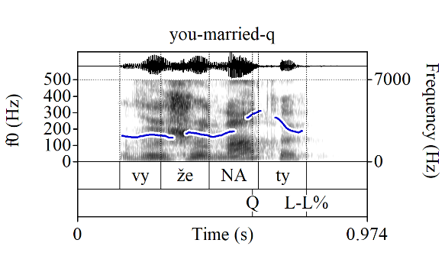
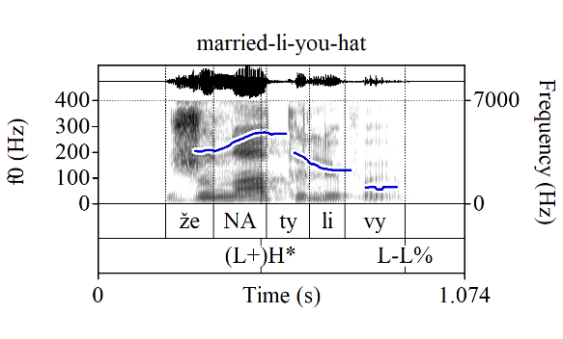
Non-echo polar questions in Russian
Two strategies to ask neutral matrix non-echo polar questions (PolQs) in Russian:
Declarative string PolQs (DSQs): the same segmental string as in a declarative and a special prosodic peak, the Q-Peak (Q), on the locus of prosodic focus marking (the Q-Peak is robustly distinct in production and perception from focus marking in assertions: e.g., Meyer & Mleinek 2006)
Li PolQs (li-Qs): the semantically focused constituent (or some part of it) is fronted; the li particle is cliticized onto it; the fronted constituent bears assertion-like focus marking ((L+)H*, sometimes L*+H) and can’t bear the Q-Peak
(4) a. Vy žena_{Q}ty_{L-L%}?
you married
‘Are you married?’
b. Žena_{(L+)H*}ty li vy_{L-L%}?
married LI you
‘Are you married?’

Slide 10
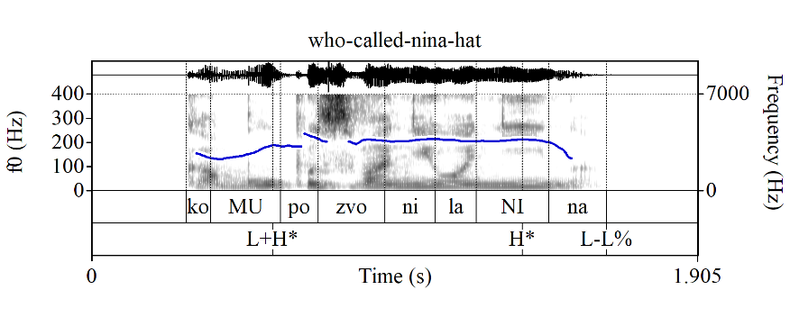
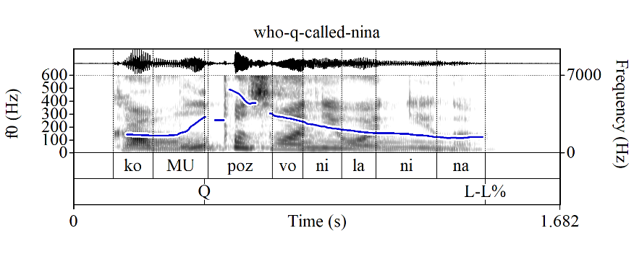
Non-echo wh-questions in Russian
Non-echo wh-questions (wh-Qs) in Russian: the wh-phrase (or some part of it) is fronted, the wh-item bears assertion-like focus marking and can’t bear the Q-Peak:
(5) a. Komu_{L+H*} pozvonila Ni_{H*}na_{L-L%}?
who.DAT called Nina.NOM
‘Who did Nina call?’
b. # Komu_{Q} pozvonila Nina_{L-L%}?
who.DAT called Nina.NOM

Slide 11
DSQs vs. li-Qs and wh-Qs
See Esipova 2024; Esipova & Korotkova 2023, in prep. for details; some relevant data:
Li-Qs and wh-Qs like are embeddable, but DSQs are not:
(6) Dima sprosil {ženat _{(L+)H*} li ja_{L-L%} / * ja ženat_{Q L-L%} / kto_{(L+)H*} ženat_{L-L%}}.
Dima asked {married LI I / * I married / who married}
‘Dima asked {if I am married / who is married}.’
DSQs always expect a response, but li-Qs and wh-Qs do not; e.g., DSQs cannot be conjectural questions, but li-Qs can:
(7) a. Xm, jest’_{L+H*} li žizn’ na drugix planetax_{L-L%}?
hm be.PRS.3SG Q-PRT life.NOM on other.PREP planets.PREP
b. # Xm, na drugix planetax jest’_{Q} žizn’_{L-L%}?
hm on other.PREP planets.PREP be.PRS.3SG life.NOM
c. Xm, skol’ko_{L+H*} vo vselennoj zvёzd_{L-L%}?
hm how-many in universe.PREP stars.GEN
Bylo b neploxo uznat’…
be.PAST.SG.N SUBJ not-bad.ADV learn.INF
‘Hm… {(a-b) Is there life on other planets[, I wonder]? (c) How many stars are there in the universe?} Would be nice to know…’
The Q-Peak can also be used with imperatives, but Q-Peak-marked imperatives can only be used as “invested requests”, not “disinterested suggestions”—see Esipova 2024 for more on this

Slide 12
What do the Q-Peak vs. li do?
Proposal in Esipova 2024:
  The Q-Peak marks focus (by virtue of being the primary prosodic prominence of the utterance) and realizes a compositionally represented ‘please react’ meaning component (the shape of the peak)
  Li-Qs and wh-Qs do not have a compositionally represented ‘please react’ component (which is why they are embeddable, can be used as conjectural questions, etc.)
The proposal in Esipova 2024 is not formalized, but I’m currently working on it (as part of my collaborative work with Natasha Korotkova); my current idea is that:
  Russian li- and wh-clauses are interrogative clauses denoting sets of possible answers and, when used in a matrix context, combine with a regular, default Question force operator, which, among other things, projects common grounds based on the alternatives in the denotation of the interrogative clause
  The Q-Peak realizes a special, “intrusive” Question force operator (in addition to marking focus), which combines with singleton sets (declarative and imperative clauses) and projects commitments for the addressee based on the sentence radical and its complement (pace Farkas 2022; 2024, where the default discourse effects of all questions involve projecting commitments for the addressee)

Slide 13
Intro
Non-echo questions in Russian
Echos to questions in Russian
Echos to assertions in Russian
Echos to imperatives in Russian
Rising declaratives in Russian
Outro

Slide 14
Polar echos to PolQs in English
Reminder, in English, polar echos to PolQs can have the same surface form as non-echo PolQs:
(8) A: Are you ma_{L*}rried_{H-H%}?
B: Am I ma_{L*} rried_{H-H%}?
I am not entirely sure how the analysis in Biezma et al.’s (2021) should be extended to this case
In particular, IDK if they would want to maintain that (8B) still denotes a set of propositions ({‘Sp is married’, ¬‘Sp is married’}) rather than a set of sets of propositions (certainly, they’d need to say the latter for wh-echos to questions?)
Regardless, we will see that in Russian, we have evidence that both echos to questions and to assertions are compositionally questions about utterances

Slide 15
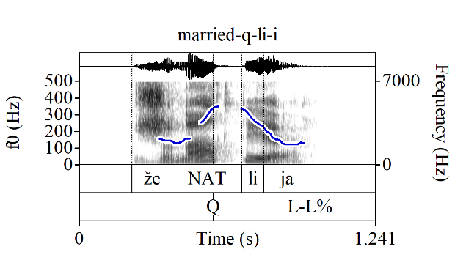
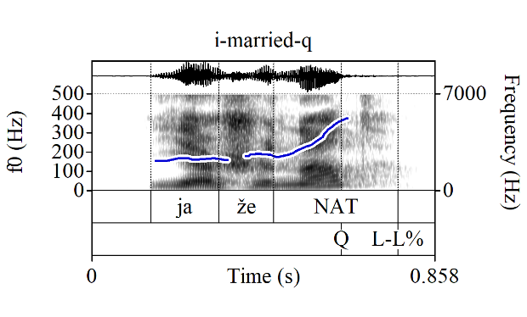
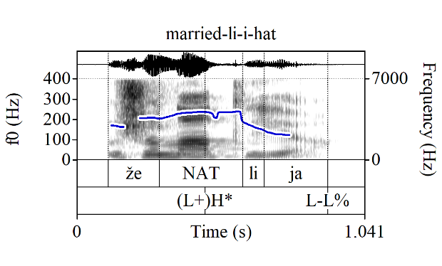
Polar echos to PolQs in Russian
However, in Russian, polar echos to PolQs necessarily combine the two PolQ forms (DSQs and li-Qs) in a way that can only have an echo interpretation: the segmental string of li-Qs (regardless of if the antecedent is a DSQ or a li-Q) + the Q-Peak
(9) A: (4a/b) (‘Are you married?’)
B: (i) Žena_{Q}t li ja_{L-L%}?
married LI I
‘Am I married?’
(only echo, i.e., ≈‘Did you just ask me if I am married?’)
(ii) # Ja ženat_{Q} _{L-L%}?
I married
‘Am I married?’ (only non-echo)
(iii) # Ženat_{(L+)H*} li ja_{L-L%}?
married LI I
‘Am I married?’ (only non-echo)

Slide 16
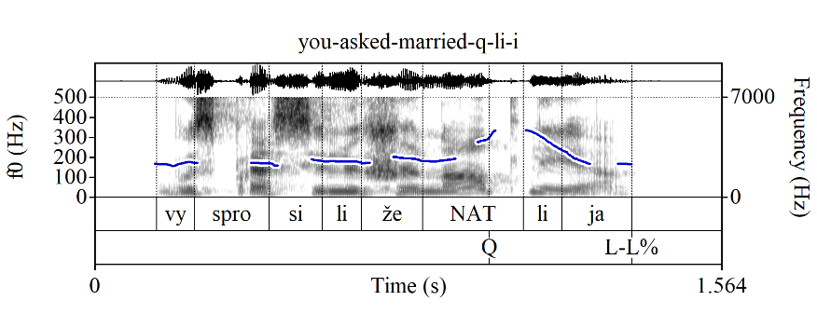
Polar echos to PolQs in Russian
This suggests that polar echos to PolQs have a compositional structure like in (11) that is actually similar to the English paraphrase in (9B-i) or indeed its Russian counterpart in (10), i.e., they are DSQs that embeds li-Qs:
(10) Vy sprosili žena_{Q}t li ja_{L-L%}? Cf. (7B-i):
you asked married LI I
‘[What did you ask?] Did you ask if I am married?’
(11) [Q-Peak [ECHO [li [‘Sp is married’]]]]]
≈‘Please address the issue of whether the utterance you just produced asks whether I am married.’
  the ECHO predicate is a speech report predicate anaphoric to the antecedent utterance; it does not have an overt realization

Slide 17
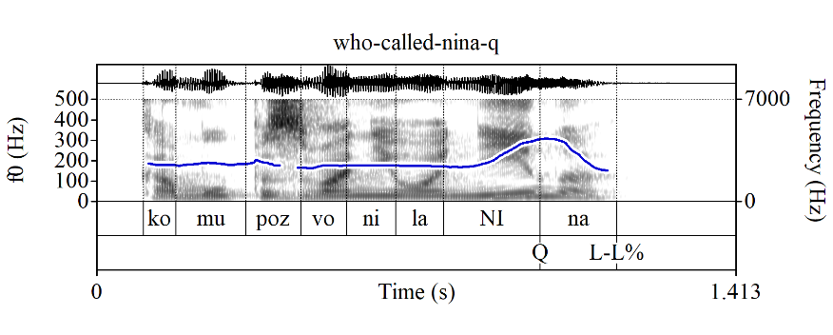
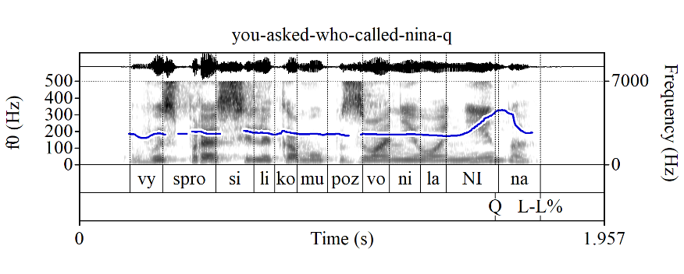
Polar echos to wh-Qs in Russian
Polar echos to wh-Qs also have the Q-Peak (which non-echo wh-Qs cannot have), again, suggesting a structure with a DSQ embedding a wh-question:
(12) A: Komu_{L+H*} pozvonila Ni_{H*}na_{L-L%}?
who.DAT called Nina.NOM
‘Who did Nina call?’ (only non-echo)
B: (i) Komu pozvonila Ni_{Q}na_{L-L%}?
who.DAT called Nina.NOM
‘Who did Nina call?’ (only echo, i.e., ≈‘Did you just ask me who Nina called?’)
(ii) Vy sprosili komu pozvonila Ni_{Q}na_{L-L%}?
you asked who.DAT called Nina.NOM
‘Did you ask who Nina called?’
(13) [Q-Peak [[ECHO [‘who Nina called’]]]]
≈‘Please address the issue of whether the utterance you just produced asks who Nina called.’

Slide 18
Intro
Non-echo questions in Russian
Echos to questions in Russian
Echos to assertions in Russian
Echos to imperatives in Russian
Rising declaratives in Russian
Outro

Slide 19
Polar echos to assertions in Russian
Neutral polar echos to assertions are just DSQs (contrary to what I said in Esipova 2024! I’ll come back to rising declaratives as echos later), which is compatible with the structure in (15), although it doesn’t immediately necessitate it; but note that there appears to be a preference for some speakers (myself included) for signaling that these DSQs are echos by producing the corresponding wh-echo first, especially with a sentence-level Q-Peak:
(14) A: Ljudmila pozvonila Nine.
Lyudmila.NOM called Nina.DAT
‘Lyudmila called Nina.’
B: (i) ?(Čto-čto_{L* H-H%}?) Ljudmila pozvonila Ni_{Q}ne_{L-L%}?
?(what-what) Lyudmila.NOM called Nina.DAT
‘(What?) [Lyudmila called Nina]_{F}?’
(ii) (Kto_{L*} pozvonil Nine_{H-H%}? ) Ljudmi_{Q}la (pozvonila Nine)_{L-L%}?
(who called Nina.DAT) Lyudmila (called Nina.DAT)
‘(Who called Nina?) [Lyudmila]_{F} called Nina?’
(15) [Q-Peak [ECHO [‘Lyudmila called Nina’]]]]
≈‘Please address the issue of whether the utterance you just produced asserts that Lyudmila called Nina.’

Slide 20
Can li-Qs be echos?
Recall that we have only seen li-Qs as embedded questions in DSQ echos, but can li-Qs themselves be echos, i.e., with structure like in (16)?
(16) [XP_{F} [li [ECHO [‘…<XP_{F}>…’]]]]
We wouldn’t expect li-Qs to be able to be echos when the whole complement of ECHO is in focus, because Russian li-Qs cannot have sentence-level focus
But attempts to have li-echos with narrower loci of uncertainty are still bad:
(17) A: Nina pozvonila Ljudmile.
Nina.NOM called Lyudmila.DAT
‘Nina called Lyudmila.’
B: (Komu_{L*} pozvonila Nina_{H-H%}? ) # Ljudmile_{L+H*} li (pozvonila Nina)_{L-L%}?
(who .DAT called Nina.NOM) # Lyudmila LI (called Nina.DAT)
Intended: ‘(Who called Nina?) [Lyudmila]_{F} called Nina?’
(Doesn’t sound like an echo, but maybe as casting doubt on what A said.)

Slide 21
Can li-Qs be echos?
There are at least two potential considerations here (not mutually exclusive):
Li-Qs are in general very marked; among other things, they sound very non-urgent, as compared to DSQs, and might be pragmatically inappropriate when the resolution of the issue is necessary for continuing the discourse; however, the impossibility of li-Qs as echos is categorical, so it’s probably not purely pragmatic
Under my analysis, (17B) would need to have the structure in (18), and this kind of extraction seems bad in general, as shown in (19), especially since you can just use a DSQ, which doesn’t involve extraction:
(18) [Lyudmila [li [ECHO [‘Nina called <Lyudmila>’]]]
(19) ??Ljudmile li ty skazal pozvonila Nina?
Lyudmila.DAT LI you said called Nina.NOM
Intended: ‘Did you say that Nina called [Lyudmila]_{F}?’
This is indirect evidence that even in echos to assertions we still have an ECHO predicate

Slide 22
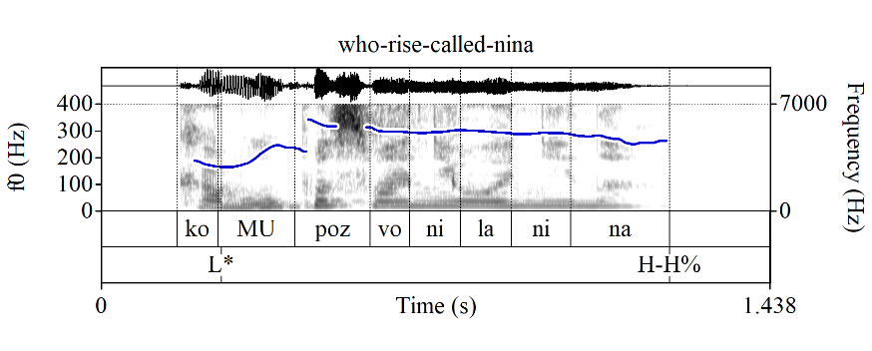
Wh-echos in Russian: prosody
As we already saw in (14B-ii), wh-echos have a different contour than non-echo wh-questions in Russian, namely the Russian equivalent of the rising tune, although it is realized differently from the English L* H-H% and is actually a rise into a high plateau (I still annotate it as L* H-H% in Russian; cf. mid-plateau, L* H-L%):
(20) A: Nina pozvonila Ljudmile.
Nina.NOM called Lyudmila.DAT
‘Nina called Lyudmila.’
B: Komu_{L*} pozvonila Nina_{H-H%}?
who.DAT called Nina.NOM
‘Who did Nina call?’
This tune is not specific to echos, though; e.g., rising declaratives do exist in Russian, as well, and don’t have to be echos (we’ll come back to this) + it’s still there in cases with overt predicates like (25b) below. It remains to be seen how the meaning contribution of this tune should be analyzed in Russian, though
Note also that, unlike in English, we typically do front wh-phrases in wh-echos

Slide 23
Wh-echos in Russian: reduplication
We also often see reduplication of the wh-item in wh-echos in Russian (although I think it’s only possible in wh-echos to assertions and imperatives, not in wh-echos to questions, and I think there’s a preference for eliding the rest of the question when the wh-item is reduplicated):
(21) A: Nina pozvonila Ljudmile.
Nina.NOM called Lyudmila.DAT
‘Nina called Lyudmila.’
B: Komu-komu_{L*} _{H-H%}?
who.DAT-who.DAT
‘Who [did Nina call]?’
Once again, I think this reduplication is a subcase of a larger phenomenon of reduplication in certain types of responses (e.g., snarky wh-wh reactions to wh-questions; net-net lit. ‘no-no’; da-da? lit. ‘yes-yes?’; sejčas-sejčas ‘now-now’; etc.) rather than a realization of the ECHO predicate

Slide 24
Intro
Non-echo questions in Russian
Echos to questions in Russian
Echos to assertions in Russian
Echos to imperatives in Russian
Rising declaratives in Russian
Outro

Slide 25
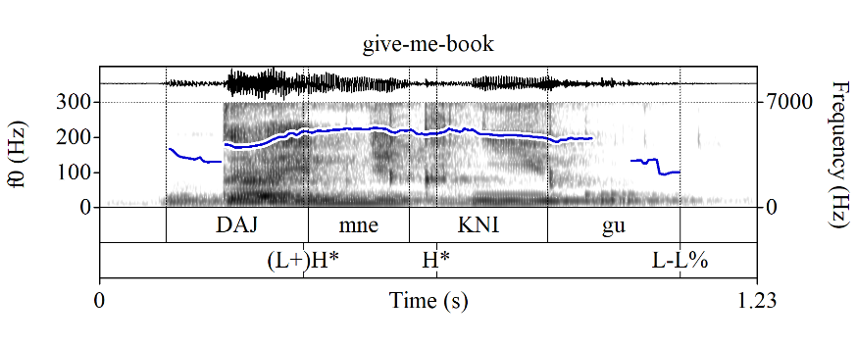
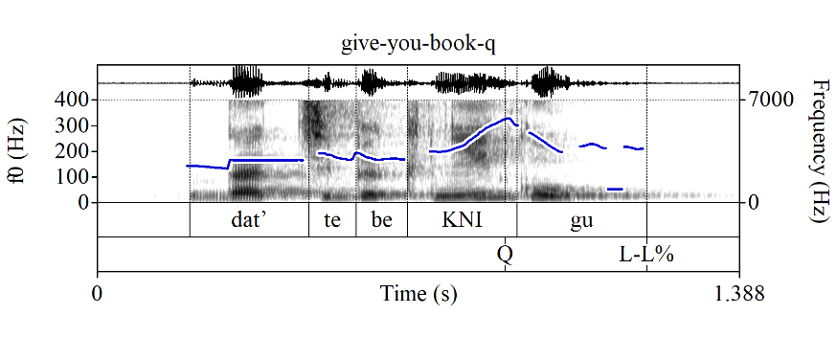
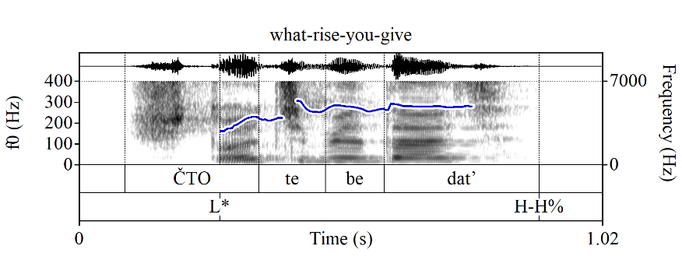
Further evidence of embedding: echos to imperatives
Echos to imperatives (polar and wh) in Russian cannot use imperative forms, but have to use infinitives instead:
(22) A: Daj_{(L+)H*} mne kni_{H*}gu_{L-L%}.
give.IMP me.DAT book.ACC
‘Give me a/the book.’
B: (i) {Dat’ / * daj} tebe kni_{Q}gu_{L-L%}?
{give.INF / give.IMP} you.DAT book.ACC
‘Give you a/the book?’
(≈‘Did you just tell me to give you a/the book?’)
(ii) Čto_{L*} tebe {dat’ / * daj}_{H-H%}?
what.ACC you.DAT {give.INF / * give.IMP}
‘Give you what?’
(≈‘What did you just tell me to give you?’)

Slide 26
Further evidence of embedding: echos to imperatives
Note that similarly to DSQs, imperative forms cannot be embedded in Russian, and to obtain an embedded directive interpretation, one must use infinitives instead:
(23) Dima skazal {dat’ / * daj} emu knigu.
Dima said {give.INF / * give.IMP} him.DAT book.ACC
‘Dima said give him the book.’
One could try to attribute the unacceptability of imperative forms in (22B) and (23) to phi-feature mismatch, but Russian imperative forms can be used elsewhere, e.g., in counterfactuals like (24), where the purported feature mismatch isn’t an issue:
(24) Pridi {ja / oni} poran’še, my by vsё uspeli.
come.IMP {I / they} earlier we SUBJ all had-time-to-do
‘Had I/they come earlier, we would have had time to do everything.’

Slide 27
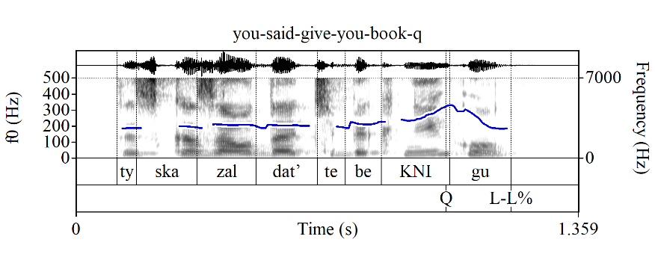
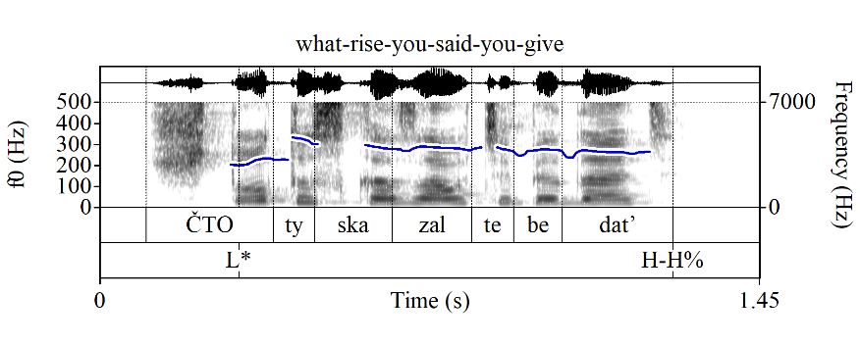
Further evidence of embedding: echos to imperatives
So even if the problem with embedded imperatives is due to feature mismatch, it emerges specifically in the context of embedding under a speech report predicate, suggesting that echos to imperatives in Russian also involve such embedding
In other words, the structure of the echos in (22) is similar to the English paraphrases or indeed their Russian counterparts:
(25) a. Ty skazal dat’ tebe kni_{Q}gu_{L-L%}?
you.NOM said give.INF you.DAT book.ACC
‘Did you tell [me] to give you a/the book?’
b. Čto_{L*} ty skazal tebe dat’_{H-H%}?
what.ACC you.NOM said you.DAT give.INF
‘What did you tell [me] to give you?’

Slide 28
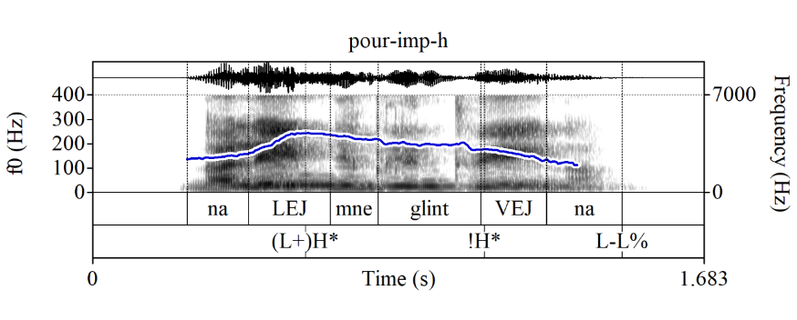
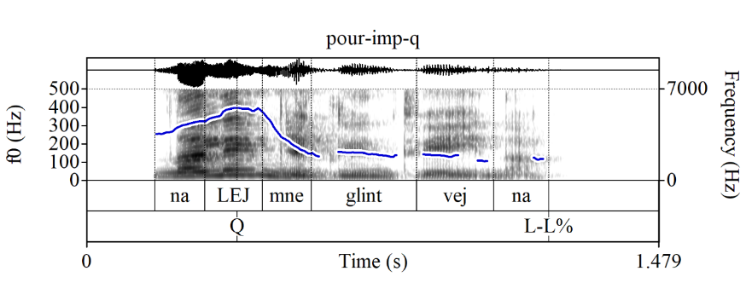
Further evidence of embedding: echos to imperatives
Note that polar echos to imperatives once again have the Q-Peak, but it’s not just a Q-Peak slapped directly onto an imperative (again, potentially pointing at a presence of an embedding predicate)
Q-Peak-marked imperatives exist, but they are used as friendly requests (Esipova 2024) and cannot have echo interpretations (cf. English rising imperatives that can have both interpretations without changes to the verb form)
(26) Nalej mne glintvejna
pour.IMP.SG/T me.DAT mulled-wine.GEN
a. Command (default interpretation) b. Request
(‘Pour me mulled wine!’) (≈‘Pour me mulled wine[, will you]?’)

Slide 29
Intro
Non-echo questions in Russian
Echos to questions in Russian
Echos to assertions in Russian
Echos to imperatives in Russian
Rising declaratives in Russian
Outro

Slide 30
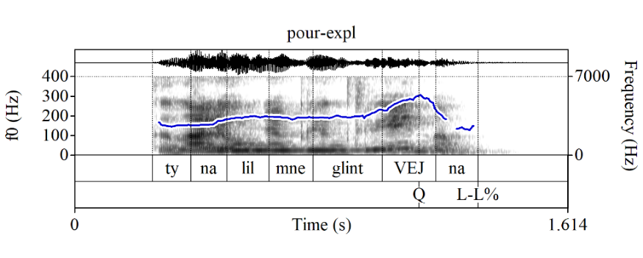
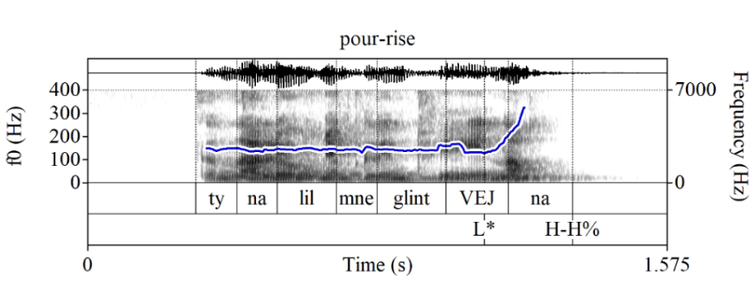
Does Russian have rising declaratives?
In English, polar echos to assertions are typically rising declaratives
In Russian, rising declaratives (again, rise into a high plateau) are used much less frequently than in English, but both rising declaratives and DSQs with a sentence-level Q-Peak can be used as what Esipova & Romero (2023) call “explanation-seeking questions”, although rising declaratives tend to sound more surprised:
(27) Context: We’re having dinner. I stepped away to go to the bathroom and come back to a glass of mulled wine next to my plate. I am asking what the explanation for this is:
Ty nalil mne glintvejna?
you.SG/T.NOM pour.PAST.SG.M me.DAT mulled-wine.GEN
‘[What is the explanation for this?]
{Did you pour me mulled wine? / You poured me mulled wine?}’

Slide 31
Can rising declaratives be echos to assertions?
While the judgements are a bit tentative, I think rising declaratives can also be used as echos to assertions, but they sound more incredulous rather than genuinely confused about the antecedent ((L+)H* H-H% is also possible with rising declaratives in Russian, and these sound extra incredulous):
(28) A: Ljudmila pozvonila Nine.
Lyudmila.NOM called Nina.DAT
‘Lyudmila called Nina.’
B: (i) (Čto-čto_{L* H-H%}?) Ljudmila pozvonila Ni_{L*}ne_{H-H%}?
(what-what) Lyudmila.NOM called Nina.DAT
‘(What?) [Lyudmila called Nina]_{F}?’
(ii) (Kto_{L*} pozvonil Nine_{H-H%}? ) Ljudmi_{L*}la (pozvonila Nine)_{H-H%}?
(who called Nina.DAT) Lyudmila (called Nina.DAT)
‘(Who called Nina?) [Lyudmila]_{F} called Nina?’

Slide 32
Are echo vs. non-echo rising declaratives distinct?
However we analyze the rising tune in Russian or English, there is no evidence that rising declaratives like in (28B) are compositionally distinct from non-echo rising declaratives
We can derive echo effects in cases like (28B) from the general semantics of the rising tune in the context of an appropriate antecedent
E.g., for English:
Rudin (2018); Rudin & Rudin (2022) maintain that the rising tune simply removes the speaker’s commitment to their utterance
Thus, a declarative assertion with the sentence radical denoting p adds a commitment to p for the speaker and puts the issue {p} on the Table; the rising tune removes the commitment part
The echo effects in the presence of the relevant antecedent can then simply come from the fact that {p} is already on the Table
A similar story can be adopted for Russian, but with a more constrained semantics for the rising tune

Slide 33
Intro
Non-echo questions in Russian
Echos to questions in Russian
Echos to assertions in Russian
Echos to imperatives in Russian
Rising declaratives in Russian
Outro

Slide 34
Summary
I have argued that echos in Russian involve embedding under an ECHO predicate; while this predicate is ostensibly silent in Russian, its presence is nonetheless felt in the compositional structure across multiple types of echos
It is entirely possible that there exist strategies that achieve the echo interpretation effect without embedding under an ECHO predicate (perhaps rising declaratives in English and Russian), and the two types of strategies may even co-exist within a single language
Thanks!

