Slide 1
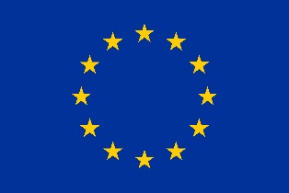
What I will tell you about Russian wh-“exclamatives”!
Maria Esipova (University of Oslo)
May 13, 2021

Slide 2
Intro
Type 1 vs. Type 2: form
Type 1 vs. Type 2: meaning
Type 1 vs. Type 2: analysis
Outro
Miscellaneous notes
References

Slide 3
Intro
Type 1 vs. Type 2: form
Type 1 vs. Type 2: meaning
Type 1 vs. Type 2: analysis
Outro
Miscellaneous notes
References

Slide 4
Degree constraint on English wh-exclamatives
English wh-exclamatives (cf. exclamations of other sentence types) require degree interpretations (Elliott 1974; Rett 2011, a.o.):
(1) a. How smart she is!
b. What a terrible friend you are!
(2) a. *Who came!
b. *What I will tell you!
(3) a. {Look / I can’t believe / You won’t believe} who came!
b. You won’t believe what I will tell you!

Slide 5
Other languages?
Nouwen & Chernilovskaya 2015:
Sentences like Who came! are grammatical, e.g., in Dutch, German, Turkish, Italian, and Russian
Don’t talk about prosody and explicitly say they won’t talk about the nature of affect expressed in the two cases

Slide 6
This talk
Strings like How smart she is! and Who came! are indeed both grammatical in Russian, but there are two types of exclamations with wh-items, Type 1 & Type 2:
They have distinct form (prosody)
They have distinct meaning (epistemic and affective)
Type 1 sentences have a degree constraint, but Type 2 sentences don’t
Proposal:
Type 1: expressive degree modification with the expressive component being the primary speech act (≈Oh the very high degree to which she is smart!)
Type 2: embedding under a mirative predicate exponed prosodically and operating on propositions (≈{Look / I can’t believe / You won’t believe} who came!)
Lesson: no “secondary” aspects of form or meaning!

Slide 7
Intro
Type 1 vs. Type 2: form
Type 1 vs. Type 2: meaning
Type 1 vs. Type 2: analysis
Outro
Miscellaneous notes
References

Slide 8
Type 1 prosody
(4) Kakaja (že) ona umnaja!
what.ADJ (ŽE) she smart
‘How smart she is!’
(5) Kak (že) ty menja dostal!
how (ŽE) you me reached
‘How fed up I am with you!’
(6) Do čego (že) on naglyj!
to what.N (ŽE) he audacious
‘How audacious he is!’
(7) Naskol’ko (že) vy talantlivy!
to-how-much (ŽE) you talented
‘How talented you are!’
Type 1 prosody in (6):
Falling boundary contour
Bitonal pitch accent on wh-item, L aligned w/stressed syllable
Additional prominence on the predicate associated w/wh-item

Slide 9
Type 2 prosody (a.o.): Peak 1 & 2; Plateau
(8) (Oj!) Kto k nam prisёl! [Peak 1, Peak 2, Plateau]
(INTERJ) who to us came
≈‘[I can’t believe / You won’t believe] who came!’
(9) (Oj!) Čto on prinёs! [Peak 1, Peak 2, Plateau]
(INTERJ) what he brought
≈‘[I can’t believe / You won’t believe] what he brought!’
(10) (Oj!) Skol’ko zdes’ narodu! [Peak 1, Peak 2, Plateau]
(INTERJ) how-much here people
≈‘[I can’t believe / You won’t believe] how many people there are here!’
(11) (Oj!) Čto ja sejčas rasskažu! [Peak 2, Plateau]
(INTERJ) what I now will-tell
≈‘[You won’t believe] what I am about to tell you!’

Slide 10
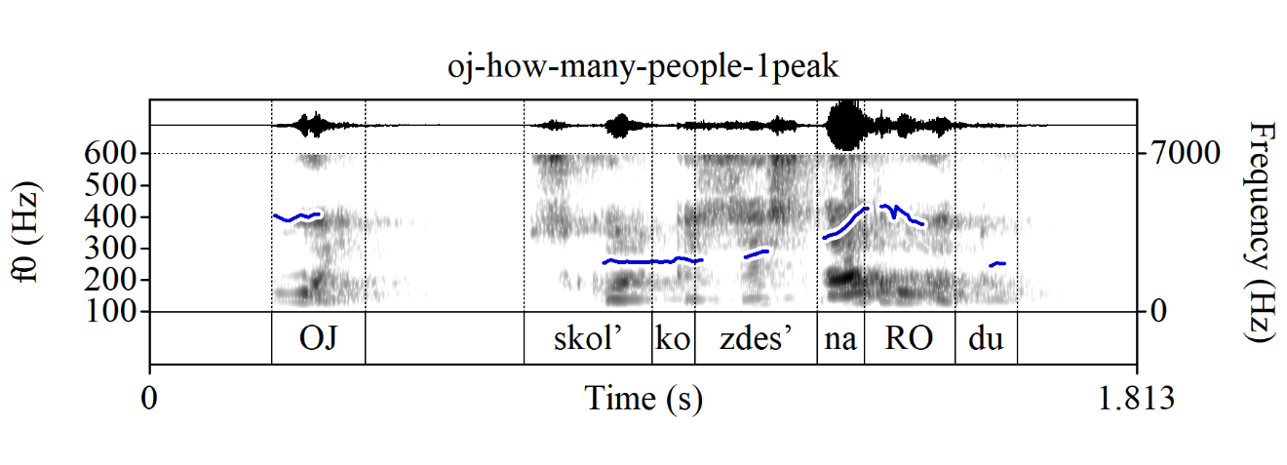
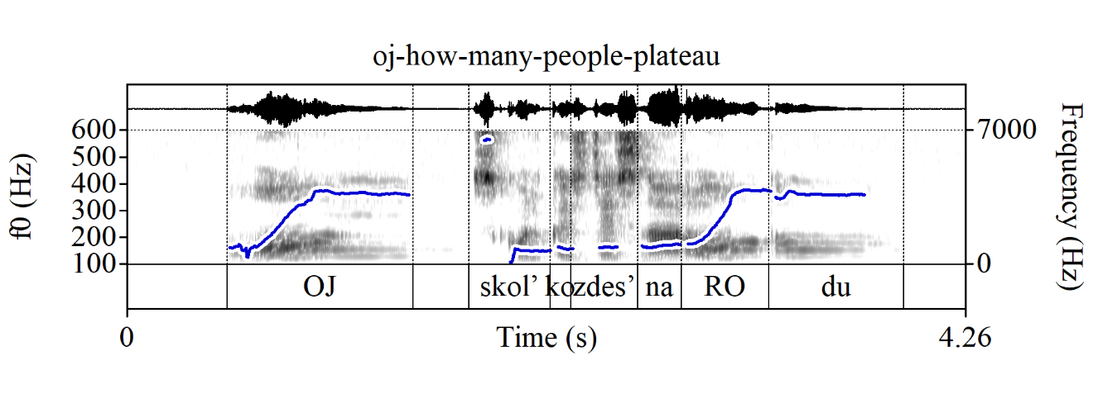
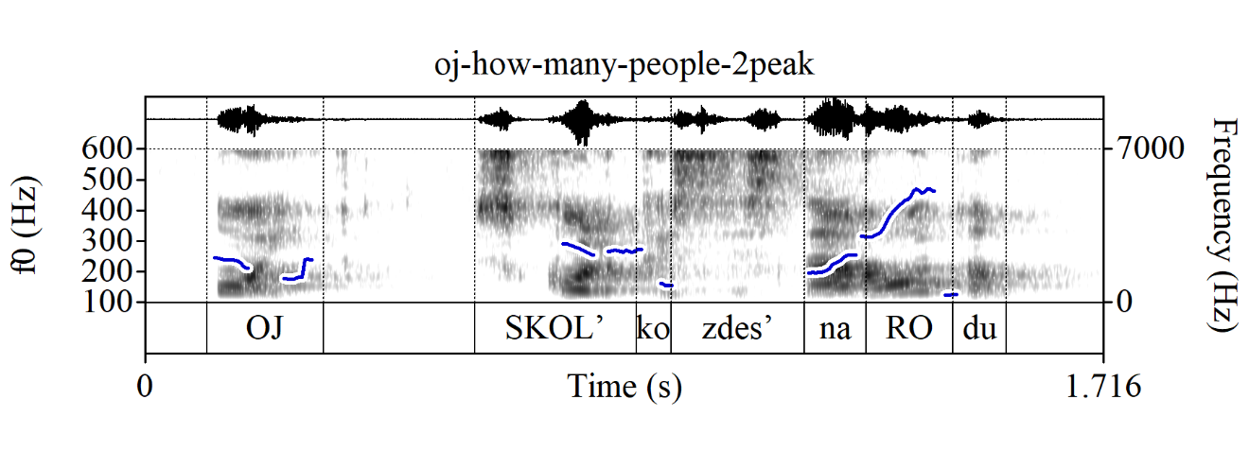
Type 2: Peak 1 & 2; Plateau
Singsongy mid-plateau boundary contour
Prominence on the last stressed syllable
No prominence on the wh-item possible
Interjection has the same contour (harder to tell for Peak)
(10) (Oj!) Skol’ko zdes’ narodu!
(INTERJ) how-much here people
Peak 1: Peak 2: Plateau:
Falling boundary contour
Shallow peak on the last stressed syllable
Pre-nuclear prominence on wh-item possible
Sharper and later final peak
More prominence on wh-item possible

Slide 11
Intro
Type 1 vs. Type 2: form
Type 1 vs. Type 2: meaning
Type 1 vs. Type 2: analysis
Outro
Miscellaneous notes
References

Slide 12
The degree constraint
The degree constraint:
The Type 1 vs. Type 2 distinction is about form and meaning, not the wh-item used or degree interpretations
But Type 1 sentences have to have degree interpretations (i.e., they have to be about the position of some item on some scale), which restricts the inventory of the wh-items that can occur in Type 1 sentences
No such constraint on Type 2 sentences

Slide 13
Epistemic status of prejacent & surprise
Type 1:
old information (but often re-activated in the context)
no expression of active counter-expectation/surprise (those can only be about new information)
instead: other feelings (anger, annoyance, awe, admiration, etc.) about that old information (pre-requisite for expressing such feelings; cf. “factive” emotive predicates)
Type 2:
always an information acquisition context by the speaker (Peak 1 or Plateau) or the addressee (Peak 2 or Plateau)
active expression of surprise-related affect or anticipating this affect from the addressee; Peak: genuine, Plateau: pretend or ironic

Slide 14
Epistemic status of prejacent & surprise
Scenario A1: I am hosting a party that starts in an hour. I need to run out and grab smth from a nearby store. I open the door and see Anya, one of my guests.
(12) Oj! Kak rano ty prisla! [Type 2 Peak 1: ]
INTERJ how early you came
Scenario B1: The party is on. I need to run out and grab smth from a nearby store. I open the door and see Anya, who I did not expect to come.
(13) Oj! Kto k nam prišёl! [Type 2 Peak 1: ; Plateau OK, but ironic]
INTERJ who to us came

Slide 15
Epistemic status of prejacent & surprise
Scenario A2: I am pretty annoyed that Anya showed up so early. I am in a different room, talking to my partner, who also saw her come in.
(14) Kak že Anja rano prišla! [Type 1 prosody: ]
how ŽE Anya early came
Scenario B2: I didn’t invite Anya, and I am angry that she showed up. I am in a different room, talking to my partner, who also saw her come in.
(15) # Kto že k nam prišёl! [Any prosody; attempt at Type 1: ]
who ŽE to us came
Scenario B3: I’m pretty excited that Anya showed up. I run to a different room to tell my partner, who didn’t see her come in; I expect them to be excited, too.
(16) Oj! Kto k nam prišёl! [Type 2, Peak 2: ; Plateau OK, but ironic]
INTERJ who to us came

Slide 16
Epistemic status of prejacent & surprise
Further note on Type 1 and counter-expectation:
Type 1 sentences are compatible w/expression of general noteworthiness
The impression of general unlikelihood/noteworthiness/etc. can also arise from talking about extreme degrees (extreme = low probability)
But there is no active counter-expectation on behalf of the speaker
(17) Kak že ty menja dostal! # Ne ožidala. [Type 1 prosody]
how ŽE you me reached not expected
‘How fed up I am with you! I did not expect this.’
(18) Do čego že on naglyj! Ne ustaju udivljat’sja. [Type 1 prosody]
to what ŽE he audacious not tire be-surprised
‘How audacious he is! I can never get tired of being surprised by that.’

Slide 17
Intro
Type 1 vs. Type 2: form
Type 1 vs. Type 2: meaning
Type 1 vs. Type 2: analysis
Outro
Miscellaneous notes
References

Slide 18
Type 1 vs. Type 2: summary
Type 1:
Distinct prosody from Type 2
Old information
No active surprise/counter-expectation; some other affect, e.g., anger or admiration
Degree constraint
Type 2:
Distinct prosody from Type 1
New information for speaker or addressee
Surprise-related affect for speaker or addressee
No degree constraint

Slide 19
Type 1 and Rett 2011
Rett 2011 about English wh-exclamatives:
wh-clauses there denote properties of degrees, converted to a proposition p of the form S(a,d) (a has the property S to a degree d)
E-Force binds the free d variable with an unselective existential closure
E-Force(p) expresses that ⱻd . the speaker had not expected that S(a,d)
Not applicable as is to Russian Type 1:
No expression of counter-expectation in Type 1, they express some other affect
Why does the argument of E-Force have to be about degrees if it’s a proposition?
In Type 1, the argument of E-Force doesn’t need to be a proposition (counter-expectation has to be about facts, but awe, fear, ire, etc. don’t)

Slide 20
Type 1: the argument of E-Force?
If the argument of E-Force in Type 1 isn’t a proposition, what is it?
Relevant fact 1: expressives re-lexicalizing as expressive high degree modifiers (high degree + an expression of affect on the side; see also Esipova 2019, 2020):
(19) She’s {fucking, (god)damn, bloody} smart!
In Russian, you can promote that expression of affect to be the primary speech act:
(20) Ona pipec (kakaja) umnaja! / Pipec (kakaja) ona umnaja!
she EXPR (what.ADJ) smart / EXPR (what.ADJ) she smart
≈‘She’s damn smart! / Damn she’s smart!’
(21) Mne zašibis’ kak xorošo! / Zašibis’ kak mne xorošo!
me.DAT EXPR how well / EXPR how me.DAT well
≈‘I’m feeling damn good! / Damn I’m feeling good!’

Slide 21
Type 1: the argument of E-Force?
Relevant fact 2: Kakoj/kak can be used in Type 1 and as relativizers in definite descriptions of degrees, but not to ask questions about degrees:
(22) a. {*Kakaja / naskol’ko} ona umnaja?
{*what.ADJ / to-how-much} she smart
‘How smart is she?’
b. {*Kak / naskol’ko} on talantliv?
{*how / to-how-much} he talented
‘How talented is he?’
(23) a. Menja vpečatljaet to, kakaja ona umnaja.
me.ACC impresses that.DEM what.ADJ she smart
‘I am impressed by how smart she is.’
b. Menja besit to, kak on talantliv.
me.ACC peeves that.DEM how he talented
‘I am peeved by how talented he is.’

Slide 22
Type 1: expressive speech acts about degree definites
Proposal for Type 1: expressive speech acts about degree definites
The wh-clauses in Type 1 sentences do denote properties of degrees, but they do not become propositions
E-Force is a permanently promoted expressive high degree modifier/determiner at the left periphery, whose expressive component is the primary speech act:
it combines with a property of degrees: λd . smart(a,d)
It modifies this property and binds the d variable with the ꙇ operator: ꙇd . smart(a,d) ∧ high(d)
it expresses feelings about that degree
E-Force(λd . smart(a,d)) (direct effect on the context à la Potts 2007, not truth conditions): the speaker expresses feelings about ꙇd . smart(a,d) ∧ high(d) (≈Oh the very high degree to which A is smart!)

Slide 23
Type 2: embedding under a mirative predicate
Proposal for Type 2: embedding under a mirative predicate, exponed prosodically, that can operate on propositions
Q: “Mirative” in what sense?
A: New information, surprise-related affect (see AnderBois 2018, Submitted for a proper discussion of surprise and meaning components associated w/mirativity)
Q: Why embedding and not some left periphery mirative projection?
A: Dutch word order data from Nouwen & Chernilovskaya 2015 and preliminary data from German; interjections w/same contour in Type 2 and smotri-ka Type 2 (see ‘Miscellaneous notes’)—but not a hill I’d die on (today)
Q: How do the various meaning components (info acquisition, affect, speaker vs. addressee, lack of speaker investment, etc.) map onto specific sub-exponents?
A: Future research, but plateaus in general convey lack of speaker investment (see ‘Miscellaneous notes’)

Slide 24
Typological picture?
In Russian (also, Dutch and German?):
The left periphery E-Force operator can only take degree predicates as its argument (as it’s basically a permanently promoted expressive high degree modifier/determiner)
Information acquisition and counter-expectation, however, operate on propositions and, thus, need to be expressed through other means, e.g., a prosodically exponed mirative predicate
But what about English?
English doesn’t have any Russian-style prosodically exponed mirative predicates that can embed wh-clauses
Are English wh-exclamatives more like Russian Type 1 (no expression of counter-expectation), or is the English E-Force operator genuinely different from Russian?

Slide 25
Intro
Type 1 vs. Type 2: form
Type 1 vs. Type 2: meaning
Type 1 vs. Type 2: analysis
Outro
Miscellaneous notes
References

Slide 26
Take-home points
Yes, you can say both strings like How smart she is! and Who came! in Russian, but the latter is more restricted in terms of form and meaning (only Type 2), in a way that the former is not (Type 1 or Type 2)
I.e., the degree constraint is real and holds for Type 1 sentences
Type 1 sentences are instances of expressive degree modification with the expressive component being the primary speech act (≈Oh the very high degree to which she’s smart!), while Type 2 sentences involve embedding under a mirative predicate exponed prosodically operating on propositions (≈{Look / I can’t believe / You won’t believe / etc.} who came!)
Main lesson: we only learnt all that, because we paid attention to prosody and fine-grained aspects of affect-related meaning, which are often overlooked, especially in combination

Slide 27
Intro
Type 1 vs. Type 2: form
Type 1 vs. Type 2: meaning
Type 1 vs. Type 2: analysis
Outro
Miscellaneous notes
References

Slide 28
List of miscellaneous notes
A note on interjections and embedding
A note on že
A note on plateaus
A note on nominal exclamatives
A note on primary and secondary speech acts

Slide 29
A note on interjections and embedding
Interjections in Type 2: full realizations of the mirative predicate?
Cf. English attention-directing look:
(24) Look! Look who came!
Cf. embedding interjections (also, English Wow/damn that she left, Zyman 2018):
(25) {Ogo / ofiget’ / ničego sebe / figase} kto prišёl!
INTERJ-MIR who came
Lit.: Wow who came!

Slide 30
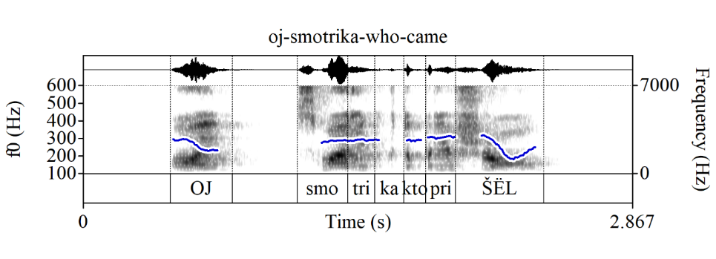
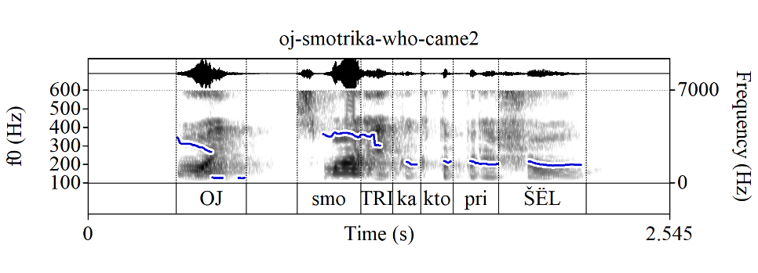
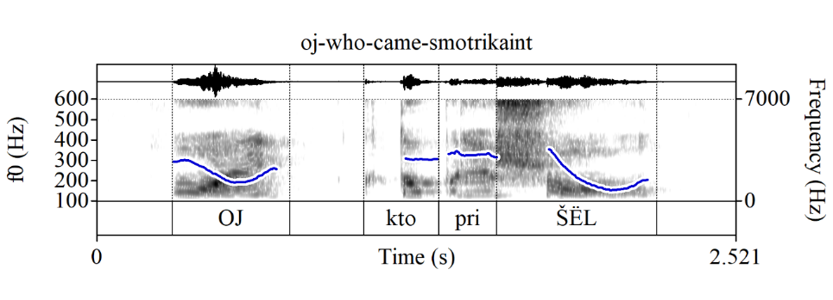
A note on interjections and embedding
Also, smotri-ka Type 2 sentences, with and w/o smotri-ka:
(26) Oj! (Smotri-ka) kto prišёl!
INTERJ (Look-IRONIC.PRT) who came
‘Look who came!’ (Ironic, ≈Huh, would you look at that!)

Slide 31
A note on že
Q: Is že obligatory in Type 1 sentences?
A: No, but it’s good to have it there
Q: Can you have it in Type 2 sentences?
A: Maybe sometimes, but it’s not inherent to Type 2 in the way it seems in Type 1
Q: What does že do in Type 1?
A: I don’t know. Že has been claimed to mark Kontrast (McCoy 2003), but IDK if I’m buying it. Perhaps it marks “old information”, reactivating smth from before (see examples on the next slide).

Slide 32
A note on že
(27) Ty že idёš’ na večerinku?
you ŽE come on party
‘You’re coming to the party, right?’ (confirmation-seeking)
(28) Kto že togda prišёl?
who ŽE then came
‘Who came then?’ (puzzled; “I thought I knew the answer, but oops”)
(29) Tebe že zavtra na rabotu.
you ŽE tomorrow on work
‘[I’m reminding you that] you have to work tomorrow.’
(30) Q: Čja èto kružka? A: Mašina že.
whose this mug Masha’s ŽE
‘Q: Whose mug is this? A: Masha’s, you dum-dum.’
(“Kindly search the common ground, the answer is already there”)

Slide 33
A note on plateaus
Plateaus are associated with lack of speaker investment, e.g.:
The “calling contour” in English (see, e.g., Jeong & Condoravdi 2017):
(30) Get well soon! H* !H-L%
OK: The addressee has a light cold.
#: The addressee is seriously ill. (Jeong & Condoravdi 2017, (4))
The “disinterested” list information:
(31) Oh I don’t know H* !H* !H* L-L% it’s got oregano H* H- ’n marjoram H* H- ’n some fresh basil H* H-L% (Beckman & Ayers 1997, <<oregano>>)

Slide 34
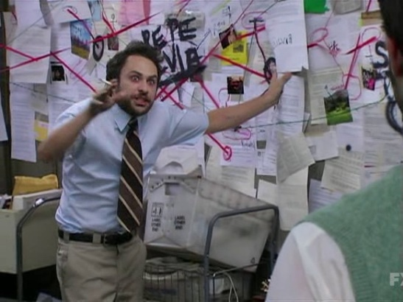
A note on nominal exclamatives
Russian doesn’t have English-type nominal exclamatives:
(32) The pianos I’ve shifted! (Ivy Russell, The Daily Mirror, 10/1/1937, p. 12)
(33) a. * Pianino {čto / kotorye} ja dvigala!
pianos that / which I shifted
b. Kakie pianino ja dvigala!
what pianos I shifted
Is this related to how Russian vs. English do expressive degree modification (e.g., you can/must have a wh-item in Russian; ‘How *very smart she is!’ in Russian)
Are English expressive modifiers, including E-Force, actually modifiers and not determiners, so we can get indefinite degree descriptions and, thus, new info (‘Oh, wow, a high degree!’)?
Is all this related to the structure of DPs in Russian vs. English?

Slide 35
A note on primary and secondary speech acts
Utterances that encode the speaker’s AFFECT about something:
Primary expressive AFFECT: Type 1; Pipec (kakaja) ona umnaja!; Damn she’s smart!
Secondary expressive AFFECT: Ona pipec (kakaja) umnaja; She’s damn smart
Primary truth-conditional AFFECT: I am {surprised / happy / sad / infuriated…} that she’s very smart
Secondary truth-conditional AFFECT: {Surprisingly / fortunately / sadly / much to my dismay…}, she’s very smart

Slide 36
Intro
Type 1 vs. Type 2: form
Type 1 vs. Type 2: meaning
Type 1 vs. Type 2: analysis
Outro
Miscellaneous notes
References

Slide 37
References
AnderBois, Scott. 2018. Illocutionary revelations: Yucatec Maya bakáan and the typology of miratives. Journal of Semantics 35(1). 171–206. doi:10.1093/jos/ffx019.
AnderBois, Scott. Submitted. Tagalog pala: a case of unsurprising mirativity. Invited contribution to Descriptive and theoretical studies of discourse particles in Asian languages, Yukinori Takubo, Hiroki Nomoto and Elin McCready (eds.), Routledge.
Beckman, Mary E. & Gayle Ayers. 1997. Guidelines for ToBI labelling. Version3.0. The Ohio State University Research Foundation.
Elliott, Dale E. 1974. Toward a grammar of exclamations. Foundations of language 11(2). 231–246.
Esipova, Maria. 2019. Towards a uniform super-linguistic theory of projection. In Julian J. Schlöder, Dean McHugh & Floris Roelofsen (eds.), Proceedings of the 22nd Amsterdam Colloquium, 553–562.
Esipova, Maria. 2020. Composure and composition. Ms., University of Oslo, in revision. URL https://ling.auf.net/lingbuzz/005003.
Jeong, Sunwoo & Cleo Condoravdi. 2017. Imperatives with the calling contour. In Proceedings of the 43rd Annual Meeting of the Berkeley Linguistics Society (BLS 43), 185–209.
McCoy, Svetlana. 2003. Connecting information structure and discourse structure through “Kontrast”: The case of colloquial Russian particles -TO, že, and VED’. Journal of Logic, Language and Information 12(3). 319–335. doi: 10.1023/A:1024110711090.
Nouwen, Rick & Anna Chernilovskaya. 2015. Two types of wh-exclamatives. Linguistic variation 15(2). 201–224. doi: 10.1075/lv.15.2.03nou.
Potts, Christopher. 2007. The expressive dimension. Theoretical linguistics 33(2). 165–198. doi: 10.1515/TL.2007.011
Rett, Jessica. 2011. Exclamatives, degrees and speech acts. Linguistics and philosophy 34(5). 411–442. doi: 10.1007/s10988-011-9103-8.
Zyman, Erik. 2018. Interjections select and project. Snippets (32). 9–11. doi: 10.7358/snip-2017-032-zymb.

