Slide 1
Performative expression of meaning and the architecture of grammar
Maria Esipova (University of Oslo)
GLiF Seminar, Universitat Pompeu Fabra
March 10, 2022

Slide 2
Intro
Performative content and ellipsis/anaphora
Performative content and compositionality
Modeling of performative content
From performatives to performances
Outro

Slide 3
Intro
Performative content and ellipsis/anaphora
Performative content and compositionality
Modeling of performative content
From performatives to performances
Outro

Slide 4
Intro
Performative expression of meaning:
Intuitive difference, e.g., b/n expressing one’s feelings vs. talking about them:
(1) Damn! / Fuck! / Ouch! / Eww! / Etc.
(2) I am {angry / frustrated / in pain / disgusted / etc.}.
The speaker achieves their expressive goal (e.g., letting out their feelings) by virtue of performing a certain act (e.g., producing a certain linguistic form) and can’t do so w/o performing this act
E.g., if you want to let out your frustration by swearing, you have to actually swear; if you want to build rapport w/addressee by using rising intonation on declaratives, you have to actually use it; etc.

Slide 5
Intro
Structure of this talk:
Architectural differences b/n performatively expressed meaning and truth-conditional meaning: ellipsis/anaphora ; compositionality
Implications of these differences for how we should model performatively expressed meaning
Going from performative expression of meaning to demonstrations of such expression within truth-conditional content (“from performatives to performances”)
Concluding remarks

Slide 6
Intro
Performative content and ellipsis/anaphora
Performative content and compositionality
Modeling of performative content
From performatives to performances
Outro

Slide 7
Performative content and ellipsis/anaphora
Performative content (i.e., content that get expressed performatively) is lost during ellipsis/anaphora resolution, as these phenomena rely on not saying the thing. E.g.:
(3) A: Did you bring a fucking gun to my house?
B: No, I didn't. / Yes, I did. / Yes, I did so. / Yes, I brought one.
(i) → A is experiencing strong emotions. (ii) ↛ B is experiencing strong emotions.
Cf., e.g., for presuppositions of items like stop or regret:
(4) a. Pam stopped smoking, {but Kim didn’t / and Kim did, too / and so did Kim}.
(i) → Pam used to smoke. (ii) → Kim used to smoke.
b. Bo regrets leaving, {but Jo doesn’t / and Jo does, too / and so does Jo}.
(i) → Bo left. (ii) → Jo left.

Slide 8
Performative content and ellipsis/anaphora
Note of caution: if a meaning effect is purely performative, it necessarily gets lost during ellipsis/anaphora resolution; the reverse isn’t true: some truth-conditional content can be ignored during ellipsis/anaphora resolution, as well, so the entailment only goes in one direction.
E.g., truth-conditional, but non-restricting modifiers (see Esipova 2019, Sailor & Colasanti 2020):
(5) Context: A loves all scotch; they are in a bar with B.
A: Could you get me another delicious shot of Laphroaig?
B: OK, I {will / will do so / will get you one}. (I don’t know how you drink this stuff, it’s disgusting.)
↛ B considers all (or any) shots of Laphroaig delicious.

Slide 9
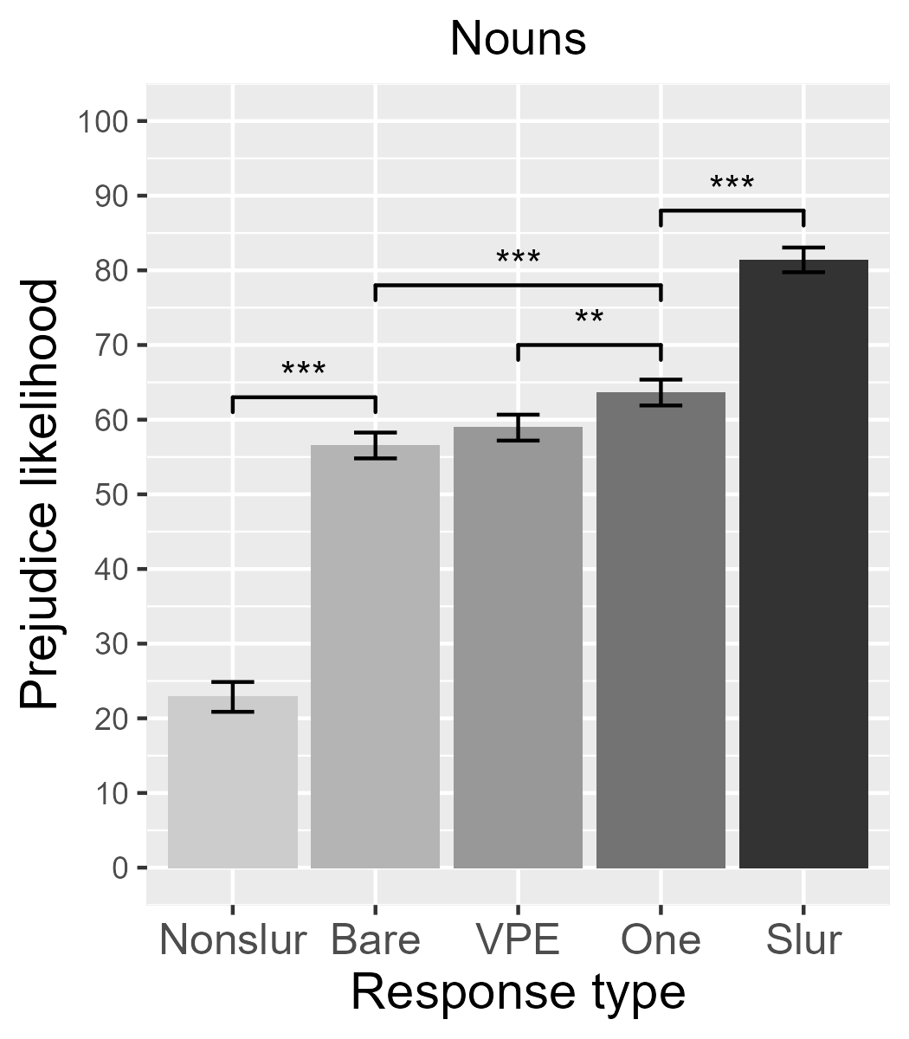
Performative content and ellipsis/anaphora
See also Esipova 2022 for experimental data on the prejudice component of slurs under ellipsis/anaphora, suggesting that it is partially, but not fully performative:
(6) Context: We are in a fictional universe where humans co-exist with centaurs, dwarves, elves, orcs, etc. The exchange happens in the context of a criminal investigation. ‘Tusky’ is a slur for orcs.
Detective: Did you see a tusky?
Witness: Yes. (‘Bare’) / Yes, I did. (‘VPE’) / Yes, I saw one. (‘One’) / Yes, I saw a tusky. (‘Slur’) / Yes, I saw an orc. (‘Nonslur’)
Question: How likely do you think that this witness is prejudiced against orcs?

Slide 10
Intro
Performative content and ellipsis/anaphora
Performative content and compositionality
Modeling of performative content
From performatives to performances
Outro

Slide 11
Performative content and compositionality
Unlike truth-conditional content, performative content doesn’t have to interact semantically with its syntactic surroundings (see Esipova 2021a for more details):
(7) Context: The speaker sees that someone is about to hurt their dog.
a. Step away from my {fucking / (god)damn / bloody} dog!
↛ The speaker’s affect is towards their dog.
b. Step away from my {lovely / awesome / obnoxious / disgusting} dog!
→ The speaker’s affect is towards their dog.
(8) Context: The speaker has previously established that they consider Jimmy Savile despicable and is now entertaining the following hypothetical scenario.
This is your babysitter showing up in a Jimmy Savile T-shirt. I don’t care what you think that represents, you are not staying with my fucking kid tonight. (‘Last Week Tonight with John Oliver’, HBO, S4E26)

Slide 12
Performative content and compositionality
Expressive vs. truth-conditional attitudinal suffixes in Russian:
(9) Context: The speaker is talking to their dog.
Ja nalʹju tebe svež-en’k-oj vod-ičk-i v mis-očk-u,
I.NOM pour.FUT.1SG you.DAT fresh-EXPR-PTV.SG.F water-EXPR-PTV in bowl-EXPR-ACC
a potom my bystr-enʹk-o pojdëm guljat-en’k-i.
and.CONTR then we fast-EXPR-ADV go.FUT.1PL walk-EXPR-INF
≈‘I will pour you some fresh water into the bowl, and then we’ll quickly go for a walk.’
[The affect is towards the dog, not fresh things, water, etc.]
(10) Vpusti ètogo <starik-an-a, starik-ašk-u>
let.in.IMP.SG/T this.ACC.M.SG <old.man-DEROG-ACC, old.man-PEJOR-ACC>
i ego <sobač-ar-u, sobač-enci-ju>.
and his <dog-DEROG-ACC, dog-PEJOR-ACC>
≈‘Let in this <stupid, pathetic> old man and his <stupid, pathetic> old dog.’
[The attitude must be towards the old man and his dog.]

Slide 13
Performative content and compositionality
Russian diminutives can also express social meanings in the same performative and non-compositional fashion:
(11) a. Otkroj, požalujsta, okno.
open.IMP.SG/T please window
‘Please open the window.’
b. Otkroj, požalujsta, ok-ošk-o.
open.IMP.SG/T please window-EXPR-NOM.SG
‘Please open the window + I am being friendly.’

Slide 14
Intro
Performative content and ellipsis/anaphora
Performative content and compositionality
Modeling of performative content
From performatives to performances
Outro

Slide 15
Modeling of performative content
Esipova 2021a:
The differences b/n performative and truth-conditional content suggest that the two are architecturally distinct and should thus be properly separated in our semantic theories, e.g., along the lines of Potts 2007 (contra Potts 2005, Schlenker 2007), but with an even more radical separation.
Each lexical item has both its truth-conditional content and the performative effects of producing the associated form (modeled as direct context-altering, following Potts 2007) specified, w/the former being non-compositional and no integration b/n the two at all. E.g., for pure expressives:
(12)

Slide 16
Intro
Performative content and ellipsis/anaphora
Performative content and compositionality
Modeling of performative content
From performatives to performances
Outro

Slide 17
From performatives to performances
Davidson 2015: demonstrations as depictions of events/individuals that can be integrated into the truth-conditional content of utterances as properties of events/individuals of the form ‘such that it resembles DEMONSTRATION’. E.g.:
(13) Still can’t stop with the romance in these medical shows. With the making out and the DEMONSTRATION. Just… Medicine is fun, we don’t need the DEMONSTRATION. Just sayin.

Slide 18
From performatives to performances
Esipova 2021: another integration mechanism turning performative expression of meaning into demonstrations of such expression within truth-conditional properties of the general form ‘such that it would make me/one go DEMONSTRATION’ (“from performatives to performances”). E.g.:
(14) Although I do think maybe we should keep Pepé Le Pew out of this movie. That character is now kinda DEMONSTRATION.

Slide 19
From performatives to performances: degree modifiers
Cross-linguistically, expressives can be used as or within degree intensifiers:
(15) She is {damn / bloody} smart.
≈‘She is very smart + I am expressing some feelings.’
Their degree modification component is TC and, furthermore, typically at-issue:
(16) A: I saw a damn good movie yesterday!
B: So did I. #But the one I saw was just good, not excellent or anything.

Slide 20
From performatives to performances: degree modifiers
These cases of expressive degree intensification from Russian highlight its demonstration-based nature and inform my analysis:
(17) Ona {pizdec / zaebis’} (kakaja) umnaja.
she {PIZDEC / ZAEBIS’} (what.ADJ) smart
≈‘She is the “Pizdec! / Zaebis’!” degree of smart.’
Pizdec: noun, ‘bad situation’ or standalone interjection (obscene)
Zaebis’: imp. of zaebat’sja ‘get tired’ or standalone interjection (obscene)
(18)

Slide 21
From performatives to performances: degree modifiers
This analysis applies straight-forwardly to instances of degree modification via facial expressions and/or prosody (see also Esipova 2019, 2021):
(19) Context: The speaker’s playing a drinking game while having a cold.
The problem with doing this with vodka is you get drunker faster. The problem with doing this while you’re sick and drinking vodka is you get drunker [faster]_INTENSIFY.

Slide 22
From performatives to performances: degree modifiers
Another example, with both demonstration-based intensifiers and attenuators + a performative use of OO (eyes wide open) within a role shift:
(20) Context: The speaker is reminiscing about giving birth to their fourth child.
And then I have like [a contraction]_INTENSIFY. If you’ve ever had a baby, you know, like, [there’s contractions]_ATTENUATE, and [then there are contractions]_INTENSIFY. I knew it was real, I was like, ‘[Oh my God, that is [a contraction]_INTENSIFY]_SHOCK’.

Slide 23
From performatives to performances: more on OO
We have seen OO (eyes wide open) used for degree intensification and as a performative, often uncontrolled expression of immediate surprise/shock/etc.
We can also use OO (+ mirative prosody) in a more controlled fashion as a sentence-level supplement, akin to surprisingly (which can also be used as a degree modifier: Surprisingly, Mia got drunk vs. Mia got surprisingly drunk), which is similarly focus-sensitive:
(21) a. Surprisingly, LIly made the marmalade.
b. [LIly]_OO made the marmalade.
→ It’s surprising that it was Lily who made the marmalade, not smb else.
(22) a. Surprisingly, Lily made the MARmalade.
b. Lily made the [MARmalade]_OO.
→ It’s surprising that it was the marmalade that Lily made, not smth else.

Slide 24
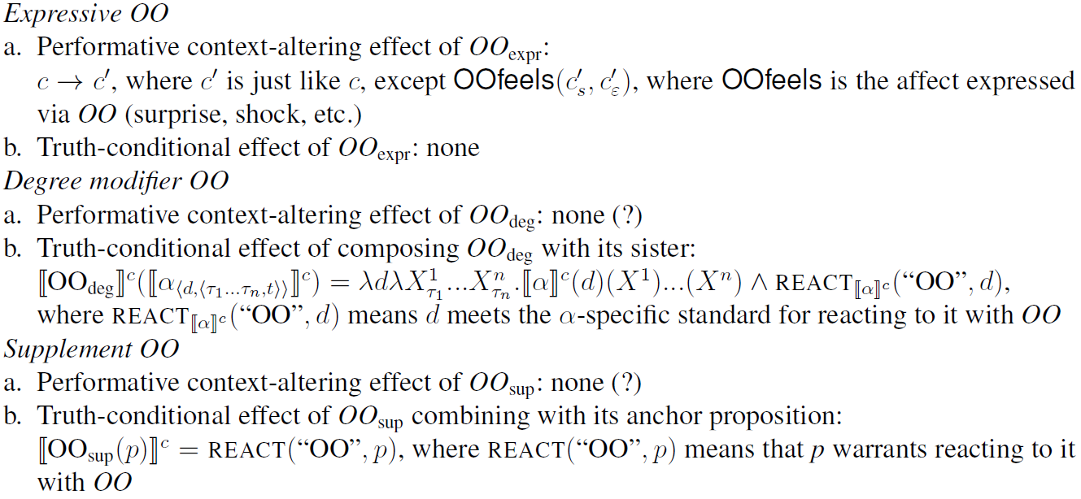
From performatives to performances: more on OO
Analysis of the different uses of OO:
(23)

Slide 25
From performatives to performances: negative affect
We can performatively express our immediate negative affect (anger, disgust, contempt, annoyance, etc.) through interjections/vocalizations, facial expressions, prosody, etc., e.g.:
(24) Eww! / Ugh! /

Slide 26
From performatives to performances: negative affect
But, once again, we can also produce facial expressions & prosody to convey non-immediate negative attitudes about specific subparts of our utterances, which we can also analyze in the same demonstration-based way as before. E.g. (14) or:
(25) I don’t have [friends]_CONTEMPT.

Slide 27
From performatives to performances: interjections
An ongoing process of interjections gaining ability to embed PPs and clauses in English (same ‘such that it would make me/one go “DEMONSTRATION”’ as before). E.g., naturally-occurring examples from Zyman 2018:
(26) a. ...wow with the level of idiocy the Angel baserunners have shown...
b. ...wow that they already have copies...
c. ...Damn with your fucking fly ass...
d. Also, damn that I missed it.
e. ...yuck with the Amber Rose pictures...
f. Cool that you have deer, yuck that they poop.

Slide 28
From performatives to performances: rituals
Turning ritualistic actions meant to have immediate performative effects into idiomatic expressions conveying TC content about propositions:
(27) If Ash recovers soon—fingers crossed/FINGERS-CROSSED-GESTURE—we can have a party at our place.
(28) Ash seems to be recovering—knock on wood/KNOCK-ON-WOOD-ACTION.
(29) Saša vrode by— t’fu-t’fu-t’fu— vyzdoravlivaet.
Sasha seemingly T’FU-T’FU-T’FU is-recovering
≈‘Sasha seems to be recovering, knock on wood.’
Note the common regularization and simplification of form in the process of going “from performatives to performances”. Cf. going from purely iconic depiction to conventionalized iconic meaning‒form mappings (e.g., spoken language ideophones and certain action‒gesture‒sign correspondences).

Slide 29
Intro
Performative content and ellipsis/anaphora
Performative content and compositionality
Modeling of performative content
From performatives to performances
Outro

Slide 30
Outro
Performative expression of meaning is architecturally distinct from truth-conditional meaning (evidence from ellipsis/anaphora and compositionality or lack thereof), so our formal models should properly capture this separation
We routinely transition from performative expression of meaning to demonstrations of such expression within truth-conditional content
Potts 2007-style semantics doesn’t really capture the nature of performativity itself, though; our common model-theoretic machinery doesn’t seem adequate
The discontent with our current formal machinery and a desire for more cognitively realistic formalisms is growing, e.g.: King et al. 2014; Pietroski 2019; Ramchand 2019; Saab 2020; Esipova 2021b

Slide 31
References
Clark, Herbert H. 2016. Depicting as a method of communication. Psychological review 123(3). 324–347. https://doi.org/10.1037/rev0000026
Davidson, Kathryn. 2015. Quotation, demonstration, and iconicity. Linguistics and philosophy 38(6). 477–520. https://doi.org/10.1007/s10988-015-9180-1
Davidson, Kathryn. 2022. Depictive versus patterned iconicity and dual semantic representations. Talk given at The 96th Annual Meeting of the LSA, Washington, DC.
Dingemanse, Mark. 2015. Ideophones and reduplication: Depiction, description, and the interpretation of repeated talk in discourse. Studies in Language 39(4). 946–970. https://doi.org/10.1075/sl.39.4.05din
Esipova, Maria. 2019a. Composition and projection in speech and gesture. PhD dissertation, NYU. https://ling.auf.net/lingbuzz/004676
Esipova, Maria. 2019b. Towards a uniform super-linguistic theory of projection. In Julian J. Schlöder, Dean McHugh & Floris Roelofsen (eds.), Proceedings of the 22nd Amsterdam Colloquium, 553–562. https://ling.auf.net/lingbuzz/004905
Esipova, Maria. 2021a. Composure and composition. Ms., University of Oslo, in revision. https://ling.auf.net/lingbuzz/005003
Esipova, Maria. 2021b. Reps and representations: a warm-up to a grammar of lifting. Ms., University of Oslo, revised and resubmitted. https://ling.auf.net/lingbuzz/005908
Esipova, Maria. 2022. Preservation of prejudice: elliptical responses to antecedents with slurs. Talk given at ‘You’re on mute’ ellipsis seminar, NYU, January 28. https://esipova.net/files/esipova-onmute2022-slides.pdf
King, Jeffrey C, Scott Soames & Jeff Speaks. 2014. New thinking about propositions. Oxford: Oxford University Press. https://doi.org/10.1093/acprof:oso/9780199693764.001.0001

Slide 32
References
Pietroski, Paul M. 2018. Conjoining meanings: Semantics without truth values. Oxford: Oxford University Press. https://doi.org/10.1093/oso/9780198812722.001.0001
Potts, Christopher. 2005. The logic of conventional implicatures. Oxford: Oxford University Press. https://doi.org/10.1093/acprof:oso/9780199273829.001.0001
Potts, Christopher. 2007. The expressive dimension. Theoretical linguistics 33(2). 165–198. https://doi.org/10.1515/TL.2007.011
Ramchand, Gillian. 2019. Verbal symbols and demonstrations across modalities. Open Linguistics 5(1). 94–108. https://doi.org/10.1515/opli-2019-0006
Saab, Andrés. 2020. On the locus of expressivity. deriving parallel meaning dimensions from architectural considerations. In Eleonora Orlando & Andrés Saab (eds.), Slurs and expressivity, 17–44. Lexington Books.
Sailor, Craig & Valentina Colasanti. 2020. Are syntax and semantics modality-blind? Testing Esipova’s Conjecture with ellipsis, CASTL FishFeed, UiT. http://www.craigsailor.net/papers/gestural_ellipsis_handout.pdf
Schlenker, Philippe. 2007. Expressive presuppositions. Theoretical Linguistics 33(2). 237–245. https://doi.org/10.1515/TL.2007.017
Zyman, Erik. 2018. Interjections select and project. Snippets (32). 9–11. https://doi.org/10.7358/snip-2017-032-zymb

Slide 33
Video sources
Primary slides:
(13) ‘Doctor Mike’ YouTube channel, ‘Real Doctor Reacts to ROYAL PAINS | Medical Drama Review’: https://youtu.be/1LIZAgv7OgU?t=258
(14) ‘Screen Rant’ YouTube channel, ‘Space Jam 2: A New Legacy Pitch Meeting’: https://youtu.be/Zk_YKmtOYyI?t=408
(19) ‘Bailey Meyers’ YouTube channel, ‘GooseDrunks - Say Cheese and Die!’: https://youtu.be/LhRWwMHiroE?t=1388
(20) ‘Mama Doctor Jones’ YouTube channel, ‘ObGyn Mom's 4th Baby Birth Story | Welcome, Pax! - MamaDoctorJones’: https://youtu.be/dMeiPyuV_Y4?t=222
(25) ‘Sherlock’, BBC, S02E02
Hidden slides:
(1) ‘Insider’ YouTube channel, ‘Former NASA Astronaut Rates 10 Space Movie Scenes in Movies and TV | How Real Is It?’: https://youtu.be/fTvZfbYj7MQ?t=301
(5) ‘Last Week Tonight with John Oliver’, HBO, S2E26
(6) ‘Bailey Meyers’ YouTube channel, ‘GooseDrunks: Ship of Ghouls ft. Jenny Nicholson’: https://youtu.be/KhO5yvS8sS4?t=124

Slide 34
Note on performativity and depiction
How does the notion of performativity connect to the notions of description vs. depiction (Dingemanse 2015, Clark 2016, Davidson 2022, a.o.)?
(1) It explodes. / It goes boom. (description)
(2) But the big thing is they blow up the Death Star, right? Which is awesome, and it goes DEMONSTRATION. (depiction)
Depiction necessarily has a performative component (“direct sensory experience”), but the reverse isn’t necessarily true (arbitrary meaning-form mappings can have strong performative effects).

Slide 35
More on expressive degree modifiers
“Strong” expressive intensifiers preserve their potential to be performative outlets for affect, which can be caused by/directed at smth utterance-external:
(3) Context: Daniel Craig, in an interview, when asked if Phoebe Waller-Bridge was a “diversity hire” for ‘Bond’:
Look, we’re having a conversation about Phoebe’s gender here, which is fucking ridiculous. She’s a great writer. Why shouldn’t we get Phoebe onto Bond? (...) I know where you’re going, but I don’t actually want to have that conversation. I know what you’re trying to do, but it’s wrong. It’s absolutely wrong. She’s a fucking great writer. One of the best English writers around.
(https://www.esquire.com/entertainment/movies/a29696991/daniel-craig-phoebe-waller-bridge-james-bond-diversity-hire/)
(4) Context: The speaker is having a general emotional breakdown.
I was a fucking great detective who loved her fucking job.
(‘Dexter’, Showtime, S6E4)

Slide 36
A non-reaction-based gestural degree modifier
Like other strategies of meaning expression, performative-reaction-based degree modification is not channel/mode-specific:
We’ve seen its manifestation both for “words” and “non-words”
We can also have, e.g., gestural degree modifiers that are not reaction-based:
(5) That’s still not as dumb as the Apple Watch, but it’s dumb. Not [that dumb]_POINT, [but dumb]_LEVEL-GESTURE.

Slide 37
A subtler example of negative affect
(6) Context: The speaker is reading a line from the POV of a pre-teen.
Glenn sometimes acts like a wimp, but he’s more fun than [parents]_PROSODIC-EYEROLL.

