Slide 1


Peaking your interest
Masha Esipova (Bar-Ilan University)
Colloquium
The Hebrew University of Jerusalem
June 2, 2024

Slide 2
Intro
Q-Peak in questions
Q-Peak in invested requests
No Q-Peak in disinterested suggestions
No Q-Peak in li YNQs
What does the Q-Peak do?
Outro

Slide 3
Intro
Q-Peak in questions
Q-Peak in invested requests
No Q-Peak in disinterested suggestions
No Q-Peak in li YNQs
What does the Q-Peak do?
Outro

Slide 4
Typological generalization in Rudin & Rudin 2022
Typological generalization in Rudin 2018, further explored in Rudin & Rudin 2022 (R&R):
Languages in which rising declaratives (L* H-H%, but see Jeong 2018 on L* H-H% vs. H* H-H%) comprise non-canonical yes/no questions (YNQs)—like English in (1) and Bulgarian in (2)—also allow for rising imperatives, used as friendly/polite/tentative, but invested requests or disinterested suggestions:
(1) English
a. Did you pour me wine_{L* H-H%}? (“syntactically” marked canonical YNQ)
b. You poured me wine_{L* H-H%}? (rising declarative as a non-canonical YNQ)
c. Pour me wine_{L* H-H%}? (rising imperative as a friendly, but invested request)
d. A: What should I do while I’m waiting for you?
B: I don’t really care. Pour yourself wine_{L* H-H%}? Take a nap_{L* H-H%}?
(rising imperatives as disinterested suggestions)

Slide 5
Typological generalization in Rudin & Rudin 2022
(2) Bulgarian (from R&R)
a. Šte xodiš li na kino?
FUT go.2SG Q-prt to cinema
‘Are you going to the movies?’ (“lexically” marked canonical YNQ)
b. Šte xodiš na kino_{L* H-H%}?
FUT go.2SG to cinema
‘You’re going to the movies?’ (rising declarative as a non-canonical YNQ)
c. Daj mi edna sigara_{L* H-H%}?
give.IMP me.DAT a cigarette?
‘Give me a cigarette?’ (rising imperative as an request)
d. A: ‘What should I do today?’
B: Napiši si doklada_{L* H-H%}? Ela s mene na plaža_{L* H-H%}?
write.IMP REFL paper.DEF come.IMP with me to beach.DEF
‘Write your paper? Come to the beach with me?’ (rising imp.-s as suggestions)
NB: There are some differences for some speakers for requests vs. suggestions, though

Slide 6
Typological generalization in Rudin & Rudin 2022
Languages in which rising declaratives comprise canonical YNQs, like Macedonian, don’t allow for such rising imperatives:
(3) Macedonian (from R&R)
a. Ke odiš na kino_{L* H-H%}?
FUT go.2SG to cinema
‘Are you going to the movies?’ (rising declarative as a canonical YNQ)
b. # Daj mi edna sigara_{L* H-H%}?
give.IMP me.DAT a cigarette?
Intended: ‘Give me a cigarette?’ (no rising imperatives as requests)
c. A: ‘What should I do today?’
B: # Piši go referatot_{L* H-H%}? Odi na plaža_{L* H-H%}?
write.IMP it paper.DEF go.IMP to beach.DEF
Intended: ‘Write your paper? Go to the beach?’
(no rising imp.-s as suggestions)
NB from R&R: “Li questions do also exist in Macedonian (…) but their semantics necessarily involves focus; they “emphasize a particular sentence element” (Kramer 2003:17), namely the constituent preceding li”

Slide 7
This talk
Let’s look at another Slavic language, Russian, further expanding and fine-tuning the typology of how different languages realize various meaning components of different types of speech acts:
While, like in Macedonian, Russian canonical YNQs are formed via an “intonation-only” strategy, said intonation doesn’t involve a rising tune, but a prosodic peak of a special kind, the Q-Peak
Despite marking canonical YNQs, the Q-Peak can also be used in friendly, but invested requests like (1/2c), but…
…not in disinterested suggestions like (1/2d)
I propose that:
The Q-Peak realizes an operator that asks the addressee to make a move wrt the speaker’s speech act—appropriate in (some) questions and invested requests, but not in disinterested suggestions
Thus, the Q-Peak is different from the English-style rising tune, which, in R&R’s words, simply “calls off the speaker’s commitment” and thus can have a wider range of meaning effects and brings a different source/flavor of politeness/tentativeness to imperatives

Slide 8
Intro
Q-Peak in questions
Q-Peak in invested requests
No Q-Peak in disinterested suggestions
No Q-Peak in li YNQs
What does the Q-Peak do?
Outro

Slide 9
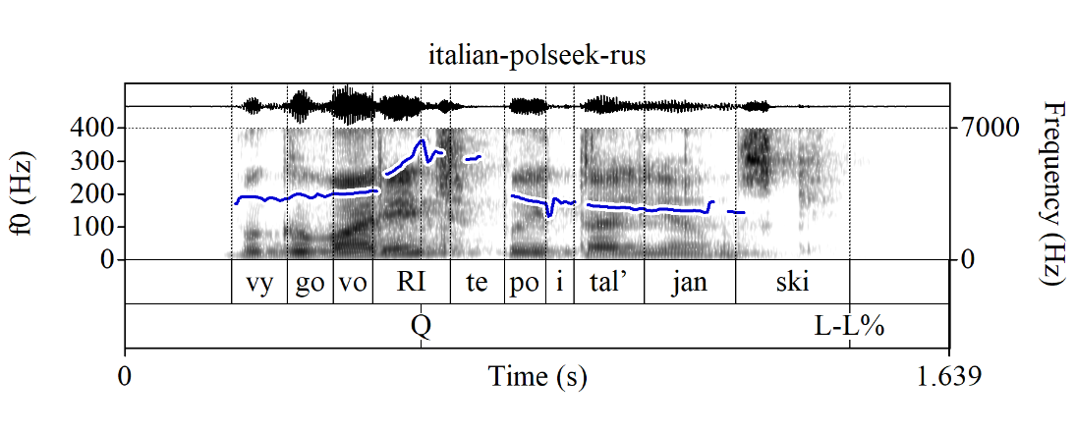

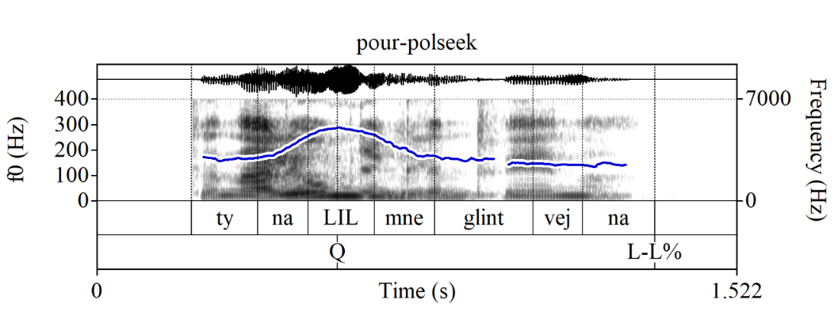
Q-Peak in questions
Default canonical YNQ strategy in Russian (cf. li YNQs: upcoming):
Same string as in a declarative sentence (hence declarative string questions)
A special prosodic peak, the Q-Peak, on the locus of prosodic focus marking within the semantically focused constituent; labelled here as Q
E.g., for what Esipova & Romero (2023) call polarity-seeking YNQs (just {p, ¬p}, no non-trivial parent QUD), which always have narrow prosodic focus marking in Russian (unlike in English), usually on the lexically stressed syllable of the inflected verb:
(4) Context: Approaching a stranger on the street.
(Izivinite,) vy govorite po-italjanski?
(excuse-me) you speak.PRS.2PL in-Italian
‘(Excuse me,) do you speak Italian?’
(5) Context: You were supposed to pour me mulled wine. I’m asking if you did (no bias either way).
Ty nalil_{Q} mne glintvejna_{L-L%}?
you.SG/T.NOM pour.PAST.SG.M me.DAT mulled-wine.PART
‘Did you pour me mulled wine?’

Slide 10
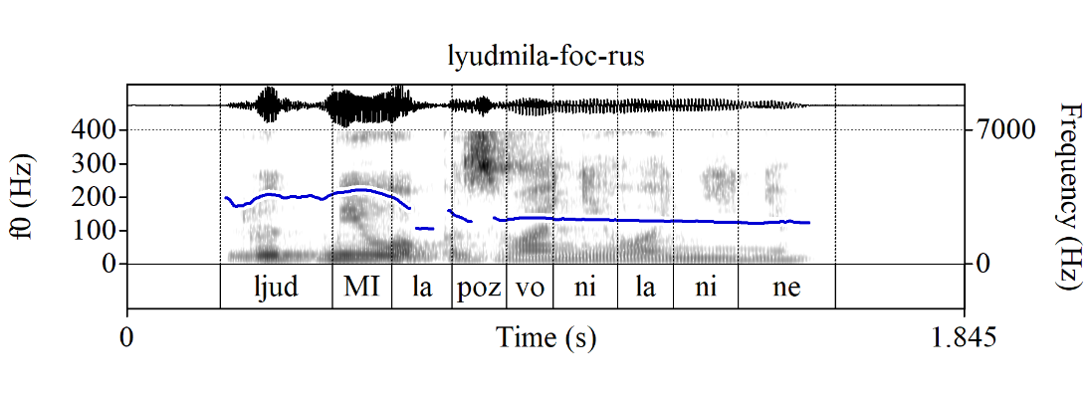
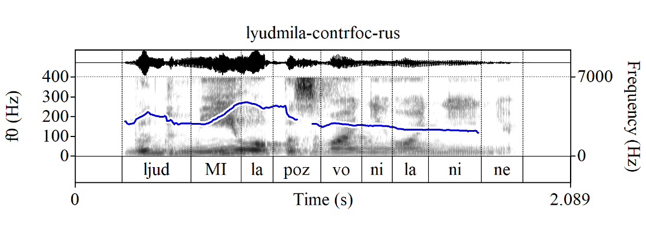
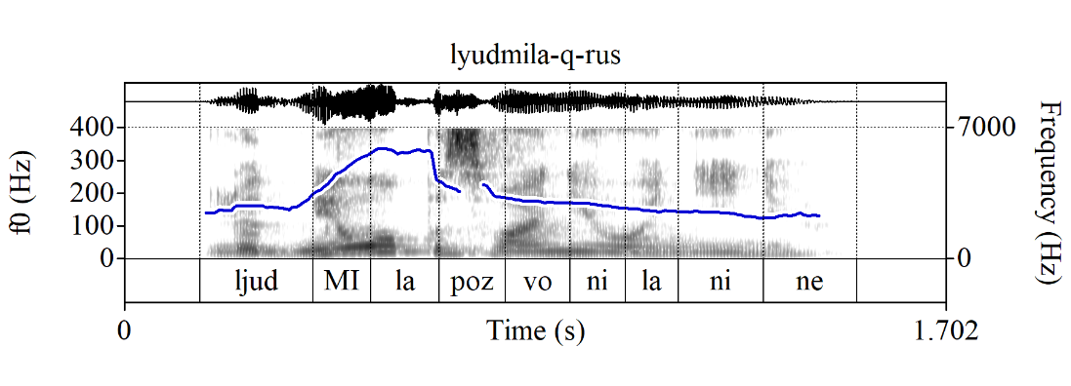
Q-Peak vs. focus marking in assertions
The Q-Peak is distinct in production and perception from focus marking in assertions (see also Meyer & Mleinek 2006; Ratchke 2006; Makarova 2007, a.o.):
(6) Assertion w/new info focus on the subject
A: ‘Who called Nina?’
B: [LjudMIla]_{FOC} pozvonila Nine.
Lyudmila.NOM call.PAST.SG.F Nina.ACC
‘Lyudmila called Nina.’
(7) Assertion w/corrective focus on the subject
A: ‘Marina called Nina.’
B: [LjudMIla]_{FOC} pozvonila Nine!
Lyudmila.NOM call.PAST.SG.F Nina.ACC
‘Lyudmila called Nina!’
(8) YNQ w/focus on the subject
‘Who called Nina?’
[LjudMIla]_{FOC} pozvonila Nine?
Lyudmila.NOM call.PAST.SG.F Nina.ACC
‘Who called Nina? Did Lyudmila call Nina?’

Slide 11
Intro
Q-Peak in questions
Q-Peak in invested requests
No Q-Peak in disinterested suggestions
No Q-Peak in li YNQs
What does the Q-Peak do?
Outro

Slide 12
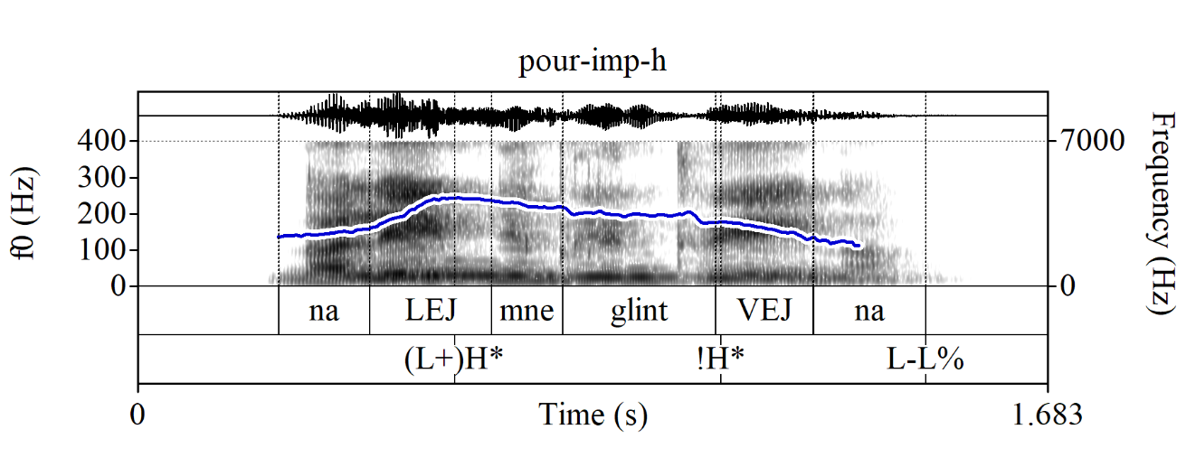
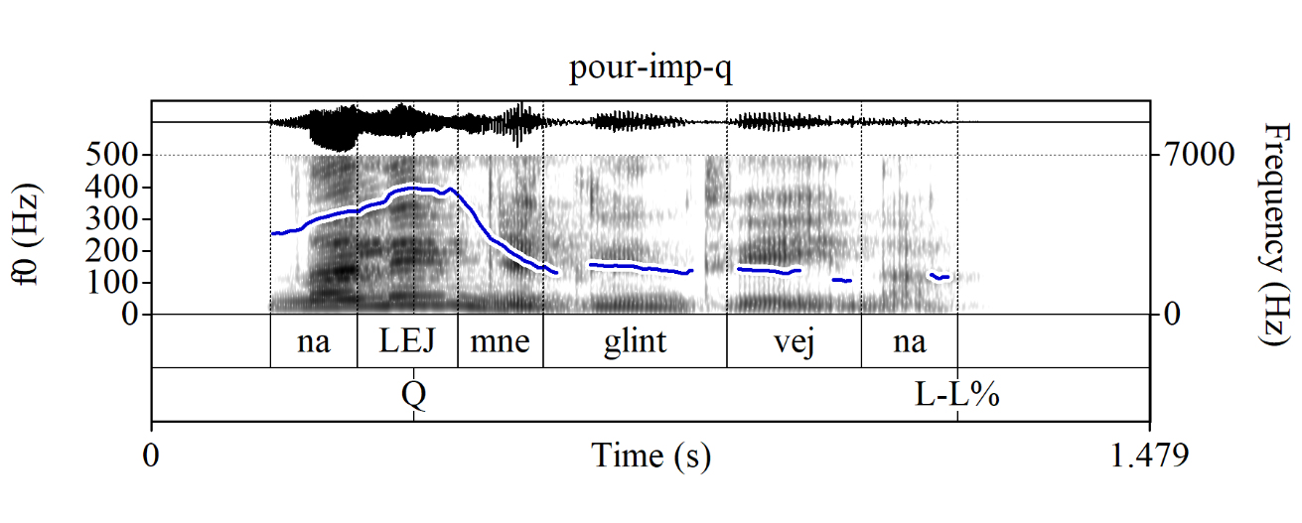
Q-Peak in requests: imperatives
I observe that the Q-Peak can be used in different sentence types to mark polite/friendly, but invested requests. Let’s look at a few cases:
Imperatives
(9) Nalej mne glintvejna
pour.IMP.SG/T me.DAT mulled-wine.PART
a. Command (default interpretation) b. Request
(‘Pour me mulled wine!’) (≈‘Pour me mulled wine[, will you]?’)

Slide 13
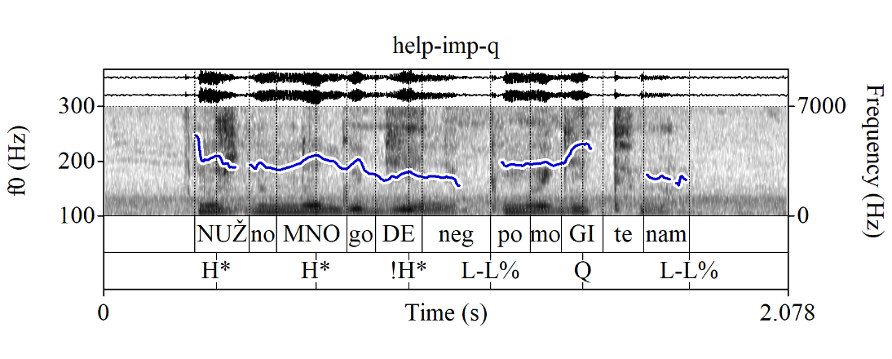
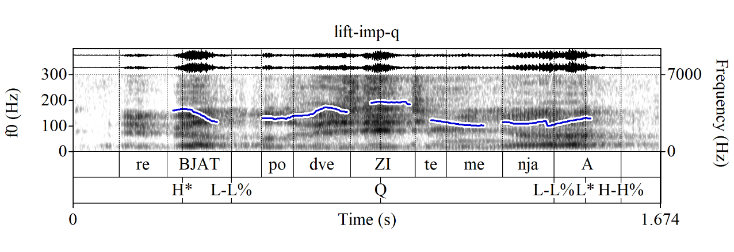
Q-Peak in requests: imperatives
Some naturalistic examples (MURCO, https://ruscorpora.ru/new/search-murco.html) of Q-Peak-marked imperative requests:
(10) Nužno mnogo deneg. Pomogi_{Q}te nam_{L-L%}?
need.ADJ much money.PART help.IMP.PL/V us.DAT
‘A lot of money is needed. Help us?’ (MURCO)
(11) Rebjat_{H* L-L%}, podvezi_{Q}te menja_{L-L%}, a_{L* H-H%}?
guys.VOC give-a-lift.IMP.PL/V me.ACC PRT
≈‘Guys, give me a lift, will you?’ (MURCO)

Slide 14
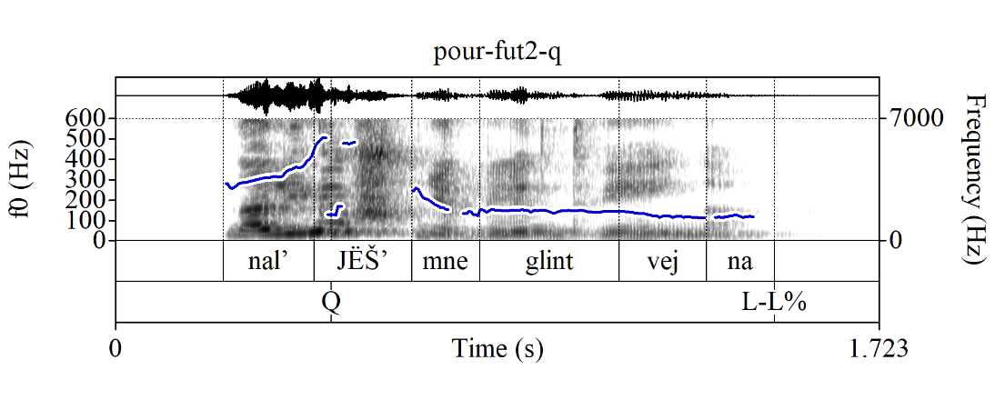
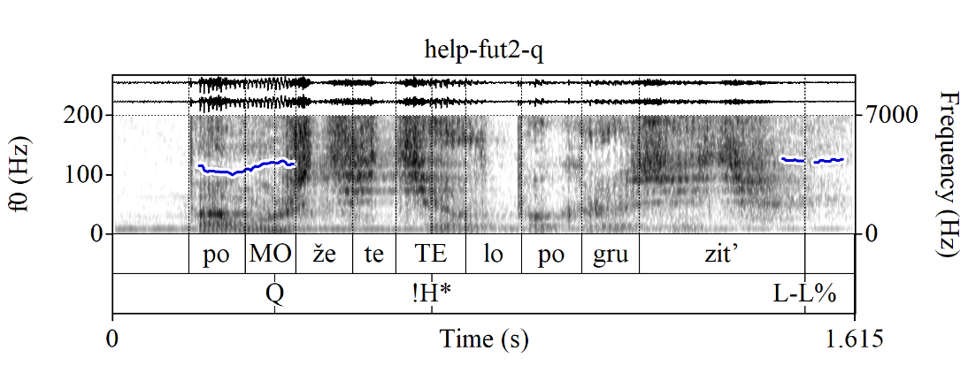
Q-Peak in requests: FUT.2
FUT.2 Q-Peak-marked declarative string “questions” (?) used as requests (preferably, but not obligatorily with a null subject; also possible w/negation, which makes them uber-polite, but those don’t have a preference for a null subject):
(12) Naljёš’_{Q} mne glintvejna (požalujsta)_{L-L%}?
pour.FUT.2SG/T me.DAT mulled-wine.PART (please)
Lit.: ‘Will you pour me mulled wine (please)?’
Cf. the imperative request in (9b):
(13) Pomo_{Q}žete te_{!H*}lo pogruzit’_{L-L%}?
help.FUT.2PL/V body.ACC load.INF
Lit.: ‘Will you help us load the body?’ (MURCO)

Slide 15
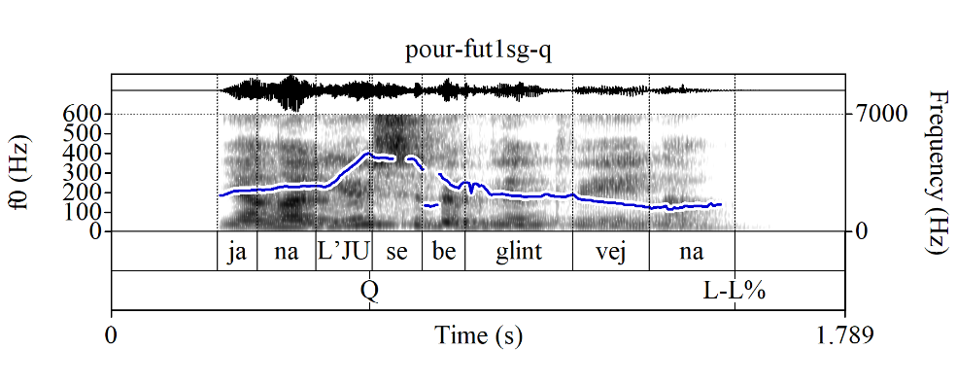
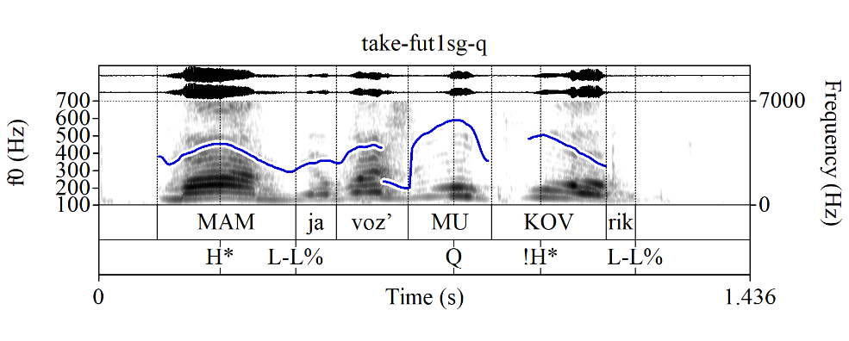
Q-Peak in requests: FUT.1SG
FUT.1SG (also, sometimes PAST, but let’s not go there) Q-Peak-marked declarative string “questions” (?) used as permission requests (here the subject seems obligatory), in which the speaker assumes the permission will likely be granted:
(14) Ja nalju_{Q} sebe glintvejna_{L-L%}?
I.NOM pour.FUT.1SG self.DAT mulled-wine.PART
Lit.: ‘Will I pour myself mulled wine?’
≈‘I’ll pour myself mulled wine, OK?’
(15) Mam_{H* L-L%}, ja voz’mu_{Q} kovrik_{L-L%}?
Mom.VOC I.NOM take.FUT.1SG rug.ACC
Lit.: ‘Mom, will I take the rug?’
≈‘Mom, I’ll take the rug, OK?’ (MURCO)
NB: Here it’s easy to tell that these are not info-seeking questions, because you wouldn’t respond to them w/smth like ‘Yes, pour/take.FUT.2SG’, but rather permission-granting/denying utterances, e.g., ‘Yes, pour/take.IMP’

Slide 16
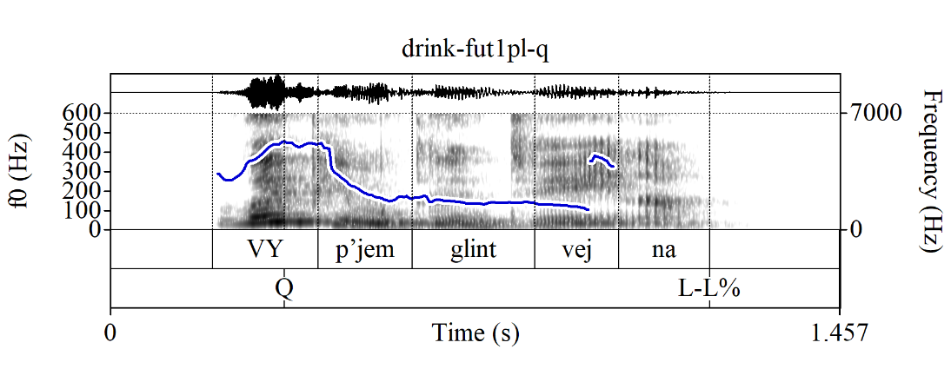
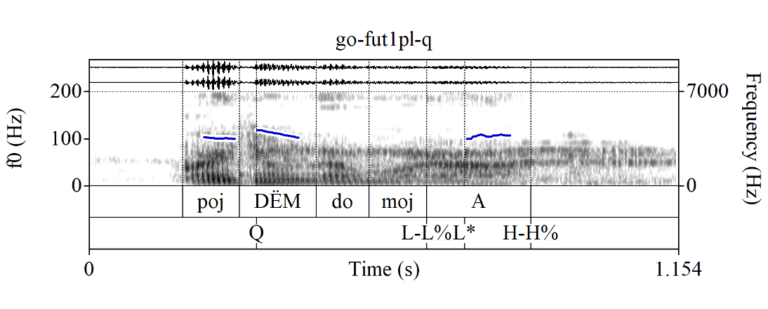
Q-Peak in requests: FUT.1SG
FUT.1PL (also, sometimes PAST, but let’s not go there) Q-Peak-marked declarative string “questions” (?) used as joint action requests (one could also say “suggestions”, but these “suggestions” are not disinterested!):
(16) Vy_{Q}pjem glintvejna_{L-L%}?
drink.FUT.1PL mulled-wine.PART
≈‘Let’s drink mulled wine[, shall we]?’
(17) Pojdёm_{Q} domoj_{L-L%}, a_{L* H-H%}?
go.FUT.1PL home PRT
≈‘Let’s go home, shall we?’ (MURCO)

Slide 17
Intro
Q-Peak in questions
Q-Peak in invested requests
No Q-Peak in disinterested suggestions
No Q-Peak in li YNQs
What does the Q-Peak do?
Outro

Slide 18
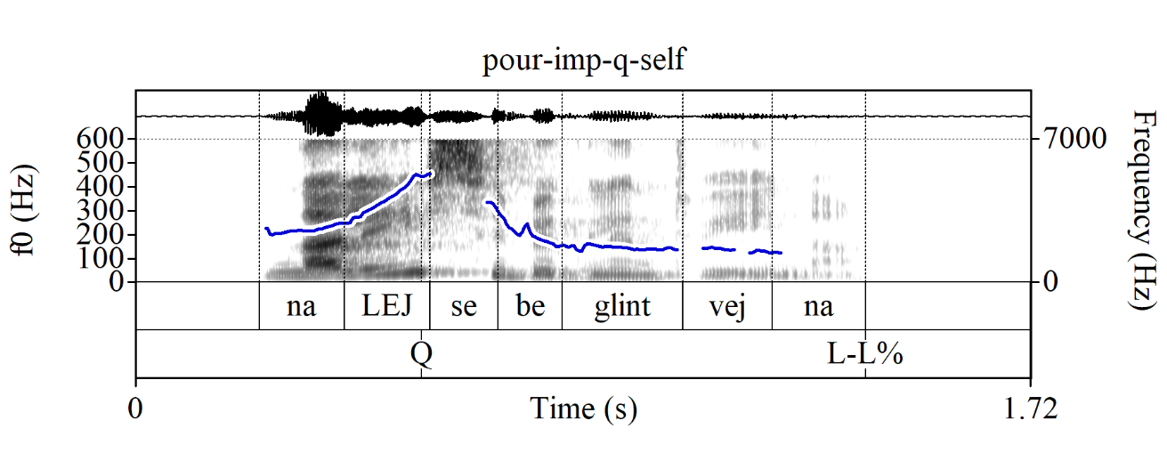
No Q-Peak in disinterested suggestions
The Q-Peak cannot be used in disinterested suggestions in Russian:
(18) A: ‘What should I do while I’m waiting for you?’
B: Da mne bez raznicy.
PRT-AVDERS me.DAT without difference.GEN
# Nalej_{Q} sebe glintvejna_{L-L%}?
pour.IMP.2SG/T self.DAT mulled-wine.PART
Intended: ‘I don’t care. Pour yourself mulled wine?’ (even worse if you try to list multiple options)

Slide 19
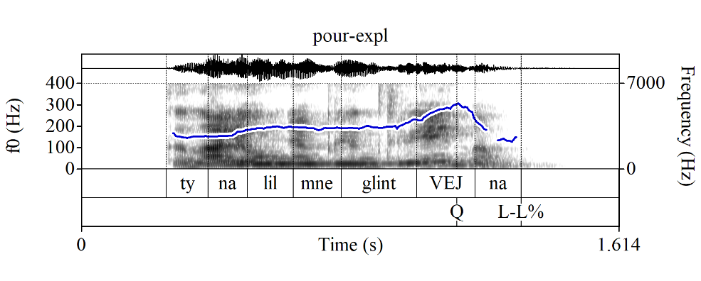
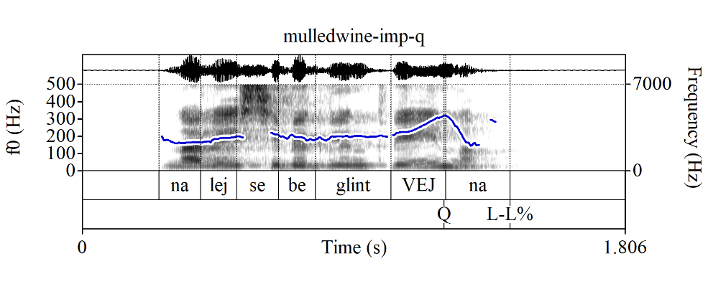
No Q-Peak in disinterested suggestions
Note that this is not an issue of where the Q-Peak goes, i.e., where the focus is
Russian declarative string YNQs can also be produced with a sentence-level Q-Peak when they are explanation-seeking (Esipova & Romero 2023, but the concept itself goes back to Bolinger 1978; biased, but still info-seeking):
(19) Context: We’re having dinner. I stepped away to go to the bathroom and come back to a glass of mulled wine next to my plate. I am asking what the explanation for this is:
Ty nalil mne glintvej_{Q}na_{L-L%}?
you.SG/T.NOM pour.PAST.SG.M me.DAT mulled-wine.PART
‘[What is the explanation for this?]
Did you pour me mulled wine?’
Yet, a sentence-level Q-Peak still can't be used in disinterested suggestions. In fact, imperatives with a sentence-level Q-Peak sound straight-up odd:
(20) * Nalej sebe glintvej_{Q}na_{L-L%}?
pour.IMP.2SG/T self.DAT mulled-wine.PART
Intended: ‘Pour yourself mulled wine?’

Slide 20
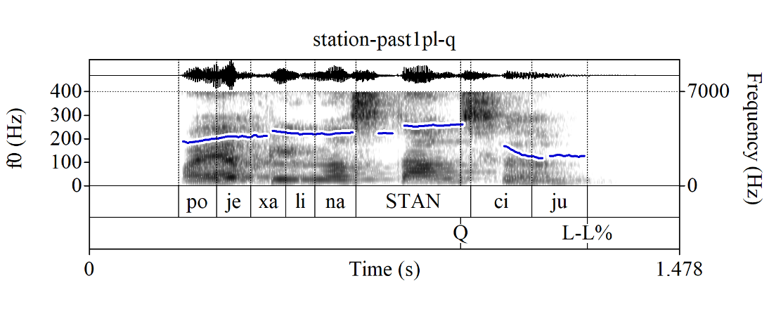
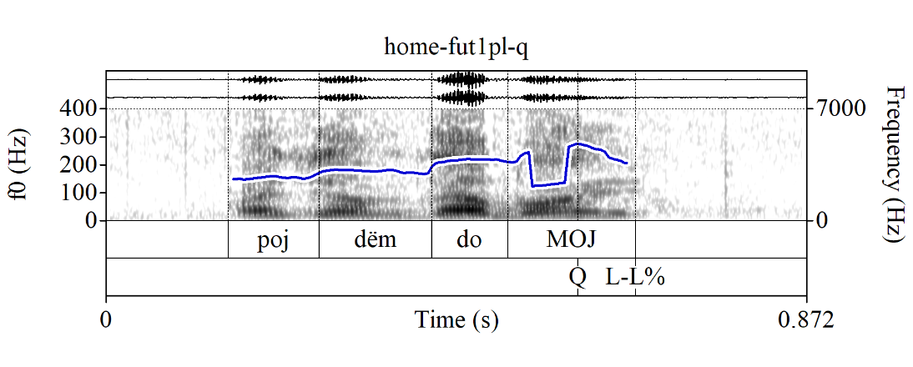
1PL joint action requests with sentence-final focus
Unlike imperative requests, (some) 1PL joint action requests can be used with a sentence-level Q-Peak (indicating a sentence-level focus, which, I imagine, signals an implicit ‘What should we do next?’ parent QUD), but they still don’t have the disinterested suggestion interpretation, i.e., they are still friendly, but invested joint action requests:
(21) Poexali na stan_{Q}ciju_{L-L%}?
go.PAST.PL on station.ACC
‘Let’s go to the station[, shall we?]’
(22) Pojdёm domoj_{Q L-L%}?
go.FUT.1PL home
‘Let’s go home[, shall we?]’ (MURCO)

Slide 21
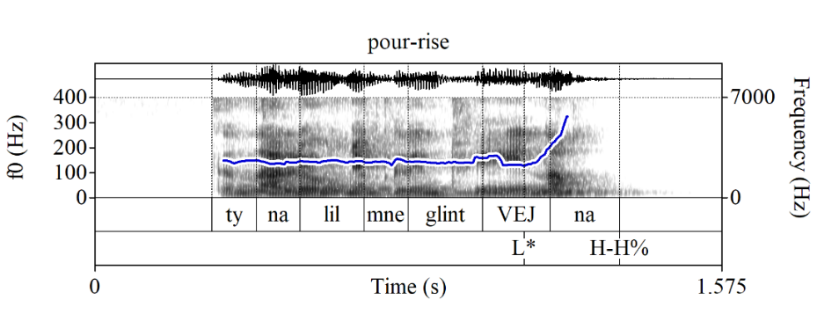
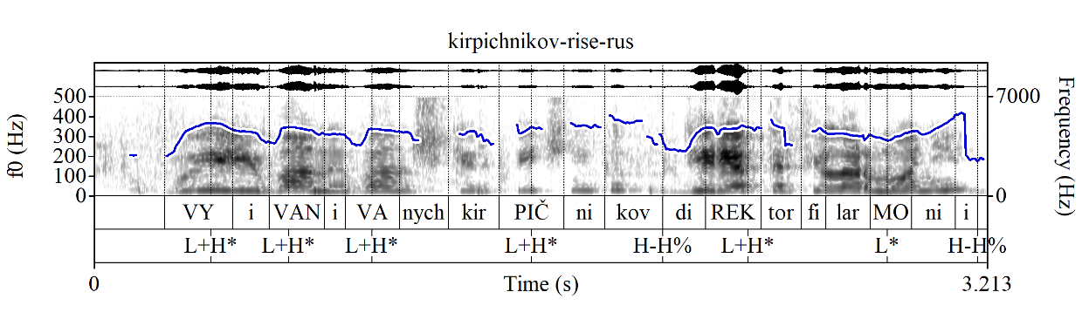
Rising contour in suggestions?
OK then, but how do we make disinterested suggestions in Russian?
Russian does have English-style rising declaratives, although they are ostensibly much less frequent and might have a more limited range of uses:
(23) Ty nalil mne glintvej_{L*}na_{H-H%}?
you.SG/T.NOM pour.PAST.SG.M me.DAT mulled-wine.PART
‘You poured me mulled wine?’
(24) Vy Ivan Ivanych Kirpičnikov? Direktor filarmonii?
you Ivan Ivanych Kirpichnikov director philharmonic.GEN
‘You’re Ivan Ivanych Kirpichnikov? The director of the philharmonic?’ (MURCO)
There is some overlap in uses between Q-Peak-marked
explanation-seeking YNQs like (19) and rising
declaratives like (23), but there are also some
differences—e.g., only the latter can be used as an
echo question in response to ‘I poured you mulled wine’
(same for the English translations ‘Did you pour me
mulled wine?’ vs. ‘You poured me mulled wine?’)

Slide 22
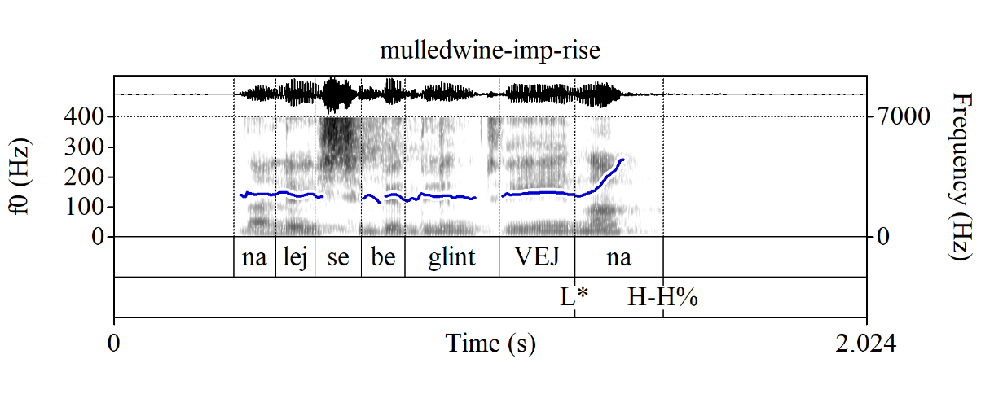
Rising contour in suggestions?
Can we use this rising contour in disinterested suggestions, e.g., with imperatives?
🤷‍♀️
I can somewhat accept them in some contexts, but it might be an influence from English; I haven’t found any exx like this in the MURCO corpus yet (but such disinterested suggestions seem in general uncommon, unlike friendly, but invested requests)
(25) A: ‘What should I do while I’m waiting for you?’
B: Da mne bez raznicy.
PRT-AVDERS me.DAT without difference.GEN
?? Nalej sebe glintvej_{L*}na_{H-H%}?
pour.IMP.2SG/T self.DAT mulled-wine.PART
Intended: ‘I don’t care. Pour yourself mulled wine?’

Slide 23
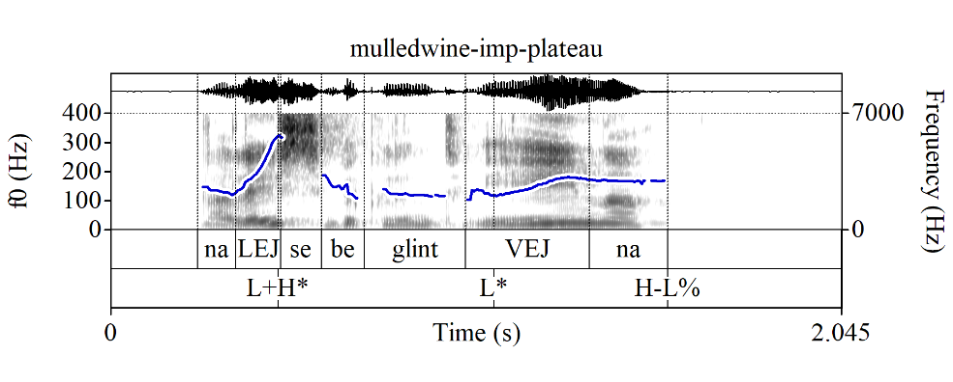
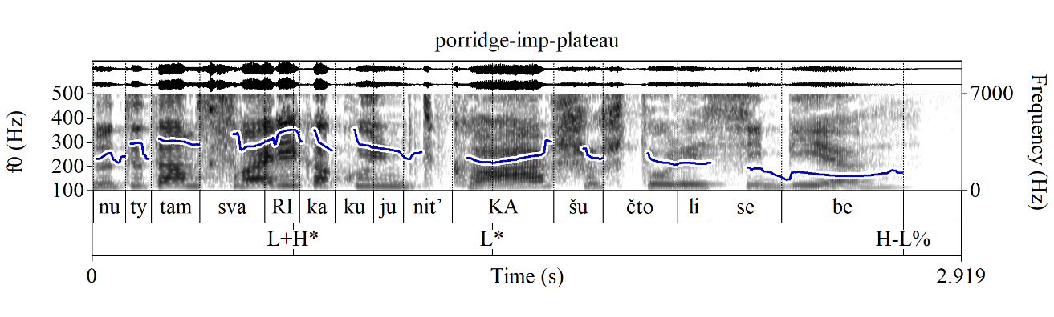
Plateau contour in suggestions
A more natural way to produce disinterested suggestions is with a mid-plateau contour:
(26) A: ‘What should I do while I’m waiting for you?’
B: Da mne bez raznicy.
PRT-AVDERS me.DAT without difference.GEN
Nalej sebe glintvej_{L*}na_{H-L%}...
pour.IMP.2SG/T self.DAT mulled-wine.PART
‘I don’t know… Pour yourself mulled wine...’
(27) Nu ty tam svari_{L+H*}
well you.SG/T.NOM there boil.IMP.2SG/T
kakuju-nit’ ka_{L*}šu, čto li, sebe_{H-L%}...
some.ACC porridge.ACC WHAT LI self.DAT
‘Well, make yourself some porridge or something...’
(MURCO)
Notes:
Mid-plateaus often signal lack of speaker interest/involvement—cf. plateaus in “disinterested lists” (Beckman & Ayers 1997 for English; also possible in Russian), downstepped plateaus in imperatives in English (Jeong & Condoravdi 2017)
These disinterested suggestions are presumably a special case of lists; note that, unlike English, Russian doesn’t use rising boundary contours in lists

Slide 24
Intro
Q-Peak in questions
Q-Peak in invested requests
No Q-Peak in disinterested suggestions
No Q-Peak in li YNQs
What does the Q-Peak do?
Outro

Slide 25
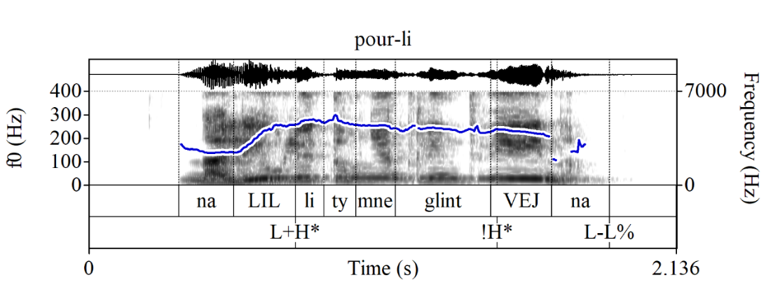
Declarative string YNQs vs. li YNQs
Russian also has li YNQs (can also be info-seeking and unbiased):
  Semantically focused constituent (or its part) is fronted
  The li particle is cliticized onto it
  The fronted constituent bears assertion-like focus marking and can’t bear the Q-Peak
(28) Context: You were supposed to pour me mulled wine. I am asking if you did.
a. Ty nalil_{Q} mne glintvejna_{L-L%}?
you.SG/T.NOM pour.PAST.SG.M me.DAT mulled-wine.PART
‘Did you pour me mulled wine?’
b. Nalil_{L+H*} li ty mne glintvej_{!H*}na_{L-L%}?
pour.PAST.SG.M Q-prt you.SG/T.NOM me.DAT mulled-wine.PART?
‘Did you pour me mulled wine?’

Slide 26
Declarative string YNQs vs. li YNQs
Li YNQs—which do not and cannot have a Q-Peak—don’t seem to (explicitly) require a move from the addressee, but declarative string, Q-Peak-marked YNQs do (Esipova & Korotkova 2023):
Li YNQs often sound more polite and/or formal:
(29) Context: On a formal medical questionnaire.
a. Ku_{L+H*}rite li vy_{L-L%}? b. # Vy ku_{Q}rite_{L-L%}?
smoke.PRS.2PL/V Q-PRT you.NOM.PL/V you.NOM.PL/V smoke.PRS.2PL/V
‘Do you smoke?’
Li YNQs, but not declarative string YNQs are good as conjectural questions (cf. Eckardt 2020):
(30) a. Xm, jest’_{L+H*} li žizn’ na drugix planetax_{L-L%}?
hm be.PRS.3SG Q-PRT life.NOM on other.PREP planets.PREP
b. # Xm, na drugix planetax jest’_{Q} žizn’_{L-L%}?
hm on other.PREP planets.PREP be.PRS.3SG life.NOM
Bylo b neploxo uznat’…
be.PAST.SG.N SUBJ not-bad.ADV learn.INF
‘Hm… Is there life on other planets[, I wonder]? Would be nice to know…’

Slide 27
Intro
Q-Peak in questions
Q-Peak in invested requests
No Q-Peak in disinterested suggestions
No Q-Peak in li YNQs
What does the Q-Peak do?
Outro

Slide 28
Meaning components of questions
Some of the meaning components a matrix question can have:
Creating a partition/raising an issue; in YNQs: {p, ¬p} (e.g., {‘You poured me mulled wine’, ¬‘You poured me mulled wine’})—core component of interrogatives
Asking for a move from the addressee wrt the speaker’s speech act; in info-seeking questions: to respond to the issue being raised—optional in questions, i.e., it can arise pragmatically without being syntactically represented and is ostensibly absent in, e.g., conjectural and self-addressed questions
Focus; in YNQs: signals how the issue being raised fits into a larger discourse structure, specifically, its parent QUD (e.g., ‘What is the truth value of p?’; ‘What is the explanation for s?’; ‘Who called Nina?’)—not specific to questions, but is still crucial for properly interpreting a question

Slide 29
What does the Q-Peak do?
Core empirical generalizations:
  Q-Peak is good in invested requests (move required), but not in disinterested suggestions (no move required)
  Declarative string YNQs (obligatory Q-Peak) require a move (e.g., can’t be used as cobjectural questions), but li YNQs (can’t have the Q-Peak) do not (e.g., can be used as conjectural questions)
Proposal: I propose that the Russian Q-Peak realizes component 2, i.e., asking for a move from the addressee wrt the prejacent (the shape of the Q-Peak itself) and component 3, i.e., focus (by virtue of being the main prominence of the utterance)
  Cf. Cantonese ho2 particles (Law et al. 2024)

Slide 30
What does the Q-Peak do?
For declarative string YNQs (which always have the Q-Peak), a few analytical possibilities:
  The Q-Peak also realizes component 1 (creating a partition/raising an issue)
  Component 1 contributed by a silent operator
  There is no component 1; declarative string YNQs do not raise non-singleton issues
  Depending on which option you choose, you might need additional constraints (e.g., selectional), to account for distributional restrictions on the Q-Peak (impossible, e.g., in li YNQs, wh-questions)
For FUT.2/1SG/1PL Q-Peak-marked requests that have the same form as declarative string YNQs, same analysis (?) + further pragmatic reasoning (cf. Could you pass me the salt?)
For imperative Q-Peak-marked requests: if imperatives can’t raise non-singleton issues, that’d exclude (i) for declarative string YNQs
Regardless of the specifics:
  The Q-Peak makes imperatives less imposing, because it asks the addressee to react, thus, highlighting that they can say no
  The Q-Peak doesn’t work in disinterested suggestions, because asking for a move from the addressee wrt your suggestion signals that you are, in fact, interested in whether they will pursue it

Slide 31
Intro
Q-Peak in questions
Q-Peak in invested requests
No Q-Peak in disinterested suggestions
No Q-Peak in li YNQs
What does the Q-Peak do?
Outro

Slide 32
What about other languages?
English:
  Auxiliary inversion in regular YNQs likely realizes component 1
  The rising tune? R(&R): “rising intonation is calling off the speaker’s commitment to their utterance, proffering a course of action for the addressee without throwing the speaker’s weight behind them pursuing it” (presumably has the same role in Russian)
  Thus, different source and flavor of tentativeness/friendliness in English-style rising imperatives (you “call off the commitment”) vs. Russian Q-Peak-marked imperatives (you ask the addressee to react to your imperative)
Bulgarian: like English, except component 1 is realized by the li particle (same in Russian li YNQs)
Macedonian: IDK, but perhaps:
  The rising tune has been conventionalized to realize component 1?
  Partition-creating/issue-raising operators cannot combine with imperatives (which is why we might want option (iii) for Russian Q-Peak-marked imperatives)?
  Li does something additional, not just component 1 (R&R suggest focus in Macedonian li YNQs has an emphatic interpretation, not regular focus like in Russian)?

Slide 33
Outro
Take-home points:
In Russian, in neutral matrix YNQs, we systematically realize the ‘asking for a move’ component—unlike in English (and arguably Bulgarian and Macedonian?)—via the Q-Peak
The Q-Peak can also be used in invested requests, including in imperatives, making them less imposing by explicitly asking the addressee to respond to them
The Q-Peak cannot be used in disinterested suggestions, because in those, we don’t want to ask the addressee to make a move
The Q-Peak is different from the rising tune in English and Bulgarian (and to some extent, Russian), which “calls off the speaker’s commitment” and can thus have a wider range of meaning effects and brings a different source/flavor of politeness/tentativeness to imperatives

Slide 34
  Thanks!
  Questions? Requests? Suggestions?

Slide 35
References
Beckman, Mary E. & Gayle Ayers. 1997. Guidelines for ToBI labelling. Version 3.0. The Ohio State University Research Foundation.
Bolinger, Dwight. 1978. Yes-no questions are not alternative questions. In Henry Hiż (ed.), Questions, 87–105. Dodrecht, Holland: D. Reidel.
Esipova, Maria & Natasha Korotkova. 2023. To li or not to li? To appear in Proceedings of FDSL 16.
Esipova, Maria & Maribel Romero. 2023. Prejacent truth in rhetorical questions. Ms.
Jeong, Sunwoo. 2018. Intonation and sentence type conventions: Two types of rising declaratives. Journal of Semantics 35(2). 305–356. https://doi.org/10.1093/semant/ffy001
Jeong, Sunwoo & Cleo Condoravdi. 2017. Imperatives with the calling contour. In Proceedings of the 43rd Annual Meeting of the Berkeley Linguistics Society (BLS 43), 185–209.
Law, Jess H-K, Haoze Li & Diti Bhadra. 2024. Force shift: a case study of Cantonese ho2 particle clusters. Natural Language Semantics 1–43. https://doi.org/10.1007/s11050-023-09219-8
Makarova, Veronika. 2007. The effect of pitch peak alignment on sentence type identiﬁcation in Russian. Language and Speech 50(3), 385–422. https://doi.org/10.1177/00238309070500030401
Meyer, Roland & Ina Mleinek. 2006. How prosody signals force and focus—A study of pitch accents in Russian yes–no questions. Journal of Pragmatics 38(10). 1615–1635. https://doi.org/10.1016/j.pragma.2005.05.011
Rathcke, Tamara. 2006. A perceptual study on Russian questions and statements. In Arbeitsberichte des Instituts für Phonetik und digitale Sprachverarbeitung der Universität Kiel, Volume 37, pp. 51–62.
Rudin, Catherine & Deniz Rudin. 2022. On rising intonation in Balkan Slavic. Journal of Slavic Linguistics (FASL 29 extra issue) 30. 1–10. http://ojs.ung.si/index.php/JSL/article/view/88
Rudin, Deniz. 2018. Rising above commitment: University of California, Santa Cruz dissertation.

