Slide 1
Prosody across sentence types lightning talk
Masha Esipova (Bar-Ilan University)
Semantics and Linguistic Theory (SALT) 34
Dalhousie University
May 29, 2024

Slide 2
Typological generalization in Rudin & Rudin 2022
Typological generalization in Rudin 2018, further explored in Rudin & Rudin 2022 (R&R):
Languages in which rising declaratives (L* H-H%, but see Jeong 2018 on L* H-H% vs. H* H-H%) comprise non-canonical yes/no questions (YNQs)—like English in (1) and Bulgarian in (2)—also allow for rising imperatives, used as friendly/polite/tentative, but invested requests or disinterested suggestions:
(1) English
a. Did you pour me wine_{L* H-H%}? (“syntactically” marked canonical YNQ)
b. You poured me wine_{L* H-H%}? (rising declarative as a non-canonical YNQ) c. Pour me wine_{L* H-H%}? (rising imperative as a tentative, but invested request) d. A: What should I do while I’m waiting for you?
B: I don’t really care. Pour yourself wine_{L* H-H%}? Take a nap_{L* H-H%}?
(rising imperatives as disinterested suggestions)

Slide 3
Typological generalization in Rudin & Rudin 2022
(2) Bulgarian (from R&R)
a. Šte xodiš li na kino?
FUT go.2SG Q-prt to cinema
‘Are you going to the movies?’ (“lexically” marked canonical YNQ)
b. Šte xodiš na kino_{L* H-H%}?
FUT go.2SG to cinema
‘You’re going to the movies?’ (rising declarative as a non-canonical YNQ)
c. Daj mi edna sigara_{L* H-H%}?
give.IMP me.DAT a cigarette?
‘Give me a cigarette?’ (rising imperative as a friendly, but invested request)
d. A: ‘What should I do today?’
B: Napiši si doklada_{L* H-H%}? Ela s mene na plaža_{L* H-H%}?
write.IMP REFL paper.DEF come.IMP with me to beach.DEF
‘Write your paper? Come to the beach with me?’
(rising imperatives as disinterested suggestions)

Slide 4
Typological generalization in Rudin & Rudin 2022
Languages in which rising declaratives comprise canonical YNQs, like Macedonian, don’t allow for such rising imperatives:
(3) Macedonian (from R&R)
a. Ke odiš na kino_{L* H-H%}?
FUT go.2SG to cinema
‘Are you going to the movies?’ (rising declarative as a canonical YNQ)
b. # Daj mi edna sigara_{L* H-H%}?
give.IMP me.DAT a cigarette?
Intended: ‘Give me a cigarette?’ (no rising imperatives as requests)
c. A: ‘What should I do today?’
B: # Piši go referatot_{L* H-H%}? Odi na plaža_{L* H-H%}?
write.IMP it paper.DEF go.IMP to beach.DEF
Intended: ‘Write your paper? Go to the beach?’
(no rising imp.-s as suggestions)

Slide 5
This poster
I look at another Slavic language, Russian, further expanding and fine-tuning the typology of how different languages realize various meaning components of different types of speech acts

Slide 6
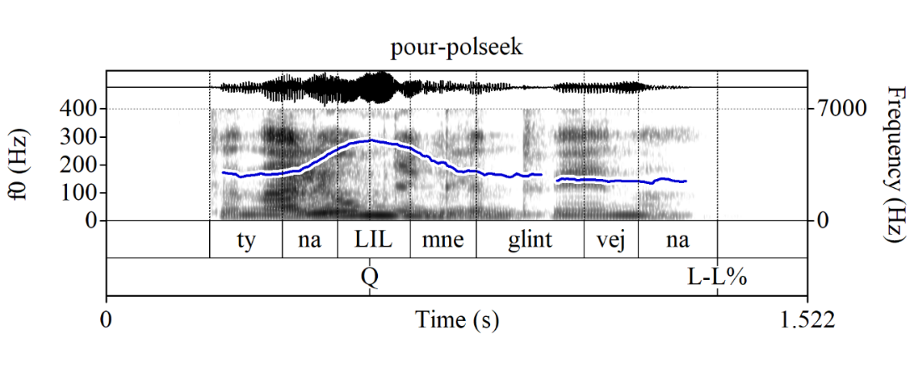
Q-Peak in canonical questions
While, like in Macedonian, Russian canonical YNQs are formed via an “intonation-only” strategy, said intonation doesn’t involve a rising tune, but a prosodic peak of a special kind on the locus of prosodic focus marking (but distinct from focus marking in assertions), the Q-Peak, e.g.:
(4) Context: You were supposed to pour me mulled wine. I’m asking if you did (no bias either way).
Ty nalil_{Q} mne glintvejna_{L-L%}?
you.SG/T.NOM pour.PAST.SG.M me.DAT mulled-wine.PART
‘Did you pour me mulled wine?’

Slide 7
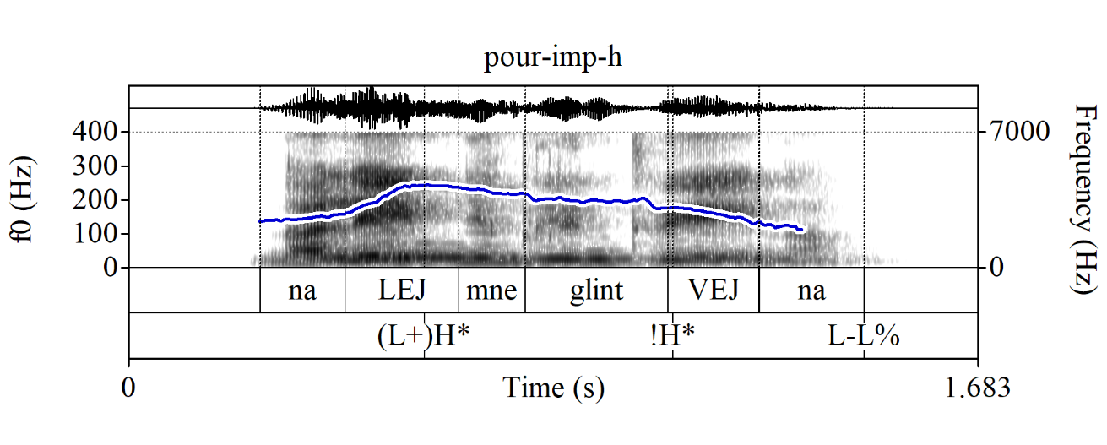
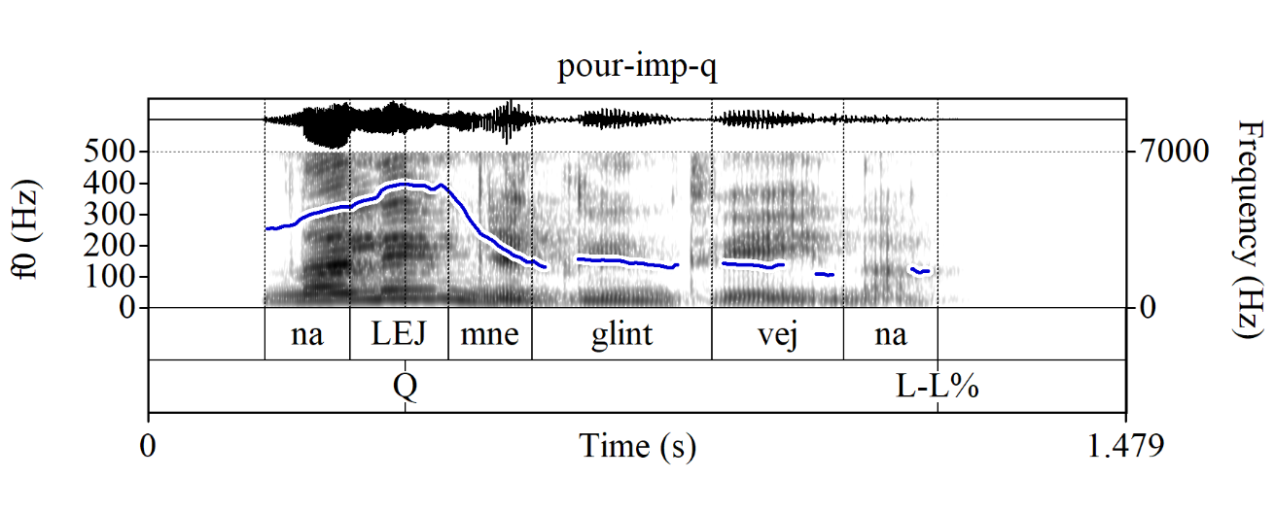
Q-Peak in invested requests
I observe that, despite marking canonical YNQs, the Q-Peak can be used in different sentence types to mark polite/friendly, but invested requests, e.g., in imperatives:
(5) Nalej mne glintvejna
pour.IMP.SG/T me.DAT mulled-wine.PART
a. Command (default interpretation) b. Friendly request
(‘Pour me mulled wine!’) (≈‘Pour me mulled wine[, will you]?’)

Slide 8
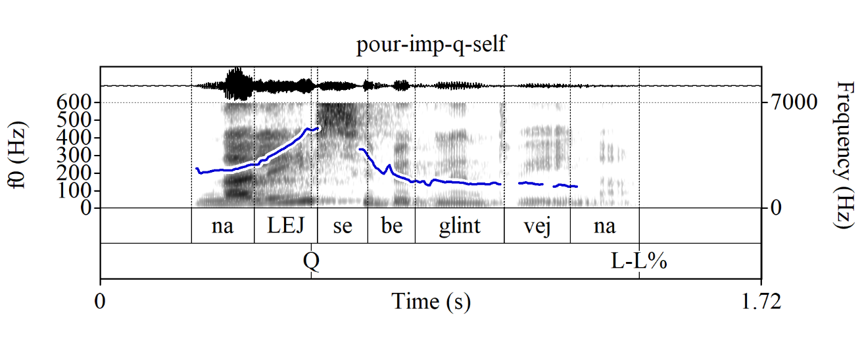
No Q-Peak in disinterested suggestions
But unlike the English-style rising tune, the Russian Q-Peak cannot be used in disinterested suggestions:
(6) A: ‘What should I do while I’m waiting for you?’
B: Da mne bez raznicy.
PRT-AVDERS me.DAT without difference.GEN
# Nalej_{Q} sebe glintvejna_{L-L%}?
pour.IMP.2SG/T self.DAT mulled-wine.PART
Intended: ‘I don’t care. Pour yourself mulled wine?’ (even worse if you try to list multiple options)

Slide 9
Proposal
I propose that:
The Q-Peak realizes an operator that asks the addressee to make a move wrt the speaker’s speech act—appropriate in (some) questions and invested requests, but not in disinterested suggestions
Thus, the Q-Peak is different from the English-style rising tune, which, in R&R’s words, simply “calls off the speaker’s commitment” and thus can have a wider range of meaning effects and brings a different source/flavor of politeness/tentativeness to imperatives

Slide 10
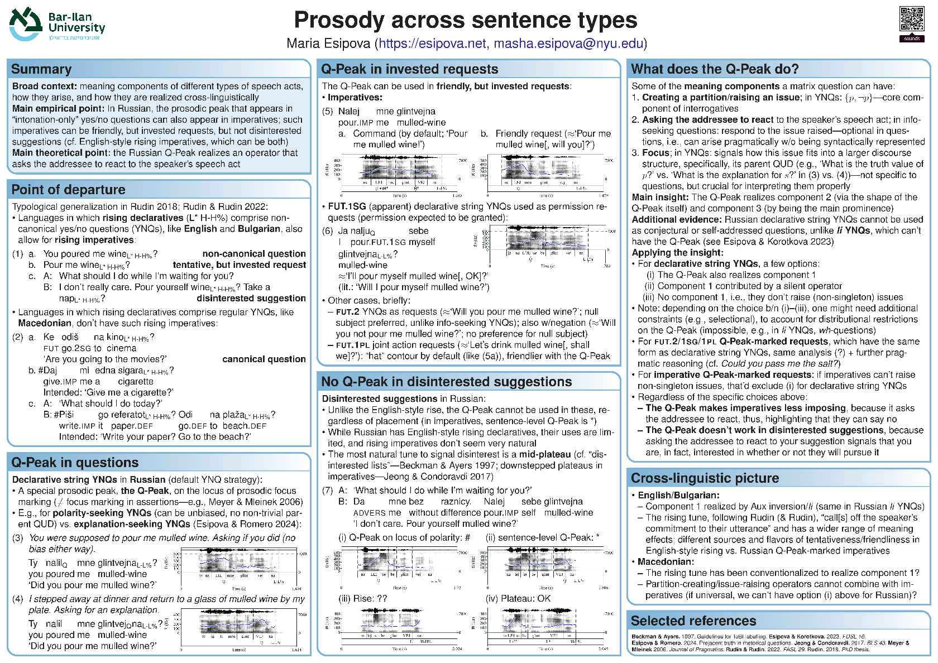
Come check out my poster
Thanks to SALT 34 organizers for their flexibility!
Huge thanks to Tanya Bondarenko for bringing my poster to SALT!
Scan the QR code for the sound files for all the Russian exx in the poster and additional corpus exx
Email me with any questions, requests, or suggestions (hopefully, not disinterested ones)

Slide 11
References
Beckman, Mary E. & Gayle Ayers. 1997. Guidelines for ToBI labelling. Version 3.0. The Ohio State University Research Foundation.
Bolinger, Dwight. 1978. Yes-no questions are not alternative questions. In Henry Hiż (ed.), Questions, 87–105. Dodrecht, Holland: D. Reidel.
Esipova, Maria & Maribel Romero. 2023. Prejacent truth in rhetorical questions. Ms.
Jeong, Sunwoo. 2018. Intonation and sentence type conventions: Two types of rising declaratives. Journal of Semantics 35(2). 305–356. https://doi.org/10.1093/semant/ffy001
Jeong, Sunwoo & Cleo Condoravdi. 2017. Imperatives with the calling contour. In Proceedings of the 43rd Annual Meeting of the Berkeley Linguistics Society (BLS 43), 185–209.
Law, Jess H-K, Haoze Li & Diti Bhadra. 2024. Force shift: a case study of Cantonese ho2 particle clusters. Natural Language Semantics 1–43. https://doi.org/10.1007/s11050-023-09219-8
Makarova, Veronika. 2007. The effect of pitch peak alignment on sentence type identiﬁcation in Russian. Language and Speech 50(3), 385–422. https://doi.org/10.1177/00238309070500030401
Meyer, Roland & Ina Mleinek. 2006. How prosody signals force and focus—A study of pitch accents in Russian yes–no questions. Journal of Pragmatics 38(10). 1615–1635. https://doi.org/10.1016/j.pragma.2005.05.011
Rathcke, Tamara. 2006. A perceptual study on Russian questions and statements. In Arbeitsberichte des Instituts für Phonetik und digitale Sprachverarbeitung der Universität Kiel, Volume 37, pp. 51–62.
Rudin, Catherine & Deniz Rudin. 2022. On rising intonation in Balkan Slavic. Journal of Slavic Linguistics (FASL 29 extra issue) 30. 1–10. http://ojs.ung.si/index.php/JSL/article/view/88
Rudin, Deniz. 2018. Rising above commitment: University of California, Santa Cruz dissertation.

