Slide 1


Agree to disagree: on refutational and confirmatory too
Masha Esipova (Bar-Ilan University)
West Coast Conference on Formal Linguistics (WCCFL) 43
University of Washington
April 25, 2025

Slide 2
Intro: regular vs. refutational too
Data on confirmatory too
Arguments against the response particle analysis
Proposal: uniform semantics for too
Outro
Appendices
References

Slide 3

Regular vs. refutational too
Most literature on too (and other additive particles) has focused on its uses like in (1)—hf. “regular too”:
(1) Axel likes cats. [BROOK]_{F} likes cats, TOO.
As a first—simplistic—approximation, regular too triggers a presupposition that one of the focus alternatives to its prejacent, distinct from the prejacent itself, is true
There has also been some discussion of “refutational too” (e.g., Rullmann 2003; Schwenter & Waltereit 2010; Sailor 2014), which refutes an antecedent utterance:
(2) a. A: You didn’t do your homework.
B: {Did too! / I did too! / I did too do my homework!}
b. A: I think I could survive in the woods for, like, a really long time.
B: You made this fire with an ‘Us Weekly’ magazine, gasoline, and a ‘Hooters’ <bleep> lighter. No, you could not, Steve.
A: I could too! (‘kallmekris’ YouTube channel)

Slide 4
Thomas 2023 on refutational too
Thomas (2023) proposes that refutational too is a [REVERSE, +] response particle (in terms of Roelofsen & Farkas 2015), akin to French si and German doch, which are used in responses:
with positive prejacents—the [+] feature (tracking absolute polarity)
to negative antecedents, thus, reversing the polarity of the antecedent—the [REVERSE] feature (tracking relative polarity)
(3) A: Nina n’a pas passé l’examen{? / .}
Nina NEG-has NEG passed the-exam
‘{Did Nina not pass the exam? / Nina didn’t pass the exam.}’
B: Si, elle l’a passé. (si realizes both [REVERSE] and [+])
SI she it-has passed
≈ ‘Yes she did.’ (yes realizes [+]) / ‘No, she did.’ (no realizes [REVERSE])

Slide 5
Thomas 2023 on refutational too
Thomas (2023) also argues that refutational too requires a stronger bias for ¬p in the antecedent than particles like si or doch—in particular, stronger than what a simple negative polar question typically conveys:
(4) Context: B is organizing a party and is in charge of supplying all the non- alcoholic beverages for teetotalers. A and B are going through a list of people that are invited. B has no previous belief or expectation about their drinking habits.
  A: Jane and Mary do not drink.
  B: OK. What about John? Does he not drink (either)? (Romero & Han 2004)
  A: He does (#too)! (Thomas 2023)
So he proposes that refutational too realizes another feature, [REFUTE], which “presupposes that the negation of the content of its prejacent is a member of the addressee’s projected discourse commitments”

Slide 6
This talk
I’ll present novel data on what I will call “confirmatory too”, which confirms an antecedent utterance
I will argue against the response particle analysis of refutational or confirmatory too
I will propose that both refutational and confirmatory too share their core semantics with regular too, with the main difference being the focus alternatives:
  refutational too: alternative projected commitments with respect to a polar issue p? (possibly a subcase or a sibling of verum focus)
  confirmatory too: alternative performances of a speech act making the same projected commitment (a subcase of dictum focus)

Slide 7
Intro: regular vs. refutational too
Data on confirmatory too
Arguments against the response particle analysis
Proposal: uniform semantics for too
Outro
Appendices
References

Slide 8
Enter confirmatory too
I will now provide some naturalistic examples of confirmatory too
Note that:
There’s no additional context in any of them that would license a ‘regular too’ reading, i.e., the target utterances are meant to be interpreted similarly to utterances with indeed (‘He is indeed. / It is indeed. / etc.’)
In those examples that have sound, one can hear that the accented items are the auxiliary and too itself (which it typically is in regular uses, as well), i.e., nothing else is focus-marked

Slide 9
Enter confirmatory too
(5) A: Hey! The new frog striker looks like you, Gav!
B: Yeah, he does too! (BNC)
(6) A: Ann Kidd thought it might also be related to the move from sheep to cows, because sheep didn’t...
B: Oh, right, yes.
A: It’s very interesting.
B: Yes, that’s interesting. It is too. Yes, Trish. (LDaCA)
(7) A: We defeated her!
B: You did too.
A: Yeah. (‘The Weekly Planet’ podcast)
(8) A: I was gonna say, so… in… on TV, he was Rick Springfield, of ‘Jessie’s Girl”s fame.
B: He was too, wasn’t he! (‘The Weekly Planet’ podcast)

Slide 10
Dialectal variation
There is ostensible regional dialectal variation wrt availability of refutational vs. confirmatory too:
All naturalistic examples of confirmatory too I have collected so far come from British or Australian English speakers/corpora
Out of 10 speakers I have polled so far (4 US, 4 England, 1 Scotland, 1 Australia), there’s a slight tendency for refutational too to be associated with AmE and a clear tendency for confirmatory too to be associated with Br/AusE, but 5 speakers accept both:
  2 England speakers have both uses; 1 England speaker only has confirmatory too and believes refutational too is AmE; 1 England speaker doesn’t have either, but might recognize refutational too from AmE media
  3 AmE speakers only have refutational too (with one of them, who lives in the UK, saying they might have heard BrE speakers use confirmatory too); 1 AmE speaker kinda accepts both, but finds confirmatory too more marked
  The Australian and Scottish speakers accept both
Craig Sailor (p.c.) didn’t observe clear regional restrictions on refutational too

Slide 11
Other additive particles in responses
Thomas (2023) also notes the existence of refutational either for negative prejacents in some speakers (in his terms it would be [REVERSE,–,REFUTE]):
(9) A: You did your homework.
B: I didn’t either.
Gary Thoms (p.c.) points out confirmatory neither exists in some varieties in responses and/or as a tag:
(10) A: It’s not a very nice night.
B: Neither it is, been rain all day.
(11) It’s no a very nice day, neither it is. (The Scots Syntax Atlas)

Slide 12
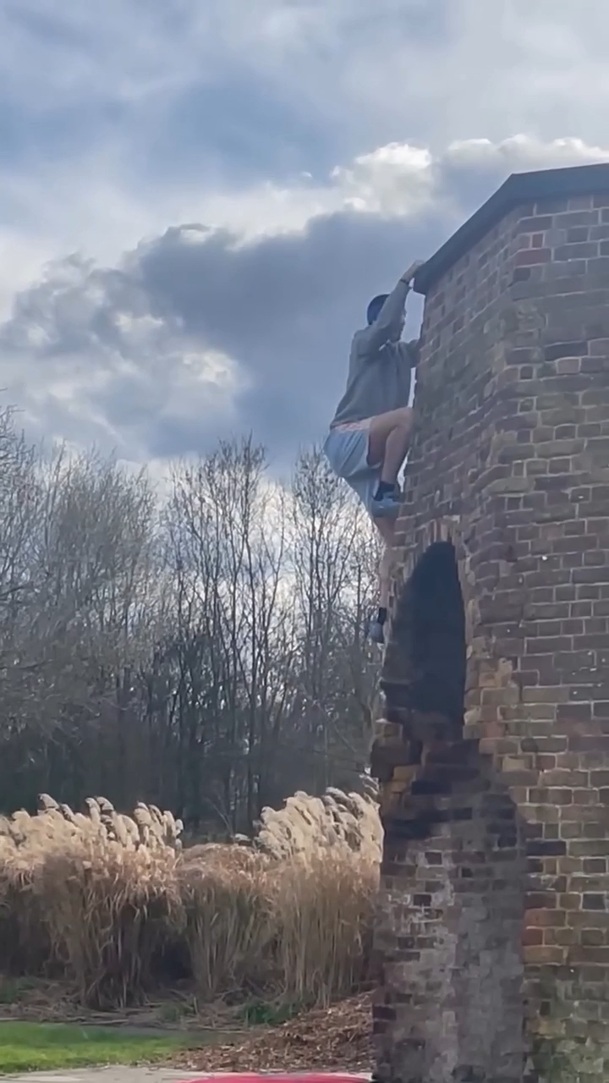
Other additive particles in responses
Also, something confirmatory-ish seems to be happening with as well here:
(12)

Slide 13
Intro: regular vs. refutational too
Data on confirmatory too
Arguments against the response particle analysis
Proposal: uniform semantics for too
Outro
Appendices
References

Slide 14
Arguments against the response particle analysis
Having both refutational and confirmatory too as response particles would be typologically odd
Thomas (2023) hypothesizes a [CONFIRM] feature, the reverse of his [REFUTE]
Confirmatory too would then be a good candidate for realizing [CONFIRM], except it would be typologically weird for the same lexical item to be able to realize either of two opposing features—including within the same speaker
That would be equivalent to the same particle being able to realize either [+] or [−] or either [AGREE] or [REVERSE], and I’m unaware of any such cases cross-linguistically

Slide 15
Arguments against the response particle analysis
The prejacent is obligatory
Unlike regular response particles, too can’t be a standalone utterance, it always needs an overt prejacent
Thomas (2023) acknowledges this, but notes that the Romanian ba particle can’t occur by itself either (Farkas & Bruce 2010)
This note is misleading, however, because ba is always part of a particle cluster ba nu or ba da, which can, in fact, be standalone utterances without an overt prejacent
  Cf. also Russian da net ≈‘but no’, where da ≈‘but’ is a prosodic clitic and can’t occur on its own, but da net can
I propose that the obligatoriness of the prejacent is due to the fact that too still must associate with focus while regular response particles don’t associate with focus

Slide 16
Arguments against the response particle analysis
Regular too already has the key properties that motivated the response particle analysis
Thomas adopts a response particle analysis for refutational too because “it exhibits what [he] take[s] to be the two key properties of polarity particles: anaphoric reference to a salient antecedent sentence (…) and sensitivity to the polarity of that antecedent and/or its prejacent”
But regular too is already sensitive to its prejacent’s polarity, typically requiring a positive prejacent and contrasting in this sense with either
Likewise, regular too is also anaphoric; e.g., from Kripke 2009: “[t]oo (...) should refer to parallel elements”, which “must come from the active context or from other clauses in the assertion (...). [T]hat they are merely very well known is not sufficient”:
(13) SAM is having dinner in New York tonight, too.

Slide 17
Arguments against the response particle analysis
Thus, the jump to a response particle analysis is unjustified, and we can account for both refutational and confirmatory too using the same core semantics as for regular too, which already has sensitivity to absolute polarity, anaphoricity, and association with focus (which, again, regular response particles don’t have)
Some notes before I introduce my proposal:
There are additional idiosyncrasies in these response uses of too and there does appear to be a certain level of idiomatization in both cases (e.g., the apparent ban on indefinite subjects at least in refutational too cases—Thomas 2023; the potentially more categorical nature of the sensitivity to the polarity of the prejacent; etc.)
But the response particle analysis doesn’t fare much better in explaining most of these idiosyncrasies
That said, if one did want to maintain a response particle analysis of too in responses for some reason, they could view the story below as a hypothesis about the relevant diachronic pathway

Slide 18
Intro: regular vs. refutational too
Data on confirmatory too
Arguments against the response particle analysis
Proposal: uniform semantics for too
Outro
Appendices
References

Slide 19
Core semantics of too
Following Kripke 2009, I will assume that too requires that its “active context” must contain a “parallel element” to its prejacent
The exact nature of said “parallel element” might need to be refined further, but let’s just say for concreteness and simplicity that it is an element from the set of focus alternatives to the prejacent, distinct from the prejacent itself

Slide 20
Refutational too: more background
As a reminder, Thomas (2023) introduces the new [REFUTE] feature to account for the fact that, unlike other [REVERSE,+] particles like French si and German doch, refutational too requires that the addressee have expressed a strong bias for the negative version of the prejacent
Thomas argues that this bias doesn’t always have to be as strong as a full commitment, but it has to be stronger than an “evidenced possibility” from Farkas & Roelofsen 2017
Thus, to define his [REFUTE] feature, he recruits the notion of “projected commitments” from Malamud & Stephenson 2015, which include both full commitments and “propositions which that interlocutor believes (and therefore expects to commit to in the future) but wishes to delay committing to”
Thus, his [REFUTE] his requires that ¬⟦prejacent⟧ ∈ DC∗_{Ad}, where DC∗_{Ad} are addressee’s projected commitments

Slide 21
Refutational too: proposal
I’ll keep the idea that refutational too operates at the level of projected commitments, but I propose that utterances with refutational too evoke them as focus alternatives
Note that utterances with refutational too must have an accentable unreduced auxiliary even with non-elliptical prejacents (which, btw, is unexplained under the response particle analysis)
I thus propose that utterances with refutational too have a subcase or a sibling of verum focus, but one that specifically evokes alternative projected commitments with respect to a polar issue p?

Slide 22
Refutational too: notes on verum focus
I remain agnostic wrt the exact relationship b/n what is typically called “verum focus” in the literature and the focus we have to posit for refutational too—and wrt the exact taxonomy of the semantic foci that are realized as an accent on the highest auxiliary in English (but I do think that some cases that have been categorized in the literature as verum focus are actually dictum focus—upcoming)
However, there are definitely cases of “accented auxiliaries” in English that do not involve any commitments and are ostensibly just polarity focus—which would be insufficient for refutational too:
(14) Maybe Zoe DIDN’T do her homework, maybe she DID (do her homework).
The focus we need for refutational too is also more narrow than whatever happens in YNQs like in (15) (again, agnostic on whether the focus in (15) is itself reducible to the focus in (14)):
(15) A: I did my homework.
B: DID you (#too) (do your homework)?

Slide 23
Refutational too: proposal
Then, in line with the core semantics of too, refutational too requires that there be an alternative projected commitment in the active context (technically, by any interlocutor) with respect to the issue p? to the one made by the prejacent
Combining this with:
  the general requirement that the prejacent of too have positive polarity (which could have been idiomatized to be categorical in response uses of too);
  the fact that a polar issue p? can only be resolved as p or ¬p; and
  the fact that the same conversation participant cannot have both p and ¬p simultaneously in their projected commitments—
we get the requirement that there be a projected commitment to ¬p in the active context by someone other than the speaker (i.e., the same requirement as Thomas’s [REFUTE] feature)

Slide 24
Confirmatory too: background on dictum focus
Confirmatory too also requires an accentable auxiliary
I thus propose that utterances with confirmatory too have a subcase of dictum focus
Creswell (2000) introduces the term “dictum focus” and proposes that one way of treating dictum focus is that it evokes alternative “performances of the speech act with identical propositional content”, varying with respect to the speaker and/or time of utterance
Let’s look at some exx of dictum focus in (16)–(19)

Slide 25
Confirmatory too: background on dictum focus
(16) A: How are we getting there?
B: I don’t know. How ARE we getting there? (Creswell 2000)
(17) A: Who’s to say?
B: Who IS to say? (‘The Weekly Planet’ podcast)
(18) A: Diedrich Bader is in this movie.
B: Diedrich Bader IS in this.
A: He’s the voice of Batman sometimes.
B: He sometimes IS. (‘The Weekly Planet’ podcast)
(19) A: I mean, he just lost all of his pieces, let’s be fair, let’s…
B: He DID lose all of his pieces! (‘GMHikaru’ YouTube channel)
Note that I classify cases like (18)–(19) as instances of dictum, not verum focus (unlike, e.g., Bill & Koev 2021; Goodhue 2022), and I don’t think there’s value in trying to reduce one to the other

Slide 26
Confirmatory too: proposal
Similarly to refutational too and verum focus, I propose that utterances with confirmatory too have a more narrow subcase of dictum focus, specifically evoking alternative performances of a speech act making a certain projected commitment
This narrowing is needed because, similarly to refutational too and verum focus, confirmatory too cannot be used, e.g., in questions (cf. indeed, yeah, right), unlike regular dictum focus:
(20) A: How are we getting there?
B: How ARE (#too) we getting there?
Note that, as is, assuming more narrow cases of verum and dictum focus is stipulative, but so is positing the more narrow [REFUTE]/[CONFIRM] features
Combining this with the core semantics of too, confirmatory too then requires that there be an alternative performance of a speech act in the active context making the same projected commitment as the prejacent (i.e., the same requirement as Thomas’s purported [CONFIRM] feature)

Slide 27
Intro: regular vs. refutational too
Data on confirmatory too
Arguments against the response particle analysis
Proposal: uniform semantics for too
Outro
Appendices
References

Slide 28
Outro
Take home points:
I’ve shown you novel data on confirmatory too, which confirms a positive antecedent—cf. refutational too, which refutes a negative one
I’ve argued against the response particle analysis for either use of too
I’ve proposed a uniform semantics for both, which builds on the core semantics of “regular” too
I have appendices with:
Notes on syntax
Notes on prosody
More exx
Thanks!

Slide 29
Intro: regular vs. refutational too
Data on confirmatory too
Arguments against the response particle analysis
Proposal: uniform semantics for too
Outro
Appendices
References

Slide 30
Appendix A: Notes on syntax
Sailor 2014 observes that refutational too cannot co-occur with prosodically integrated response particles like yes, i.e., they are in complementary distribution:
(A1) A: You didn’t do your homework!
B: {Yes I did! / I did too! / *Yes I did too!}
He takes it as evidence that yes and too in these cases are base-generated in the same position, but yes then obligatorily moves:
(A2) (A3)

Slide 31
Appendix A: Notes on syntax
While I for now remain agnostic about the details, my view is largely compatible with the general syntax-semantics set-up where:
both yes and too in cases like (A1) are indeed base-generated in the same position or move through the same position—hence their complementary distribution—and, thus, they do share some meaning component(s) (e.g., the [+] feature)
but yes has additional meaning components that trigger this obligatory movement to some higher discourse-related position and that make it a true response particle (the [+] feature simply tracks the absolute polarity of the utterance and is not specific to responses)
As is, I don’t have a reason to assume that confirmatory and refutational too live in different syntactic positions, but their focus associates do

Slide 32
Appendix A: Notes on syntax
Yes-like particles have to move, with the prejacent TP then being able to be elided
Too-like particles either don’t move, so only VPE is possible, or they move in a more convoluted pattern, yielding subjectless retorts (impossible with yes); Sailor proposes the following structure for the latter:
(A4)

Slide 33
Appendix A: Notes on syntax
Further thoughts:
As I said, I think that yes-like particles obligatorily move to a projection that corresponds to their role in the discourse qua response particles
I thus don’t think it’s reasonable to assume too-like particles move to the same position in subjectless retorts, since that movement is optional
Note that the auxiliary has to evacuate before everything below too gets elided in subjectless retorts because, once again, too must associate with an (overt) focused constituent
I am yet to see examples of subjectless confirmations with too; if they aren’t possible, that would suggest there are syntactic differences between refutational and confirmatory too, which would be unexpected if the only difference between them is [REFUTE] vs. [CONFIRM]

Slide 34
Appendix B: Notes on prosody
Sailor 2014 argues that:
  In retorts with too, too is the thing that bears the entire “contradiction contour” (L*+H L-H%), and that it’s obligatory
  In yes retorts, either yes or the auxiliary can bear the L+H* accent of the contradiction contour
(B1) a. (I) did [TOO]_L*+H L-H% / *(I) [DID too]_L*+H L-H%
b. [YES I did]_L*+H L-H% / Yes I [DID]_L*+H L-H%
Sailor devises a syntax/prosody story for why that’s the case, which, among other things, relies on the L+H* pitch accent being a realization of Σ

Slide 35
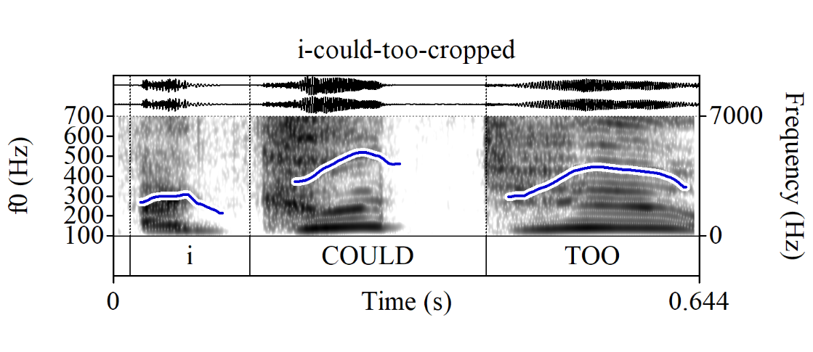
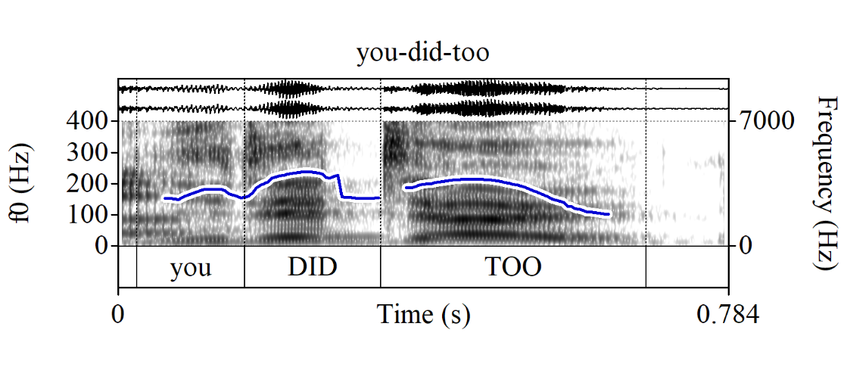
Appendix B: Notes on prosody
A few further notes in response to that:
Regular too also always bears a pitch accent, so we might not need a separate story for that for responses
It’s not clear to me that responses with refutational too always have the contradiction contour
But it IS clear to me that both responses with refutational and confirmatory too can bear a pitch accent on the auxiliary:
(B1) (B2)

Slide 36
Appendix B: Notes on prosody
Admittedly, it’s often hard to see what exactly is going on prosodically in such responses, as they tend to be very short, but it does look like the pitch accent on the auxiliary is not always obligatory (although it’s possible that it’s just sometimes very reduced)
I assume that, naturally, the pitch accent on the auxiliary realizes the focus feature on the focus associate of too—but then why is it optional while the auxiliary itself isn’t?
We then need a story where:
  at some level of representation an overt “carrier” for the pitch accent marking focus on the focus associate of too that is distinct from too itself is needed
  but at some later level it can essentially “merge” with the accent on too that is now doing double duty: realizing focus on the focus associate of too and whatever it is the pitch accent on too is normally doing (cf. Ahn et al. 2021 on apPAranteLY)

Slide 37
Appendix C: more exx
Notes:
Many exx of confirmatory too are information (re-)acquisition contexts (e.g., very obviously: (C5)-(C11)), but (i) some clearly aren’t (e.g., (C2)); (ii) people who accept refutational too, but don’t accept confirmatory too don’t accept the latter regardless of whether it’s an information (re-)acquisition context
Sailor (2014) claims no new truth-conditional material, including epistemic adverbials like definitely, is licensed in utterances with refutational too (“neophobia”), but in (C1), we have probably in what appears to be a confirmatory too utterance
Expressive intensifiers are fine, though, in both refutational too (Sailor 2014) and confirmatory too cases (see (C7))
In (C5)-(C6), (C10), the form of the antecedent is not preserved

Slide 38
Appendix C: more exx
Confirmatory too:
(C1) A: I think Pam said that the very first time she met you was she’d written her Honours thesis about pituri and had said that there were no traditional owners left and that you had pointed out to her that she was wrong in that.
B: Oh, I probably did too, Trish. I probably did too. (LDaCA)
(C2) A: It’s in Barrett
B: Oh it’s in Barrett
A: That’s right it is too (LDaCA)
(C3) A: That, that has come off
B: Oh
A: that cabinet hasn't it?
B: it has too, oh yeah (BNC)
(C4) A: Yeah, but I think at the moment Lesley’s finding everything boring!
B: Yeah, she is too! (BNC)

Slide 39
Appendix C: more exx
(C5) A: Oh there’s your bra
B: Oh it is too (LDaCA)
(C6) A: There’s a robot arm! Maybe that’s the robot arm!
B: Shit! Shit! It was too! (‘The Weekly Planet’ podcast)
(C7) A: And then you mentioned to me that ‘Constantin Films’ hit you with a copyright strike.
B: Oh, they fucking did too! (‘The Weekly Planet’ podcast)
(C8) A: A little cameo, which we won’t spoil until spoilers, I think.
B: A cameo, Mason?
A: Yeah-yeah.
B: Oh yeah, there is too! I forgot about that!
A: Not of an actor! Oh but there is a cameo! I’m talking about… I’m thinking about… <disfluency> There’s some character cameos, and there’s an actor cameo, which we’ll talk about.
B: Oh, there is too! I completely forgot! (‘The Weekly Planet’ podcast)

Slide 40
Appendix C: more exx
(C9) A: No, doesn’t he save the president in the first one?
B: That’s ‘Escape from LA’.
A: I don’t think so, I think it’s the first one. The president’s plane goes down, and <??> in New York.
B: Oh, it is too! (‘The Weekly Planet’ podcast)
(C10) A: Oh no, he is in the post-credits scene. So there you go.
B: Great.
A: He’s back.
B: Oh, he is too. Yeah-yeah-yeah. OK, I remember.
(‘The Weekly Planet’ podcast)
(C11) A: But he also called this movie clown work.
B: Oh, he did too, didn’t he. (‘The Weekly Planet’ podcast)
(C12) A: Eugene Cordero, he’s on ‘Loki’.
B: Oh my God! Oh, he is too! (‘The Weekly Planet’ podcast)

Slide 41
Appendix C: more exx
(C13) A: But he is also in the new ‘Knives Out’ movie, with Daniel Craig.
B: Oh yeah-yeah, he is too! (‘The Weekly Planet’ podcast)
(C14) A: He’s in ‘Nosferatu’.
B: He is too. (‘The Weekly Planet’ podcast)
(C15) A: ‘Cause he got captured on purpose. Why did you do that?
B: Mmm… Did he? <??>
A: Yeah, remember he let himself be captured by Sam Wilson? He’s like ‘I’m here and the <??>’
B: Oh, he did too, he turned himself in. (‘The Weekly Planet’ podcast)

Slide 42
Appendix C: more exx
Dictum focus
(C16) A: What’s the average for this guy? What’s the average score?
B: What IS the average score? (‘Boy Boy Productions’ YouTube channel)
(C17) A: What did he know? What did he know?
B: What DID he know? (‘The Weekly Planet’ podcast)
(C18) A: Who’s wri- Who’s writing this?
B: Who IS writing this? (‘The Weekly Planet’ podcast)
(C19) A: One would hope.
B: One WOULD hope. (‘The Weekly Planet’ podcast)
(C20) A: And he still caught her.
B: He still <disfluency> DID catch her, yeah. (‘The Weekly Planet’ podcast)

Slide 43
Appendix C: more exx
Dictum focus
(C21) A: Nothing turned into a snake in this movie.
B: That’s true! Nothing DID turn into a snake out of ten.
(‘The Weekly Planet’ podcast)
(C22) A: I was gonna say, how did you know that, considering that no one’s seen them.
B: Nobody HAS seen them. (‘The Weekly Planet’ podcast)
(C23) A: This is embarrassing.
B: That IS embarrassing. (‘Double Toasted’ YouTube channel)

Slide 44
Intro: regular vs. refutational too
Data on confirmatory too
Arguments against the response particle analysis
Proposal: uniform semantics for too
Outro
Appendices
References

Slide 45
References
Creswell, Cassandre. 2000. The discourse function of verum focus in wh-questions. In Masako Hirotani, Andries Coetzee, Nancy Hall & Ji-yung Kim (eds.), Proceedings of the 30th Meeting of the North East Linguistic Society (NELS), 167–179. URL https://hdl.handle.net/20.500.14394/36979.
Farkas, Donka F & Kim B Bruce. 2010. On reacting to assertions and polar questions. Journal of Semantics 27(1). 81–118. doi: 10.1093/jos/ffp010.
Farkas, Donka F & Floris Roelofsen. 2017. Division of labor in the interpretation of declaratives and interrogatives. Journal of Semantics 34(2). 237–289. doi: 10.1093/jos/ffw012.
Goodhue, Daniel. 2022. All focus is contrastive: On polarity (verum) focus, answer focus, contrastive focus and givenness. Journal of Semantics 39(1). 117–158. doi: 10.1093/jos/ffab018.
Kripke, Saul A. 2009. Presupposition and anaphora: Remarks on the formulation of the projection problem. Linguistic Inquiry 40(3). 367–386. doi: 10.1162/ling.2009.40.3.367.
Malamud, Sophia A & Tamina Stephenson. 2015. Three ways to avoid commitments: Declarative force modifiers in the conversational scoreboard. Journal of Semantics 32(2). 275–311. doi: 10.1093/jos/ffu002.
Roelofsen, Floris & Donka F Farkas. 2015. Polarity particle responses as a window onto the interpretation of questions and assertions. Language 91(2). 359–414. doi: 10.1353/lan.2015.0017.
Romero, Maribel & Chung-Hye Han. 2004. On negative yes/no questions. Linguistics and Philosophy 27(5). 609–658. doi:10.1023/B:LING.0000033850.15705.94.
Rullmann, Hotze. 2003. Additive particles and polarity. Journal of Semantics 20(4). 329–401. doi: 10.1093/jos/20.4.329.
Sailor, Craig. 2014. The variables of VP ellipsis: University of California, Los Angeles dissertation.
Schwenter, Scott A & Richard Waltereit. 2010. Presupposition accommodation and language change. In Kristin Davidse, Lieven Vandelanotte & Hubert Cuyckens (eds.), Subjectification, intersubjectification and grammaticalization, 75–102. Berlin, New York: De Gruyter Mouton. doi: 10.1515/9783110226102.2.75.
Thomas, William C. 2023. English does too have a [REVERSE,+] polarity particle! In Maria Onoeva, Anna Staňková & Radek Šimík (eds.), Proceedings of Sinn und Bedeutung 27, vol. 27, 641–654. doi: 10.18148/sub/2023.v27.1091.

